Slide 1
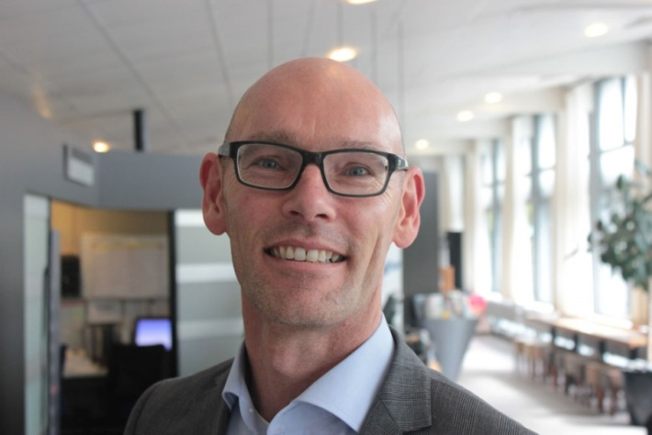
Discovering Hospitality Insights and Experiences
Jan Huizing
Strategic Management
City Hospitality design & change
Euhofa Annual Conference Nov 3, 2014, The Hague

Slide 2
Let’s talk
Hospitality
Insights City Hospitality
Visitor Journey perspective
OK or Wow
Managing (city) hospitality
Best practice

Slide 3

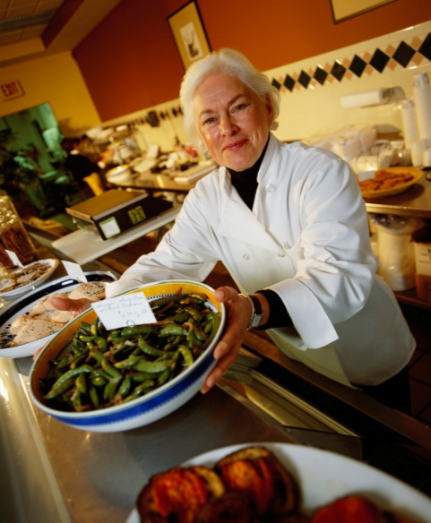
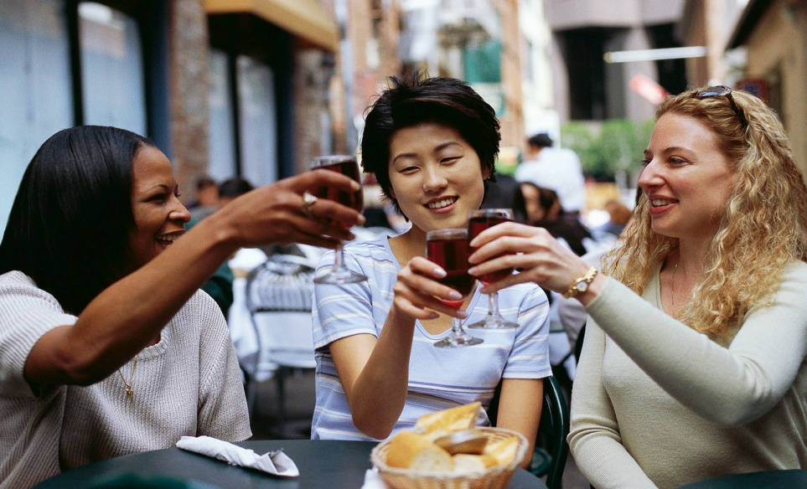
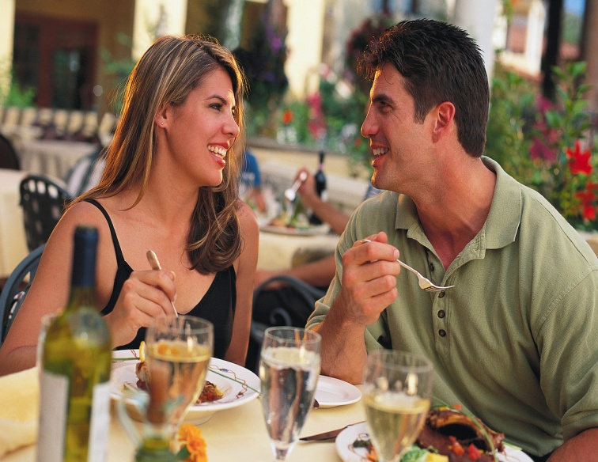
  Which product, service, experience made you really smile / happy?

Slide 4
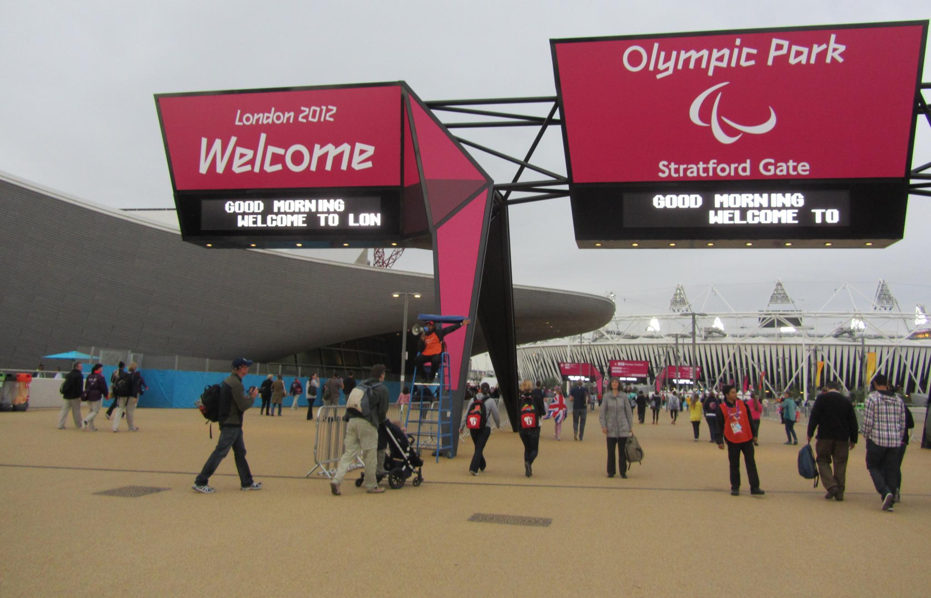
Notes:
Er is geen 2e kans voor de eerste indruk, zelfs voor een olympisch event. Een fantastische prestatie die blijft hangen – overal in de stad je welkom voelen! De eerste indruk op het vliegveld – voor mij was die een echte wow!
Wat is de eerste indruk van de stad – die zal de beleving beinvloeden
In veel grote steden (iig in NL ) liggen de stations overhoop → grote uitdaging om mensen het gevoel te geven dat ze welkom zijn

Slide 5
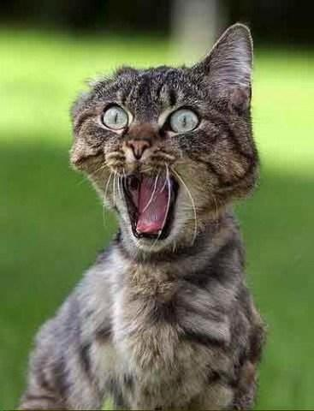


Slide 6
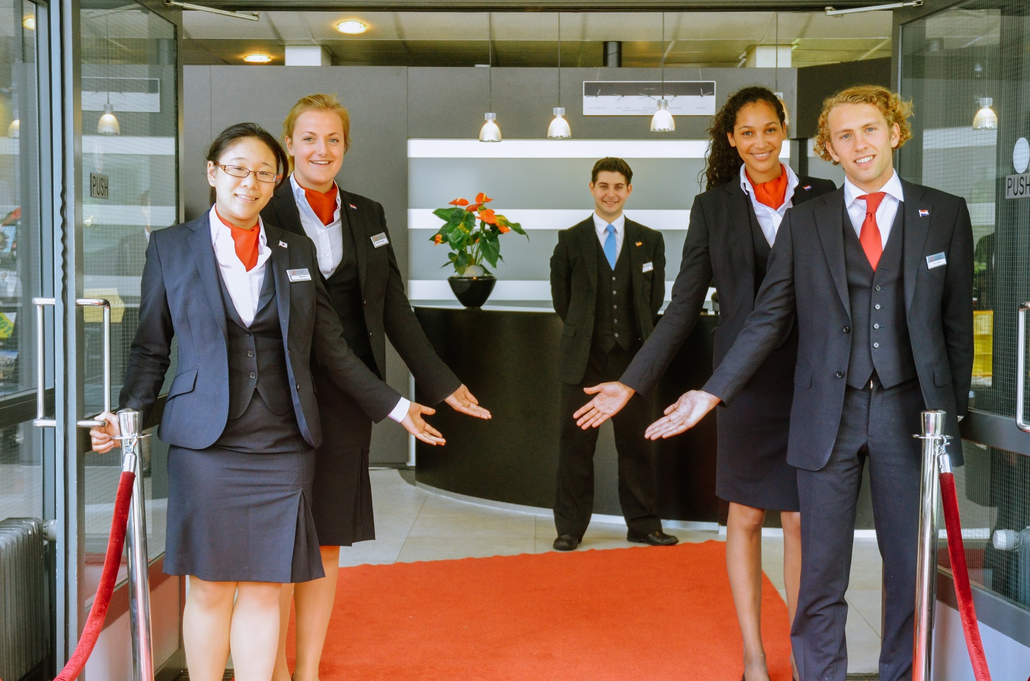
Welcome at the heart of hospitality

Slide 7
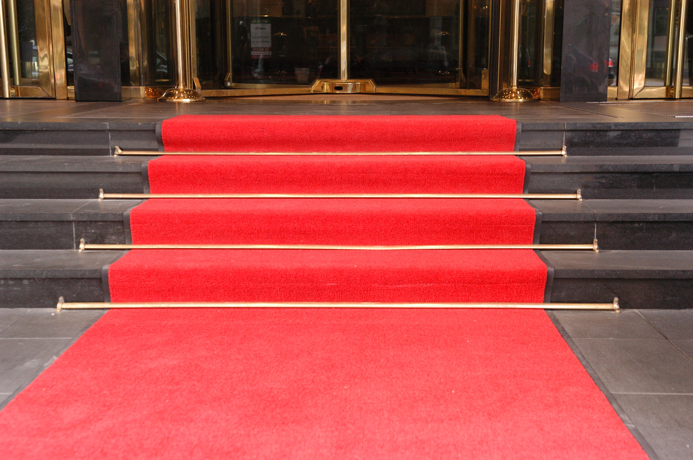
Hospitality
=
the art
of making people feel
genuinely welcome
Hostmanship, Gunnarsson & Blohm.

Slide 8
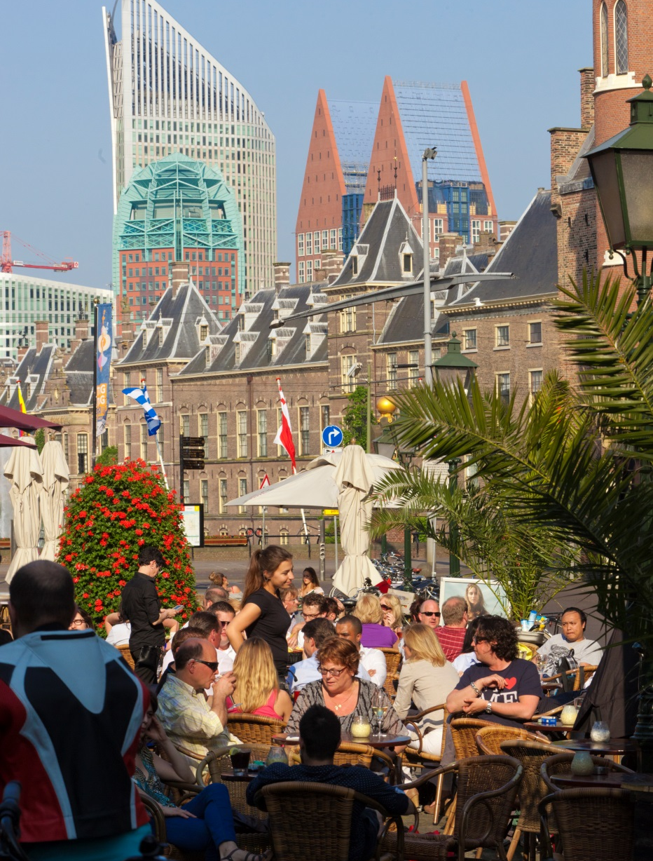
Hospitality = perception
Senses
Emotions
Memory
Engagement
Sharing
Individual, time, context, social influence, …

Slide 9
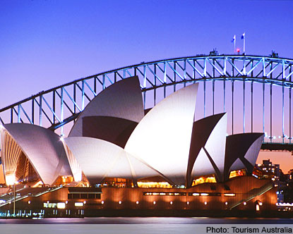
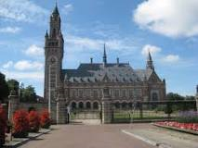
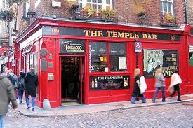
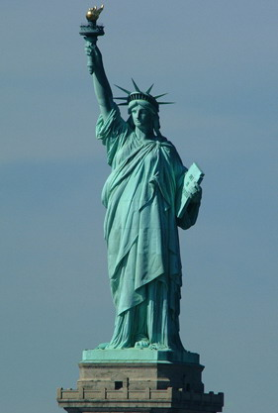

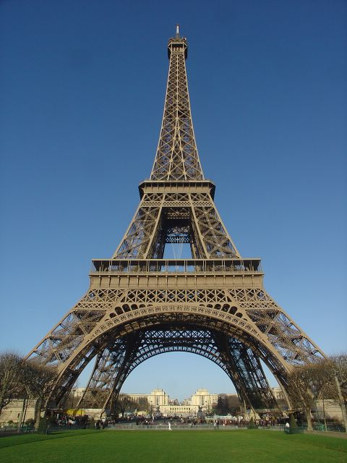
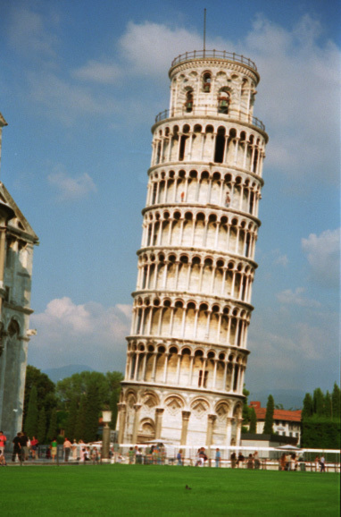
Notes:
Place to be: verwachte wows
Maar ook winkels,

Slide 10
Notes:
Vind ik de weg? Signage, logische infrastructuur, apps, planners etc.
Mensen zijn gewend → wifi wordt zo normaal als lucht en water → enorme dissatsifier als in hotels betaald moet worden , je kunt je nog onderscheiden door gratis wifi op straat maat over een paar jaar zal dat ook niet meer het geval zijn.

Slide 11
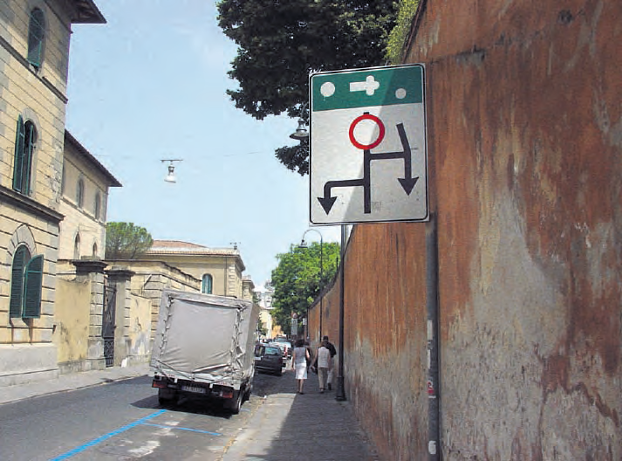
Notes:
However, in Pisa the Italians have their own way to show the right way to the kathedrale and the tower of pisa

Slide 12
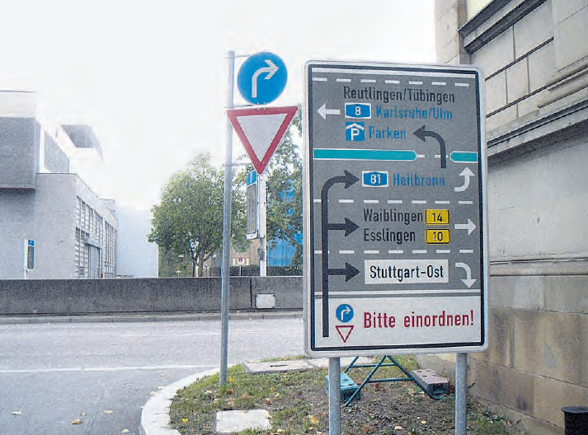
Notes:
Not to speak about a German example of ‘thorough’ signage

Slide 13
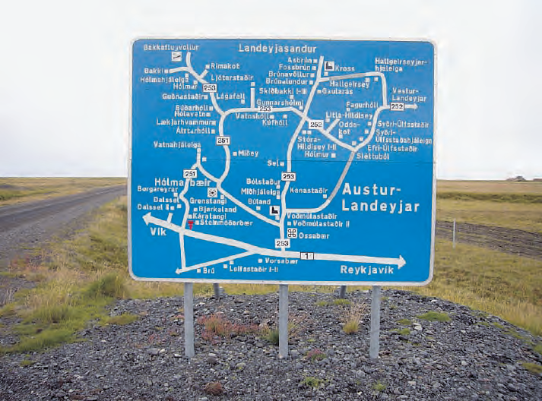
Notes:
And this iceland’s example shows that you really take some time to understand how the island looks like
A cool example of slow wayfinding??

Slide 14
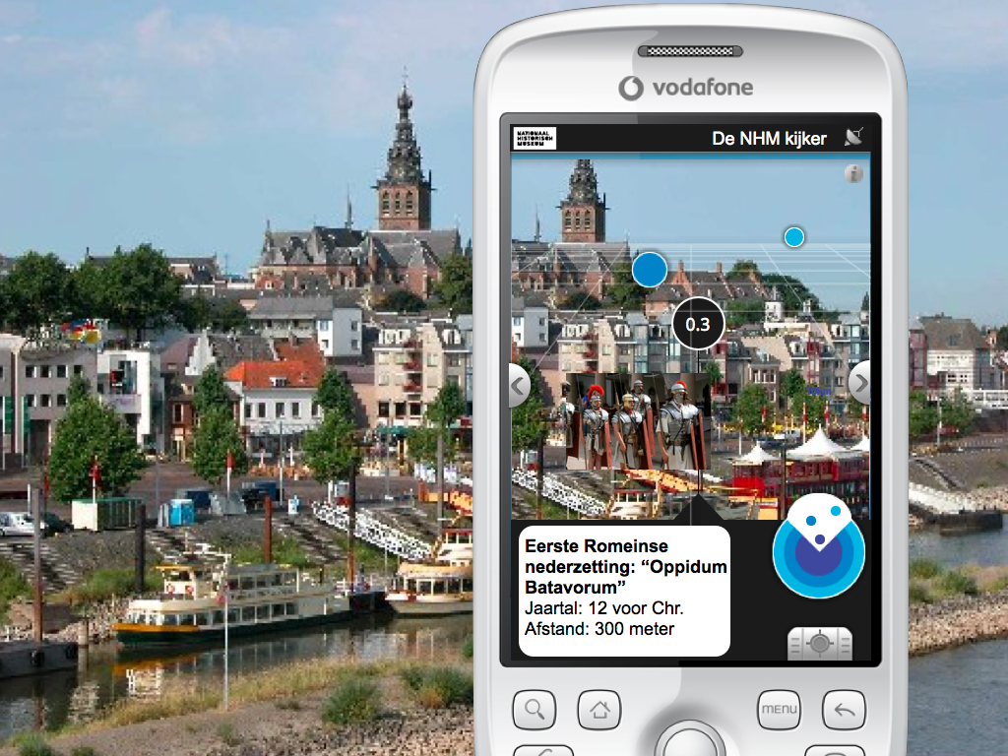
Notes:
And even more if it is cominded with Augmented reality
Online meets offline which combines best of both worlds voor the exploring visitor and makes a citytrip a real experience

Slide 15

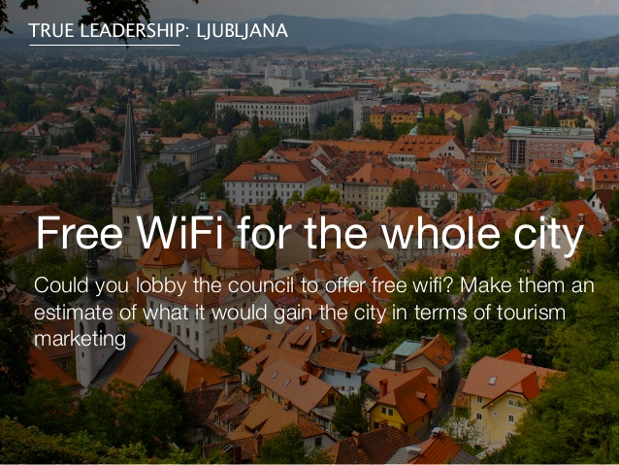
Notes:
Wordt normaal als lucht en water
In hotels al dissatisfier, in

Slide 16
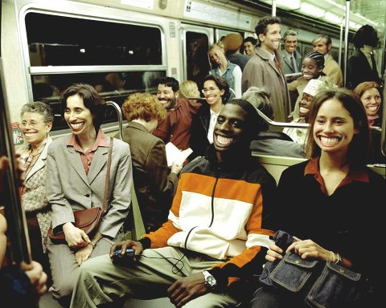
Notes:
Plekken van sociale ontmoeting

Slide 17
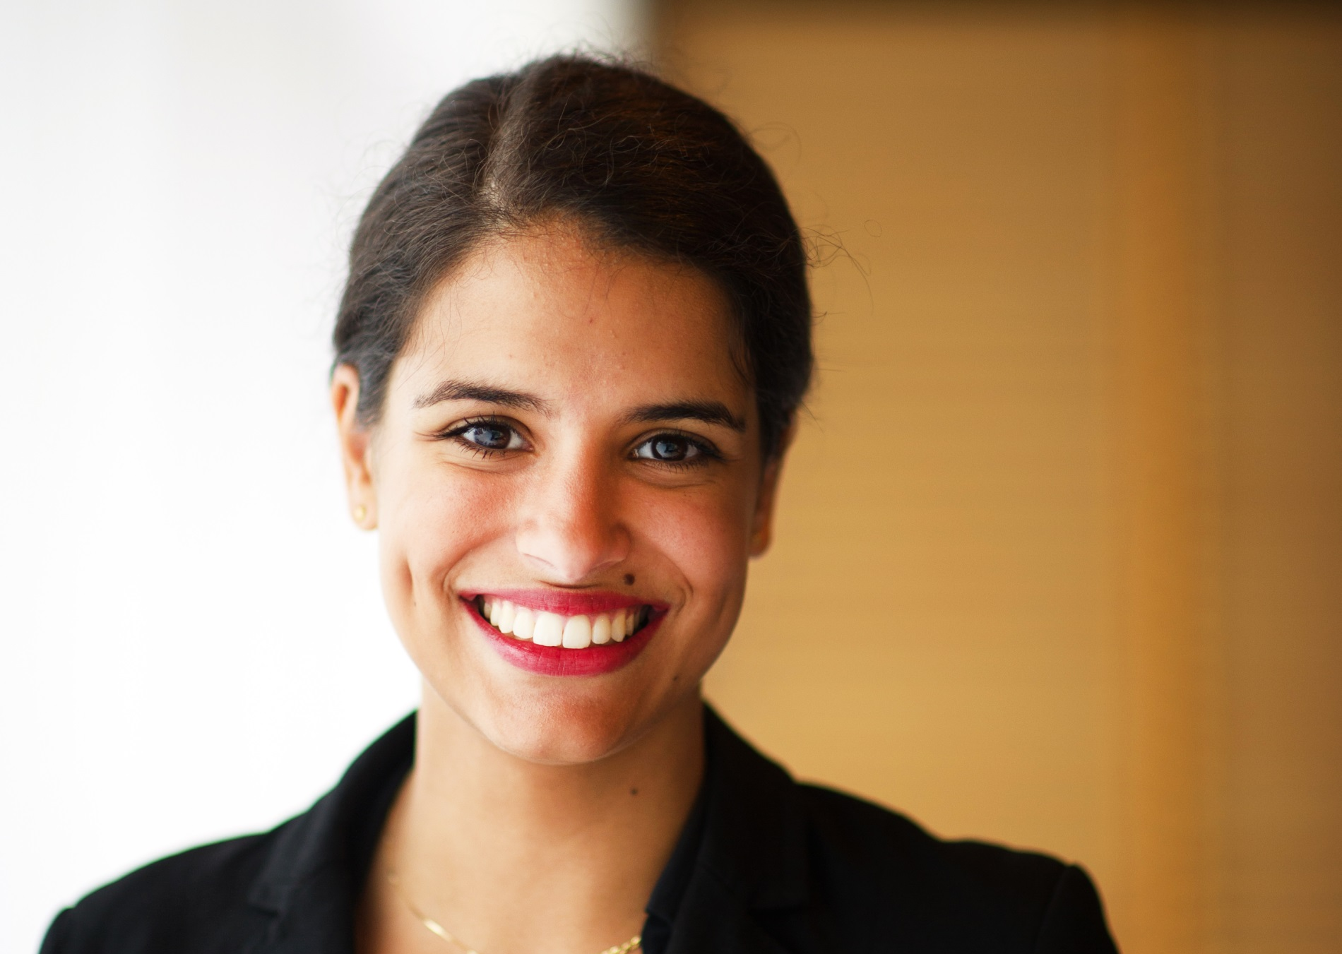
Notes:
En de menselijke factor maakt het verschil → en kan zeker een wow zijn….

Slide 18
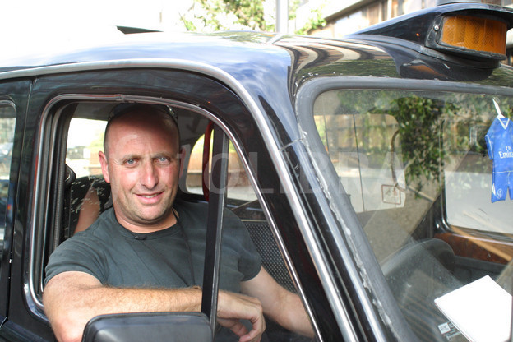
Notes:
Often starting with a taxi driver and of course all encounters with shop personel,

Slide 19
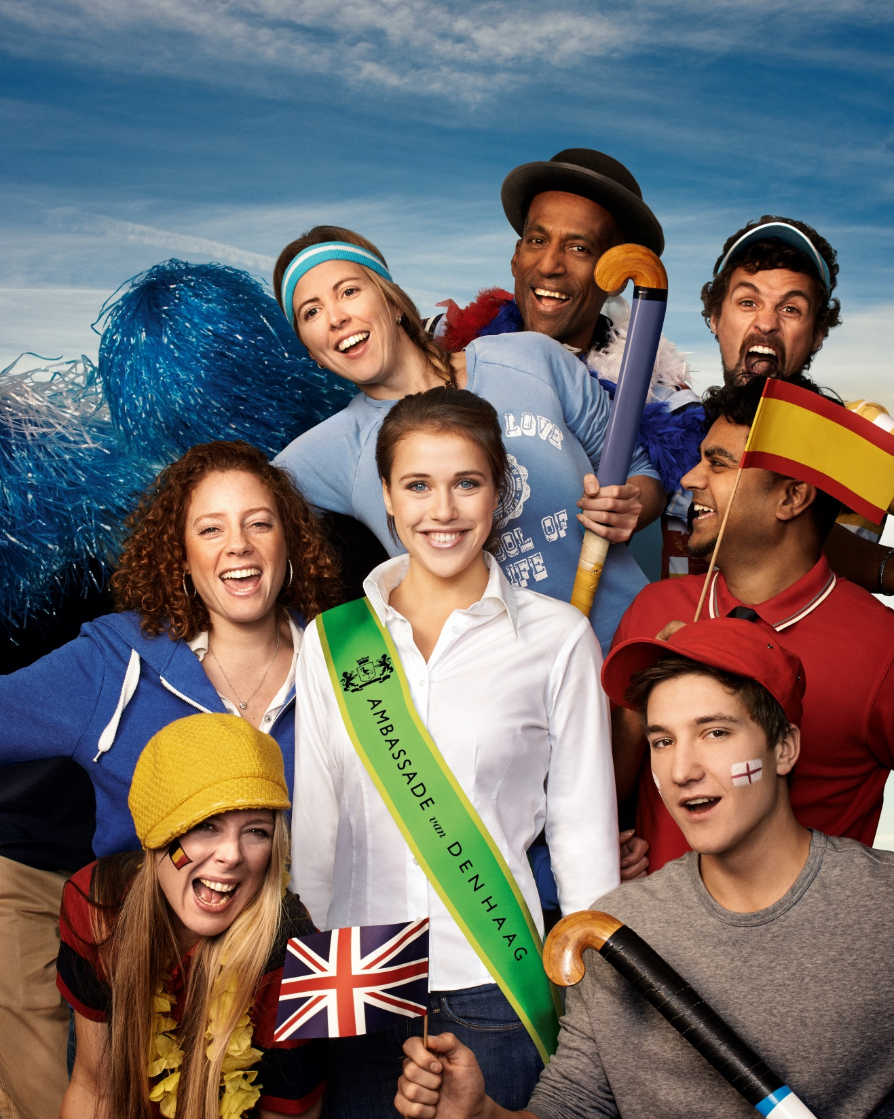
Notes:
Cool cities aiming to invest in real city hospitality launch projects of so called city hosts
City hosts contribute to the welcoming factor of the puplic space.
They are there to welcome guests, and give them a genuine feeling to be welcome
The Hague has a city host project in development – Ambassy of The Hague (where we as Hotelschool are involved in the selection, training and motivational part of the project) specially designed for the upcoming event of the world championship hockey which will take place in the month of june

Slide 20
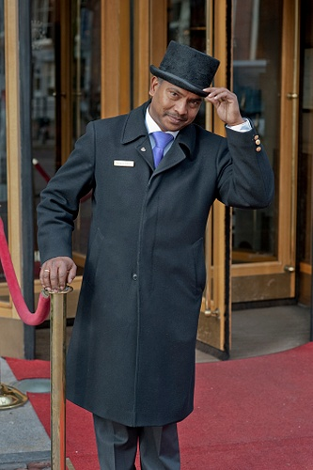

Slide 21
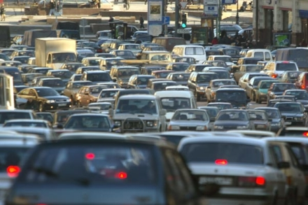
Notes:
And than you may hope the the cool experiences are not spoiled with a final impression when visitors find themselves in the traffic jam?
At the end of the journey

Slide 22

!
Notes:
So I hope that you now get a feeling of what Cool city hospitalities could be
And please go out and find them.

Slide 23

In the meantime….. not to be missed

Slide 24
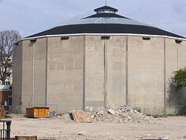
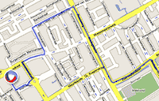
In the meantime….. not to be missed

Slide 25
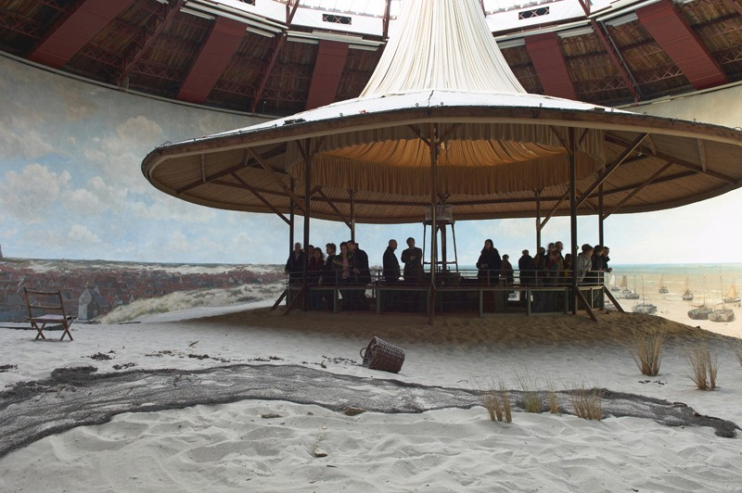
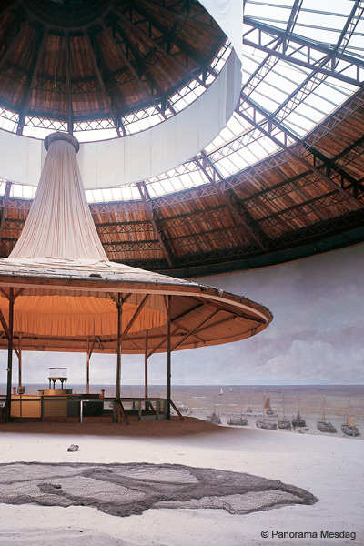
In the meantime….. not to be missed

Slide 26
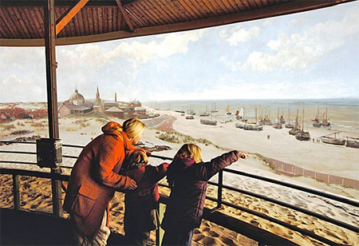

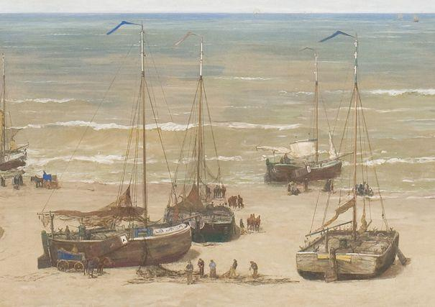
In the meantime….. not to be missed

Slide 27
!
Notes:
So I hope that you now get a feeling of what Cool city hospitalities could be
And please go out and find them.

Slide 28
Cityhospitality e perience Model
X
Economic value creation
Ervaren
gastvrijheids-
beleving
City-
Hospitality
Experience
City-
Hospitality
Experience
Hospitable City hosts
Performance by inter-dependent various Hosts
hardware
atmosphere
behaviour
Residents
Companies
Visitors
needs, wants, goals
expectations
Doelstel-
lingen
Verwachting-
en
Gastgericht
gedrag
Hardware
Atmosfeer
City-
Hospitality
Experience
Guest Value perception

Slide 29
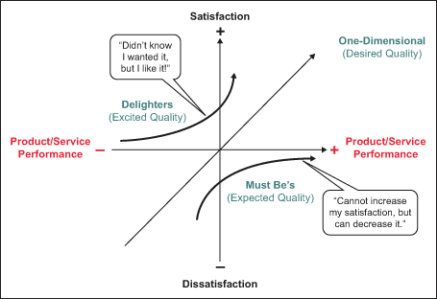

Slide 30
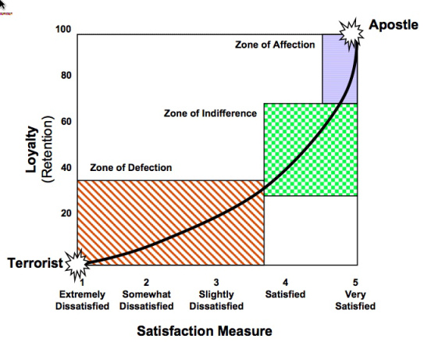
Satisfied? Not good enough!

Slide 31

Satisfied? Not good enough!
Memorable, positive experience -> affection
Engaged visitors -> promotors, ambassadors
Loyal visitors, returning, longer stay, more spending
Positive, empowering culture; great conditions for creating wow hospitality

Slide 32
Journey touchpoints … IKEA
What I was looking for…
Appearance at home
Assortment
Constructing
kids
Queuing
Car park
Routing
Sampson Lee & Tote-M

Slide 33

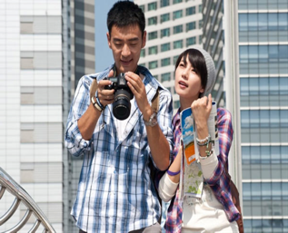


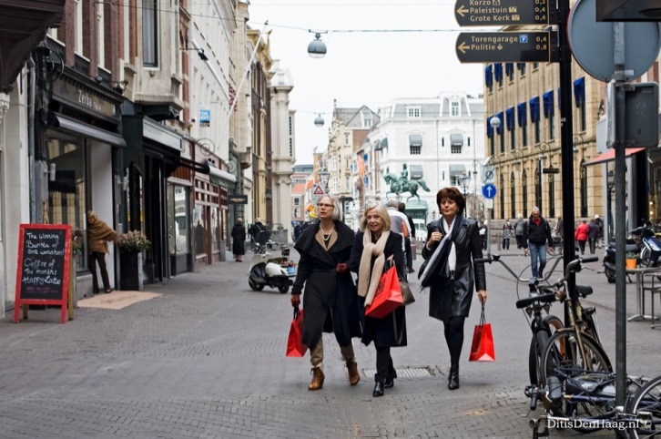
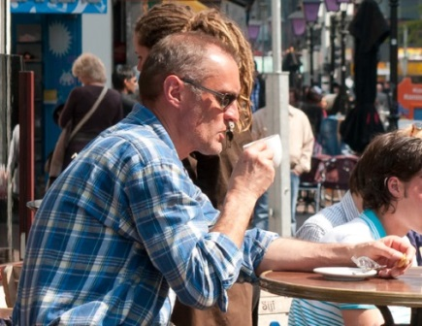
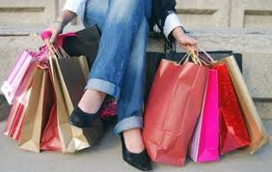
Guest perception is key
Orientation
Good bye
Memory
Trip, Arrival, welcome
Stay
Motives, expectations | Managing welcome | Moments of truth Hardware Atmosphere Behaviour | Hospitable good bye | Stay connected, keep memory alive

Slide 34


Customer insights…
Who are my most important visitors?
What do they do, feel, think, (dis)like, value? Step in the mind and shoes of …
What makes a WOW difference to my guest? What should be avoided anyhow?
  now
  in this encounter
  in this context

Slide 35
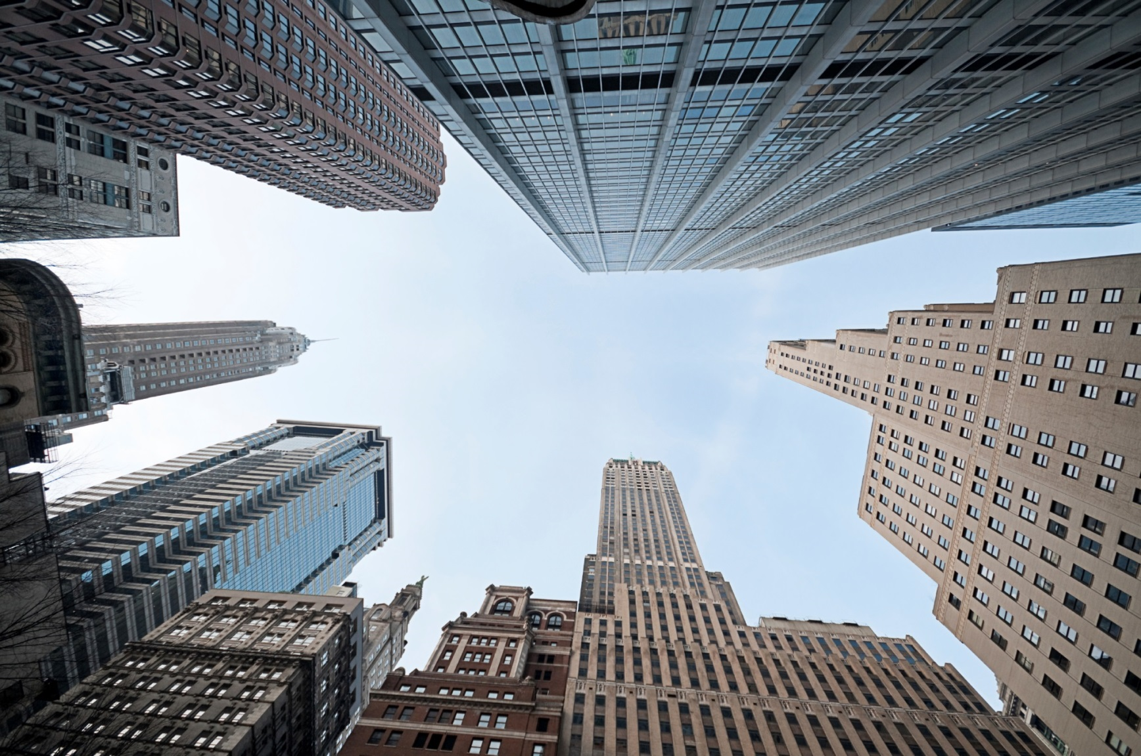
Management perspective: moving towards hospitable city
Hospitable city
Awareness
Insights
Vision, core values
Priorities, direction
Programmes
Dashboard

Slide 36



Best practice: collaborative city hospitality

Slide 37
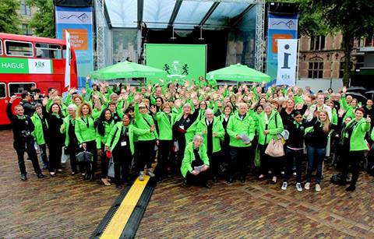
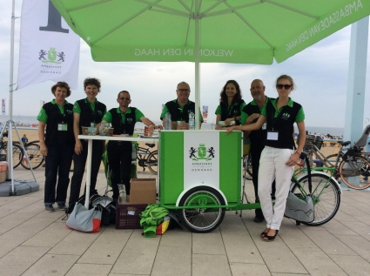
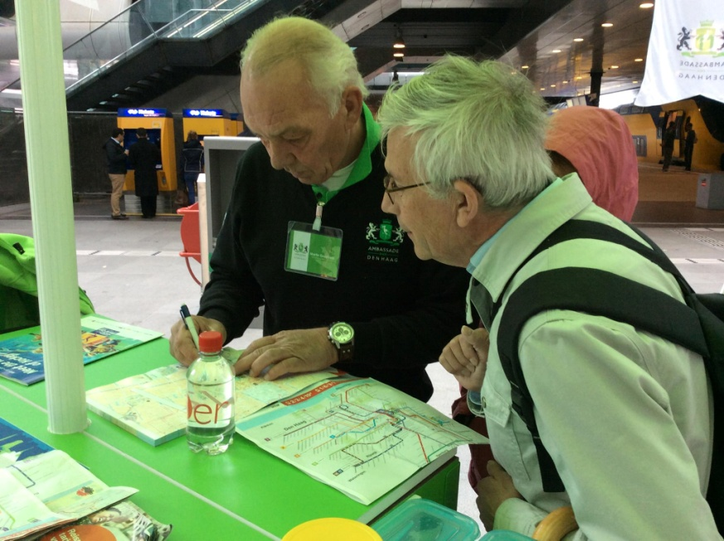
Best practice

Slide 38
Your journey today
Wowww!
Oow!
Please bring your postcards tonight!

Slide 39

Thank you!
Welcome to share insights:
Jan Huizing
Hotelschool The Hague
J.Huizing@hotelschool.nl

