Slide 1
EUHOFA 2014 November 5th 2014, The Hague
Dr. Xander Lub
Dr. Daphne Dekker
Mark Spoor
Merel Vis

Slide 2
Program
09.55-10.50 Research on hospitality
10.50-11.45 Worldcafe
11.45-12.05 Wrap up
12.05-12.20 Interschool collaboration
12.20-12.50 Hospitality Excellence Program

Slide 3
Hospitality and research
Host
Guest
Research studies conducted
for project “Gastvrijheid
Verdient”
What is hospitality?
Motivation
Hospitable behavior
Link behavior and personality
HR Managers

Slide 4
Hospitableness and motivation
What is the real motivation of people to be hospitable?
Karmann, 2011:
Socialising with local people
Make foreign friends
Personal experience
Economic benefit
What motivates people to be a host without monetary rewards?
Insight in true hospible motivations

Slide 5
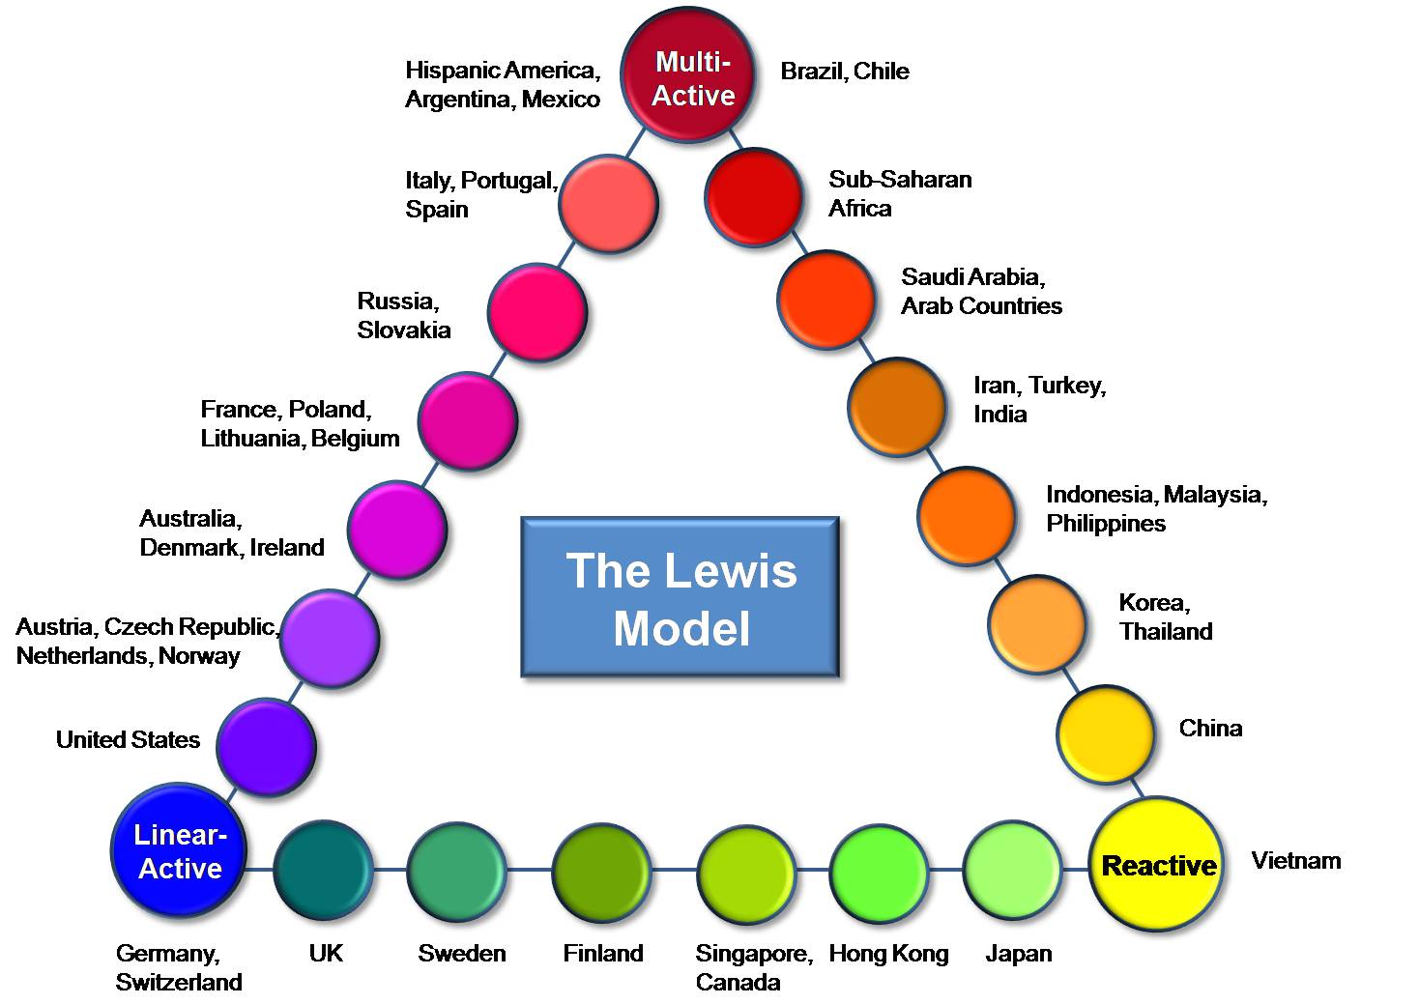
Hospitableness and motivation
Elisabeth Telfer (2000)
We held 21 interviews with coachsurfers from Germany (4 male/4 female), China (3 male/3 female)and Italy (4 male/3 female).
Questionnaire was designed to quantify data
Other regarding motive
Reciprocal motive
Non-reciprocal motive

Slide 6
What motivates hosts?
155 Couchsurfing hosts (average age 31).
Only 4,3% working in the hospitality related business.
The hosting motives that respondents indicated for their first, third, fifth and last CSer
1. Support of the sharing concept – 75%
2. Attraction by request with personal touch – 63%
3. Willingness to help – 57%
4. Cultural Exchange - Enhancing knowledge about other culture – 49%

Slide 7
What motivates hosts?
The most frequent motive for each culture group:
Italiy (Multi-Active) – Non-reciprocal and Other-regarding
Germany (Linear-Active) – Other-regarding
China (Reactive) – Non-reciprocal and Reciprocal

Slide 8
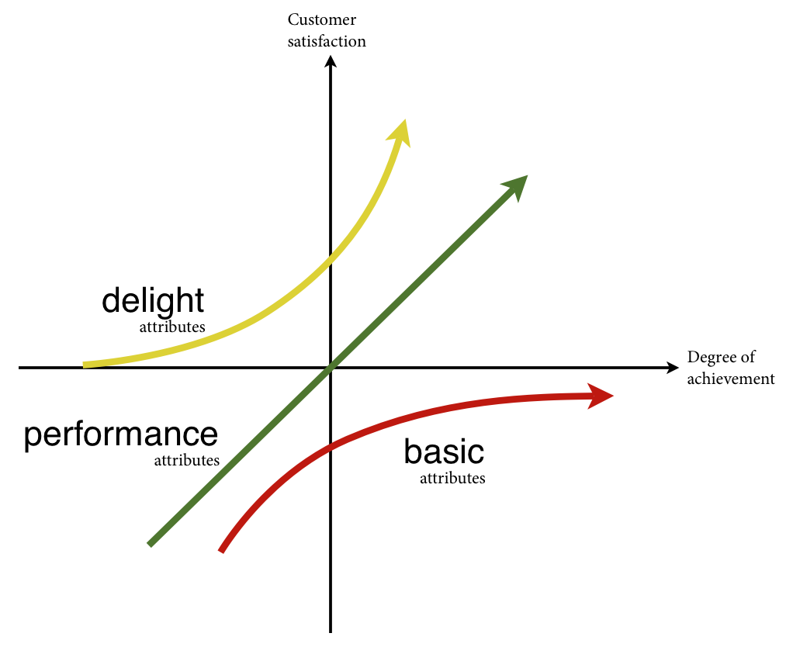
What employee behaviors drive customer delight?
Key performance indicator of any hospitality organization:
GUEST EXPERIENCE
CUSTOMER DELIGHT
Importance of human interaction element (e.g. Crosby & Stevens, 1987)
Employees are key in moment of truth in which experiences turn into customer delight (Rogelberg et al., 1999)
Online travel reviews and staff behavior (Magnini et al., 2011)

Slide 9
Method
Focus on guest perspective: what behaviors cause customer delight as perceived by guests?
Guests and employees disagree with regard to
service evaluation (e.g. Brown & Swartx, 1989)
sources of guest satisfaction (e.g. Bitner et al., 1994)
We do not focus on general words associated with positive experiences, but we focus on specific indidents and behaviors of employees (Critical incident Technique).

Slide 10
Method (continued)
Participants: 43 Dutch high-frequency (>20 overnight stays) guests visiting high-end (4+ star) hotels
Incidents in which guests experienced hospitable employee behaviors causing delight → CIT Technique
“I invite you to think back to an extremely (non-) hospitable incident that has occurred to you while staying in a hotel. Can you describe the (non-) hospitable behavior of the hotel employee? Would you describe for each example: (1) what were the circumstances surrounding this incident (e.g. purpose of visit, length of stay, time of the year), (2) what exactly said or did the employee that was critical, and (3) why did this behavior feel (non-) hospitable”

Slide 11
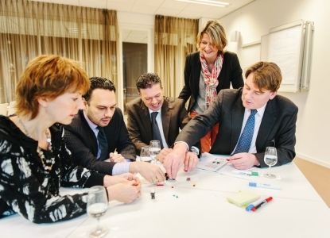
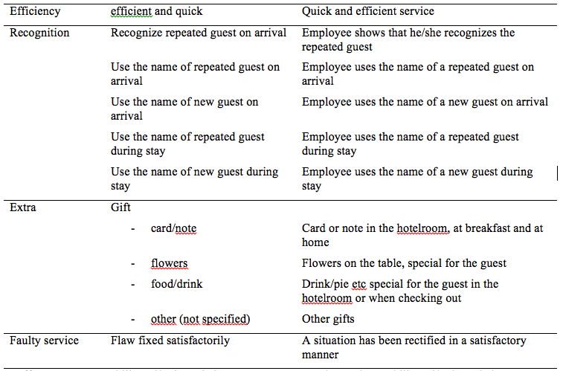
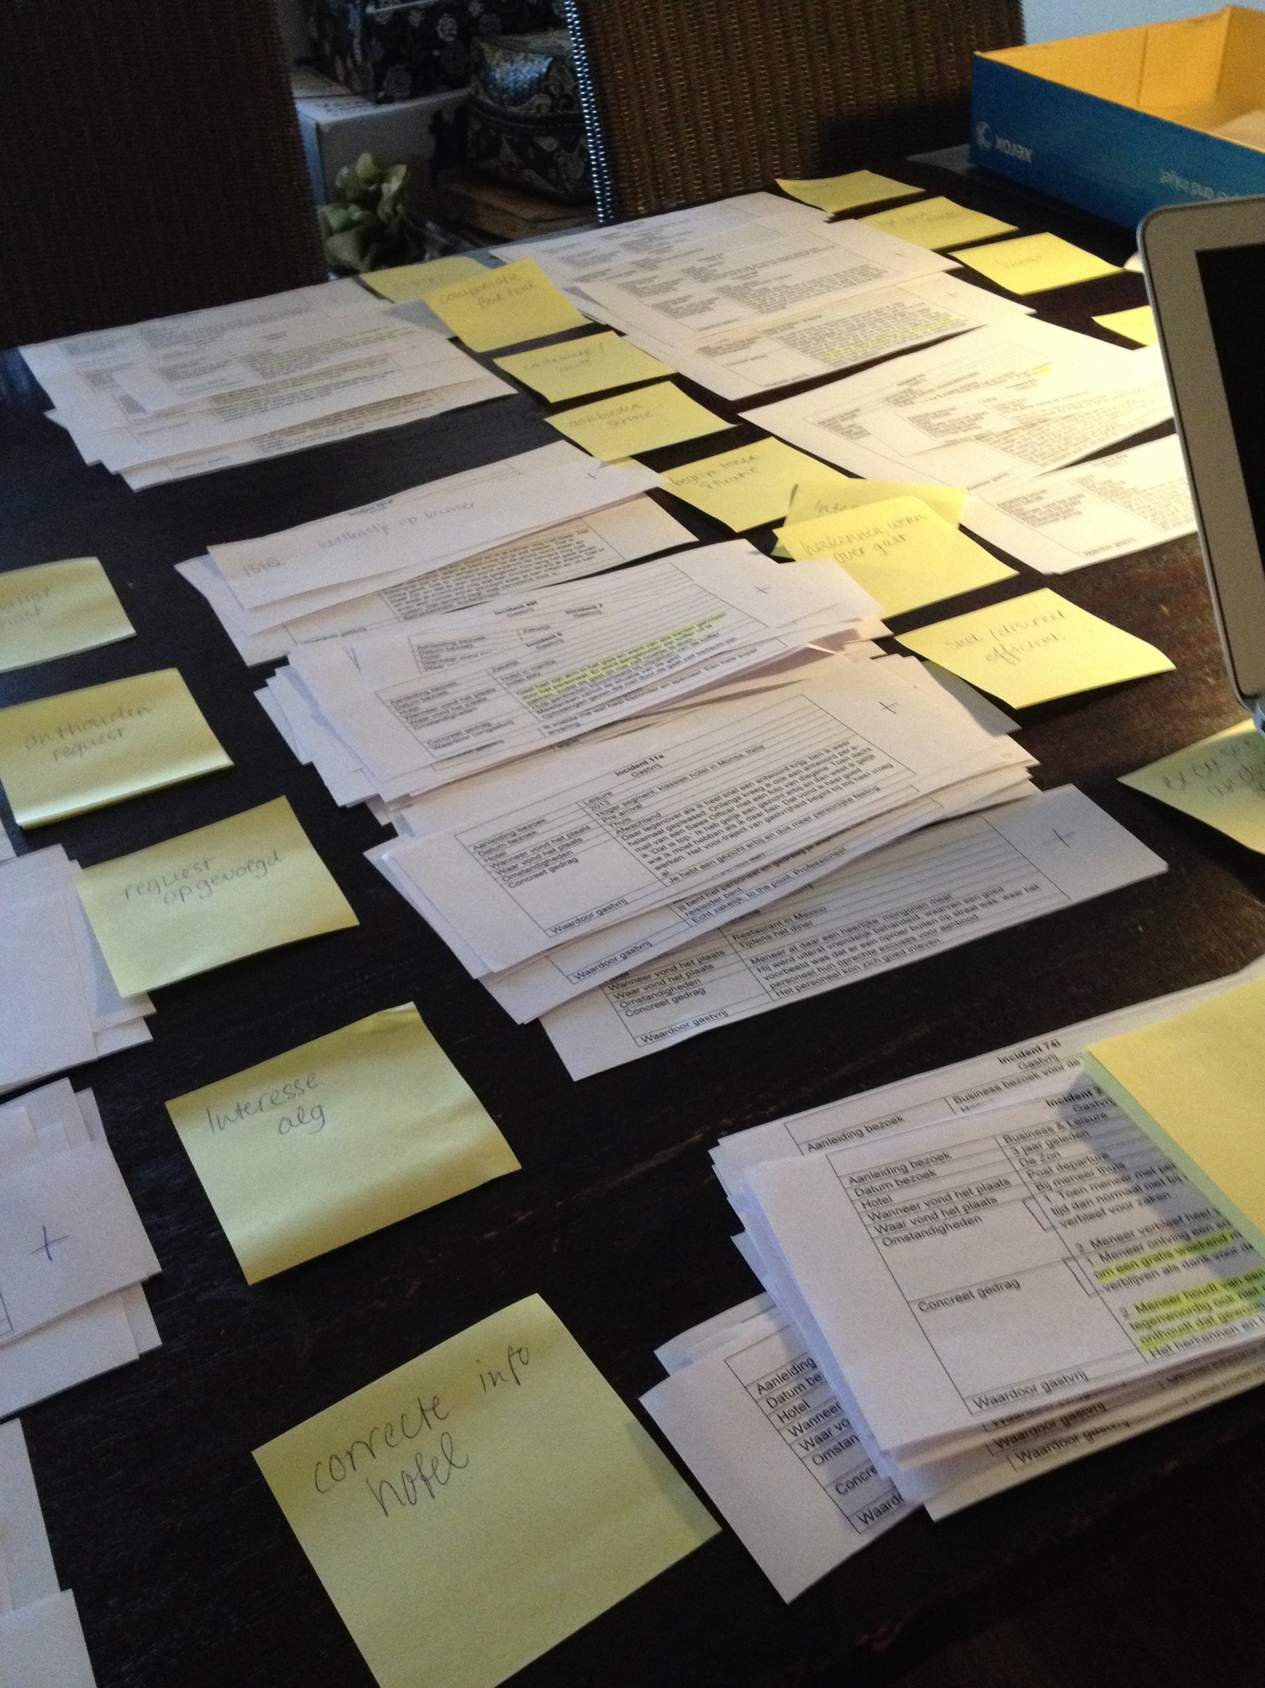
Preliminary results
List of 272 observed acts. 145 positive acts have been categorized into a framework of 15 categories.
“I arrived in the hotel, and the employee clearly remembered me, he said “Welcome back mr. Jansen!” ”
“We had been away all day, and when we got back the receptionist was very interested in what we had done that day”
“When I arrived at the breakfast that morning, the employee prepared eggs for me the way I explained yesterday. I did not expect this!”
“A little after I checked out I was in a taxi on my way to the airport, the phone rang and the receptionist warned me about a traffic jam”
“There was a cake and wine waiting in our room for our anniversary”
“I had a cast around my arm, because it was broken. I wanted to ask my wife to cut my meat, but then notices that this was already done in the kitchen”

Slide 12
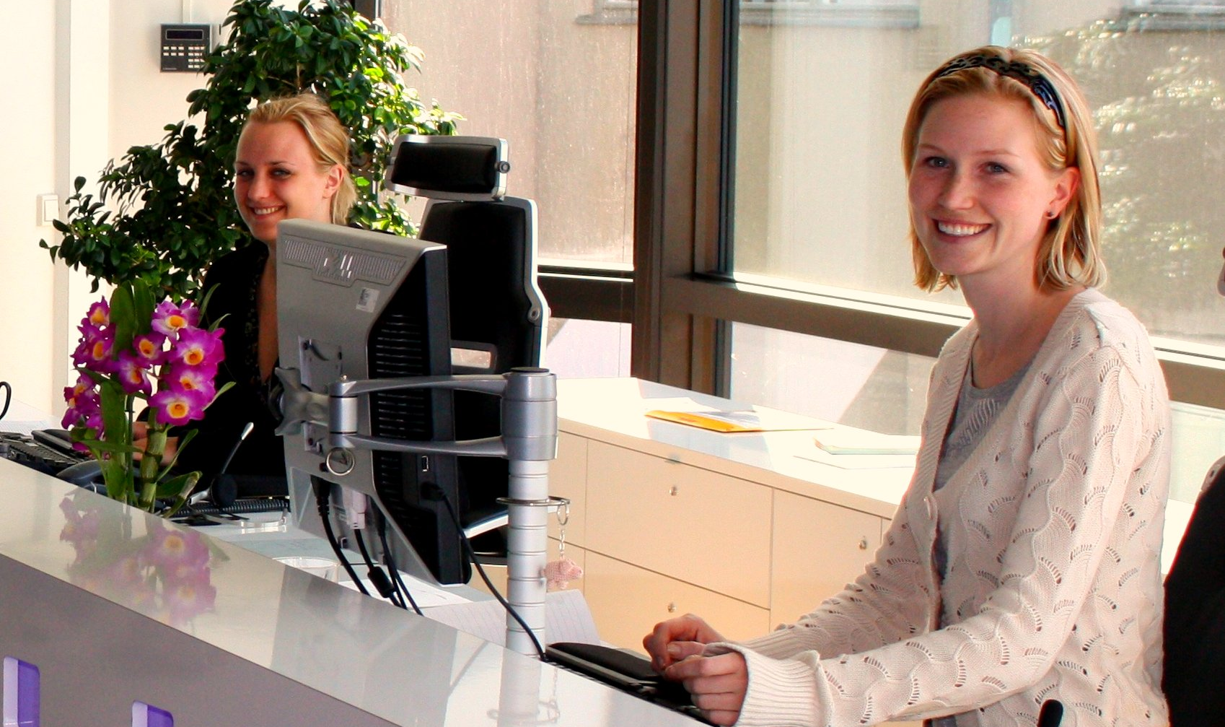
From a framework to measurement
Supervisor
Observed
Employee
Guest

Slide 13
Personality and service adaptive behavior
Big Five Theory:
Openness
Conscientiousness
Extraversion
Agreeableness
Emotional stability
Service adaptive behavior:
Deliberate modification of service offering/behavior in a
situationally appropriate manner in response to meeting
the customers need (Gwinner et al, 2005)
Depending on the service climate (organization needs to
support and facilitate behaviors)
Personality
Behavior

Slide 14
What did we find?
Hospitableness:
Service adaptive behavior
Conscientiousness
Emotional stability
Extraversion

Slide 15
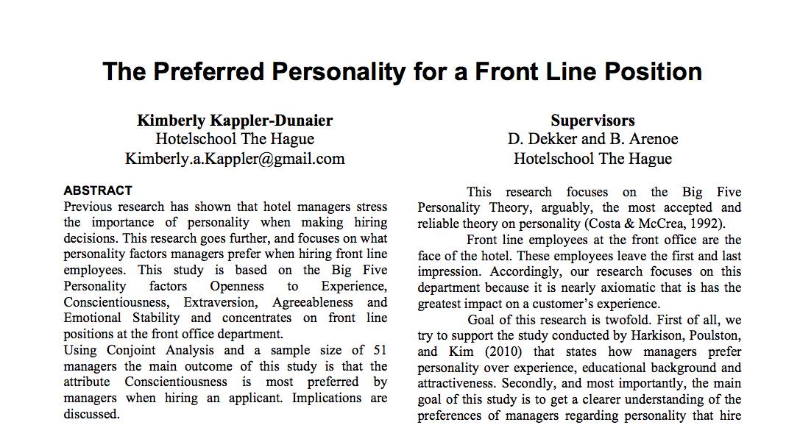
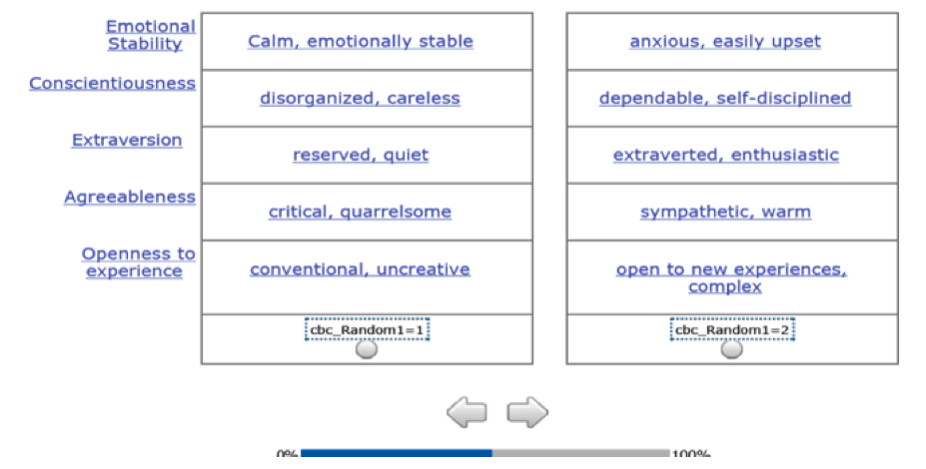
Who are chosen by HR managers?
Conjoint analysis
52 HR managers
What is most important when selecting a front line employee?
Personality
Educational background
Appearance
Choose between profiles
Conscientiousness, Agreeableness and Emotional Stability were considered most important.
Extraversion least important.

Slide 16
v
Service adaptive behavior
Conscientiousness
Emotional stability
Extraversion
v
Agreeableness

Slide 17
Next steps in Research
Phase 3: Interview study
Small hotels
Medium-sized hotels
Large chain hotels
Tool development
Phase 4: Pilot study to optimize tools

Slide 18
Worldcafe
Various tables with topic:

Slide 19
Worldcafe
Selection:
Based on what criteria can you select hospitality students now and in the future?
How can we help the industry select and how can we provide the right students?
How can we improve selection procedure and what could the role of industry be?
Excellence:
How can you stimulate excellence now and in the future?
How can we focus on development of hospitableness in school?
How can we stimulate excellence and what could the role of industry be?
Interschool collaboration:
How can you collaborate now and in the future?
What are crucial conditions for international collaboration?
How can we improve interschool collaboration and what could the role of industry be?

Slide 20
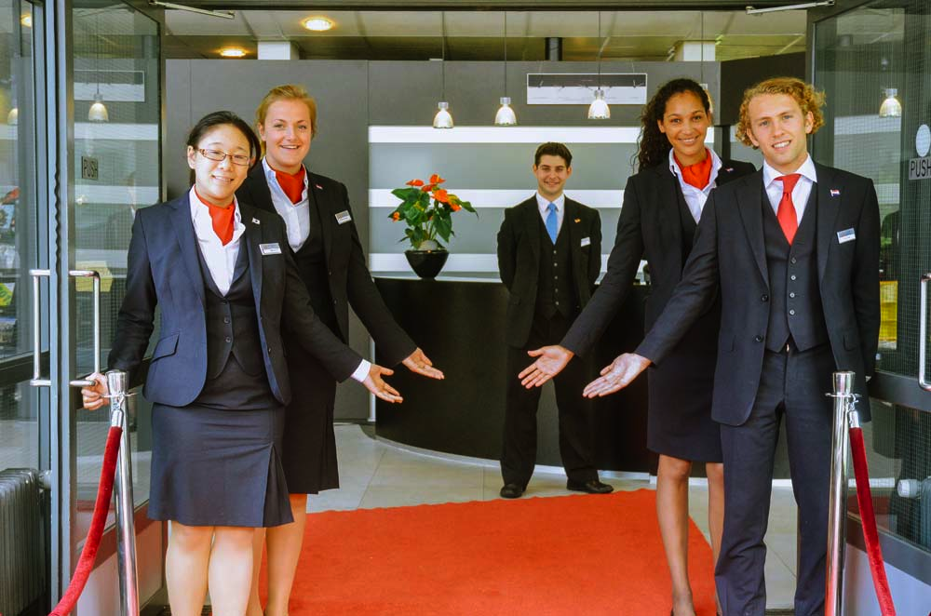
Worldcafe

Slide 21
Welcome back

