Slide 2

1. INTRO
LIVING IN THE FLAT WORLD

Slide 3


Slide 4
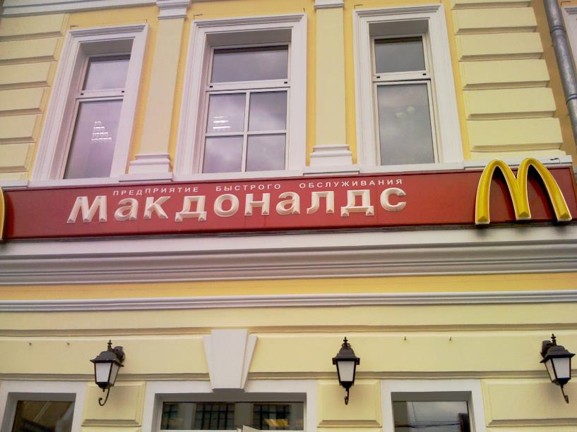

Slide 5
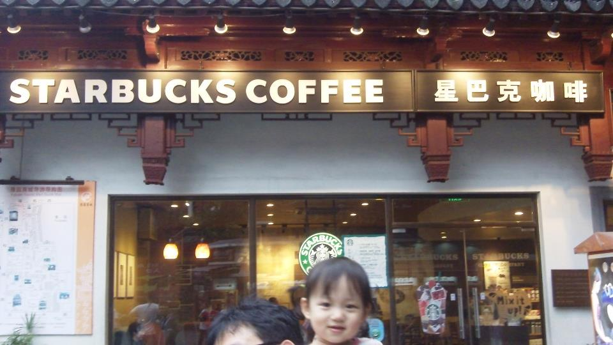

Slide 6
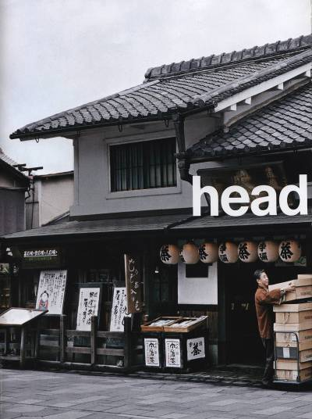
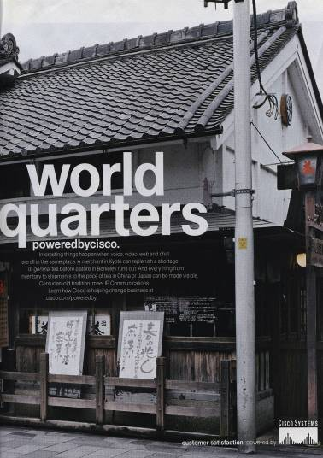

Slide 7
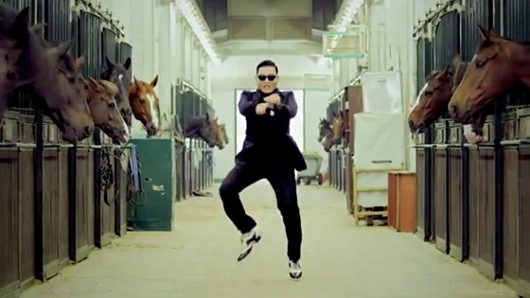

Slide 8
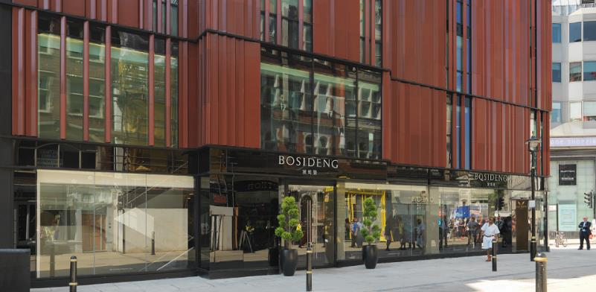

Slide 9


Slide 10


Slide 11
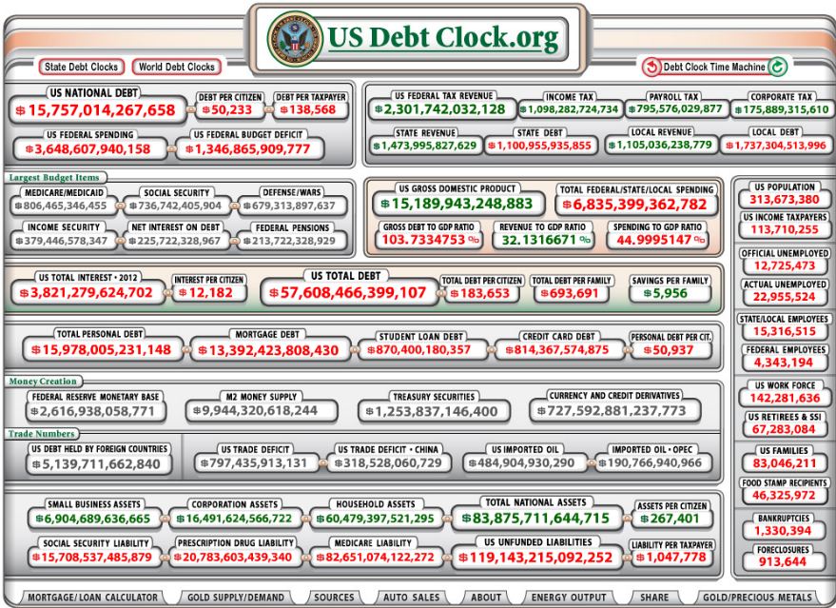

Slide 12
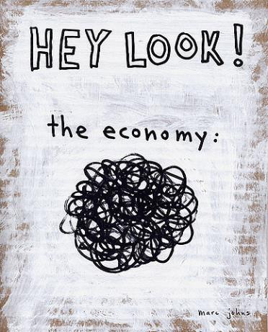

Slide 13


Slide 14

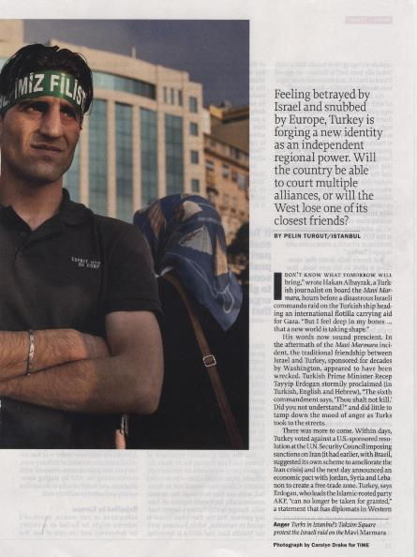
Notes:
FT 11th of October 2013: “ Turkey has chosen a Chinese over an American air defence system.”

Slide 15


Slide 16


Slide 17
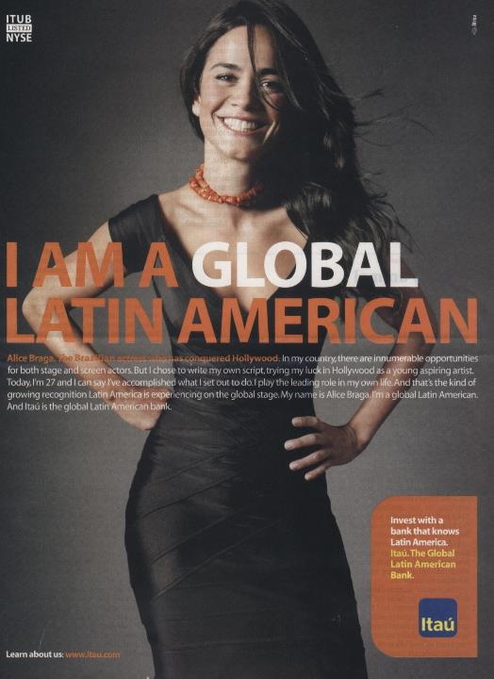

Slide 18
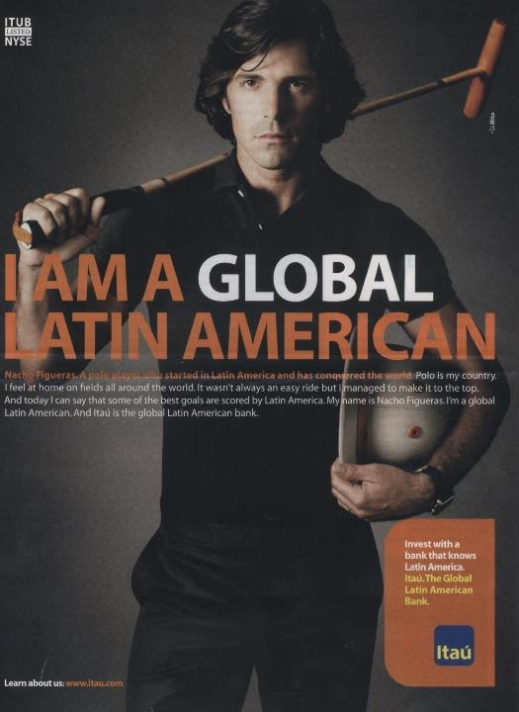

Slide 19
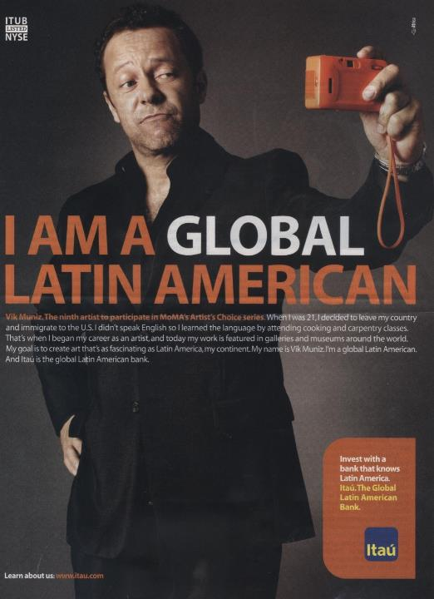

Slide 20
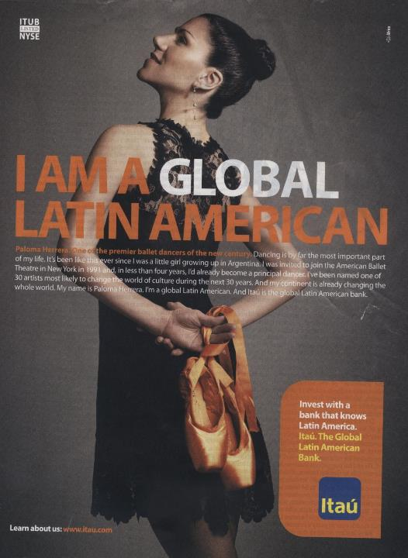

Slide 21


Slide 22
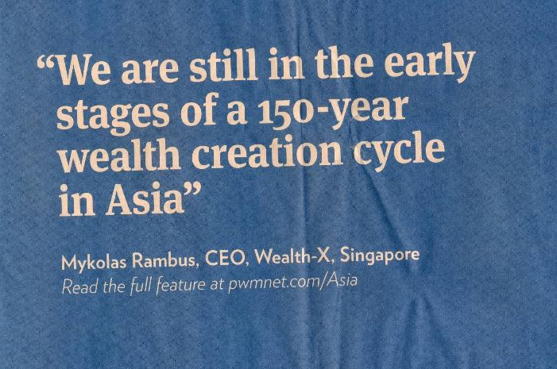

Slide 23


Slide 24


Slide 25
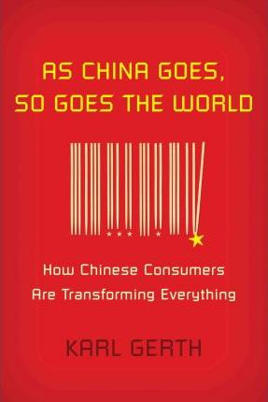

Slide 26
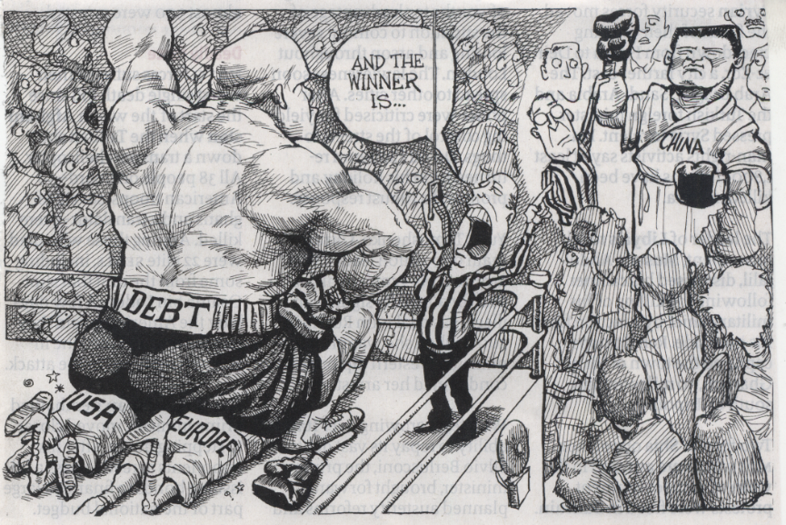

Slide 27


Slide 28
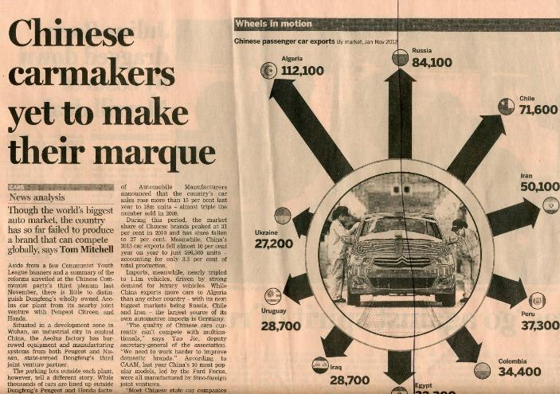

Slide 29
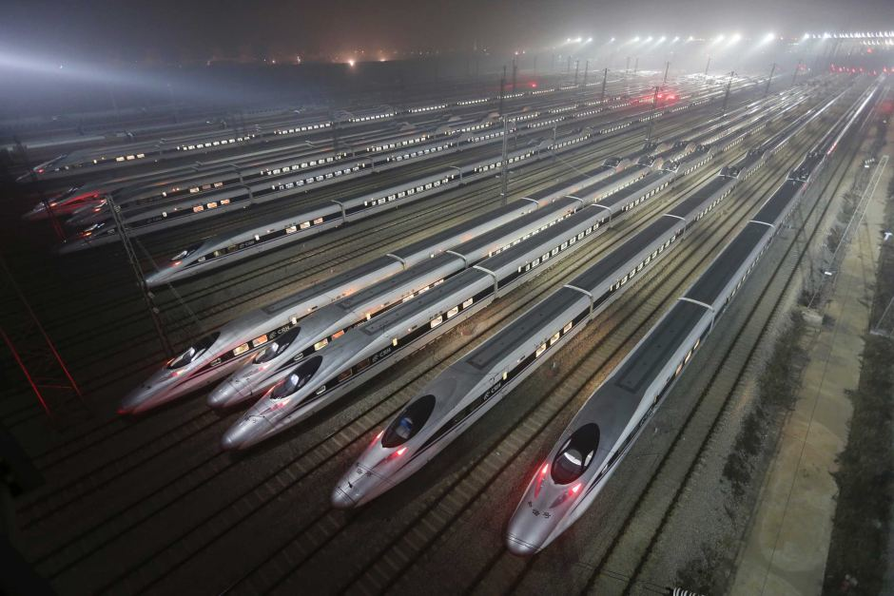

Slide 30
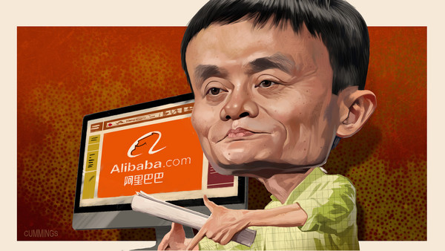
JACK MA (ALIBABA):
“CHINESE BRAINS ARE AS GOOD AS AMERICAN ONES. WHICH IS WHY WE COMPETE.”
Notes:
Jack Ma: Alibaba’s various e-commerce sites account for 60 per cent of parcels delivered in China; just two of its portals handled more sales globally in 2012 than eBay and Amazon combined. Half of all online payments in China go through its online payment processor.

Slide 31


Slide 32

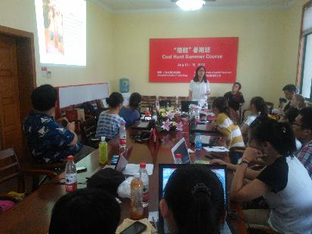
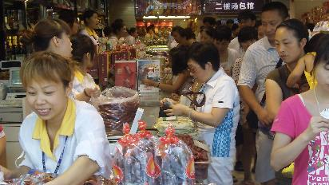




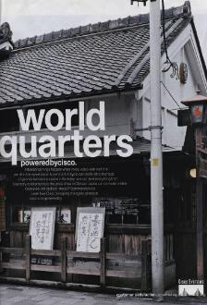
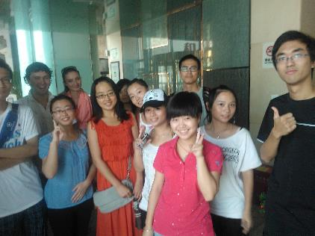


THE WORLD IS FLAT

Slide 33
HOW TO STAY SUCCESSFUL
IN A FLAT WORLD?

Slide 34
2. WINNING MEANS:
BEING CREATIVE AND INNOVATIVE!

Slide 35
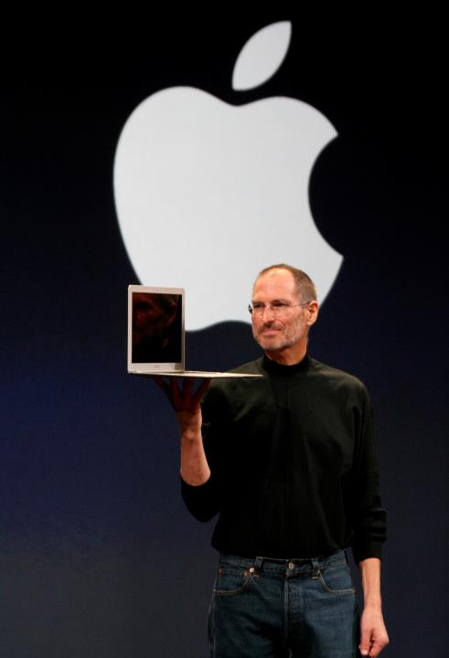

Slide 36
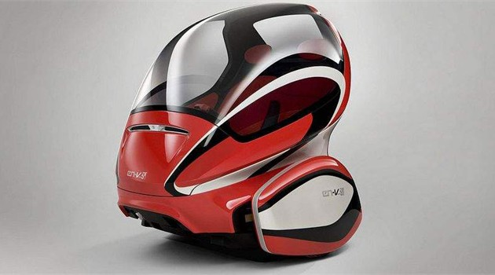

Slide 37
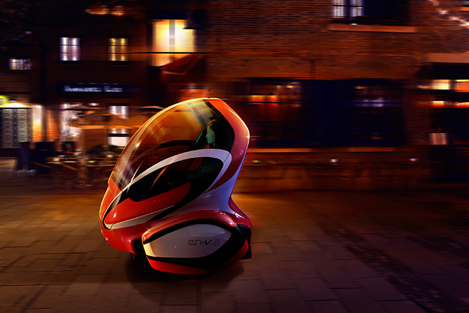

Slide 38
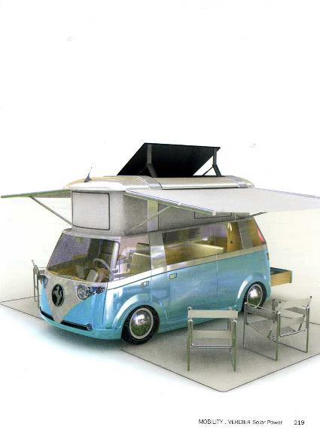

Slide 39
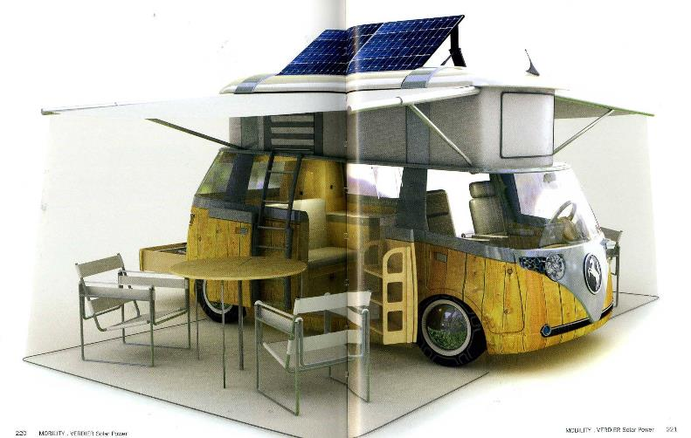

Slide 40
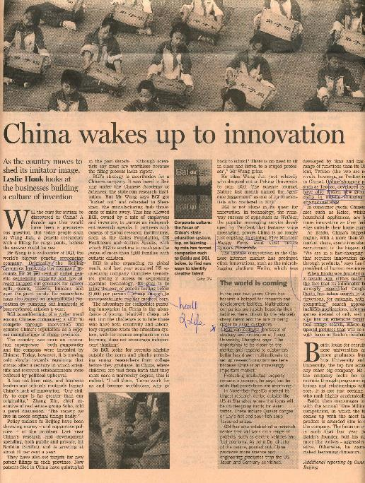

Slide 41
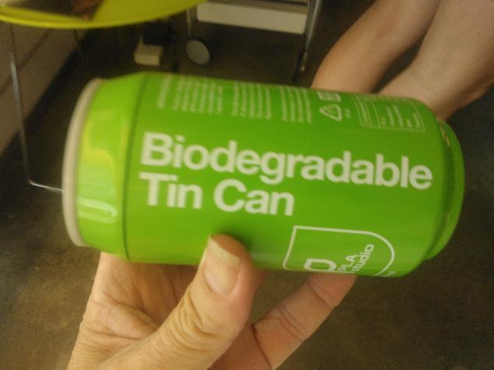

Slide 42
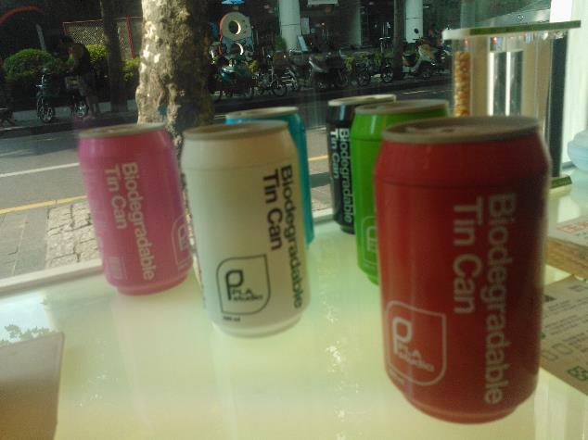

Slide 43
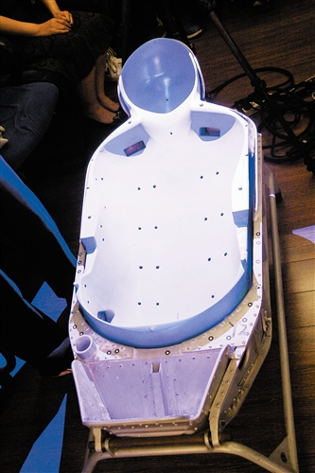
Notes:
China’s astronauts sit in 3D-printed seats shaped to fit their bodies. Officials regard 3D printing as a way to upgrade China’s manufacturing base as rising labour costs erode its advantage.
- The economist – From dental braces to astronauts’ seats – 7th September 2013

Slide 44
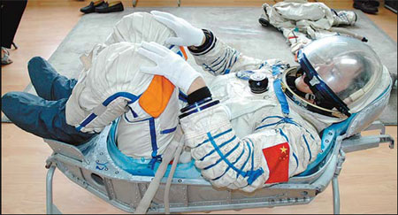
Notes:
China’s astronauts sit in 3D-printed seats shaped to fit their bodies. Officials regard 3D printing as a way to upgrade China’s manufacturing base as rising labour costs erode its advantage.
- The economist – From dental braces to astronauts’ seats – 7th September 2013

Slide 45
THE INTERNATIONAL COOL CITY HUNT PROJECT

Slide 46
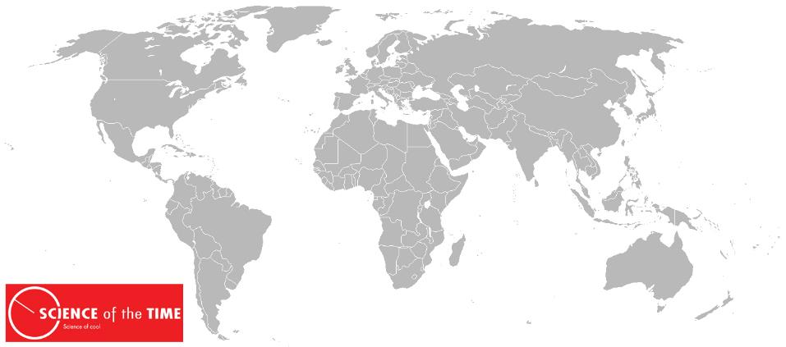

Slide 47
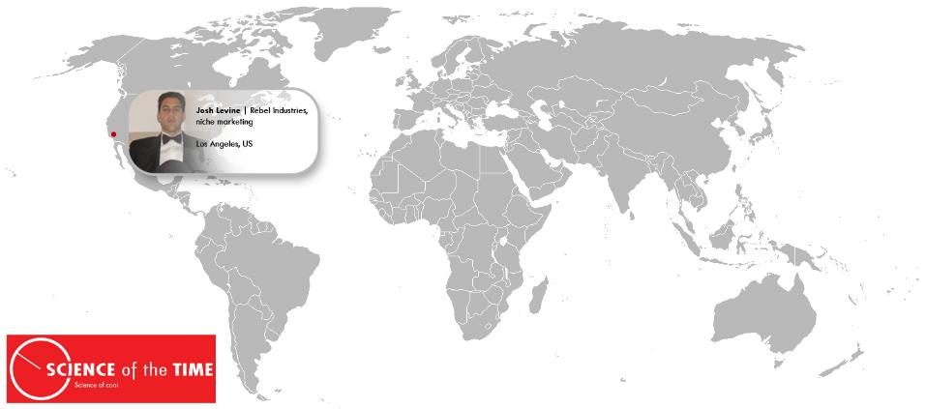

Slide 48
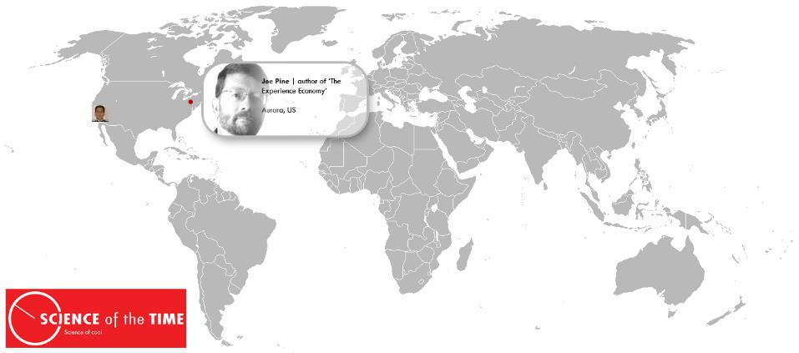

Slide 49
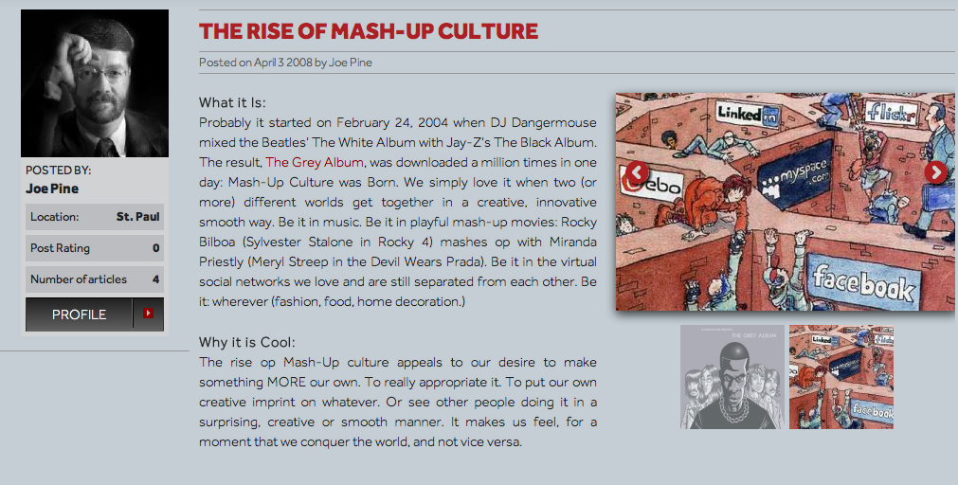

Slide 50
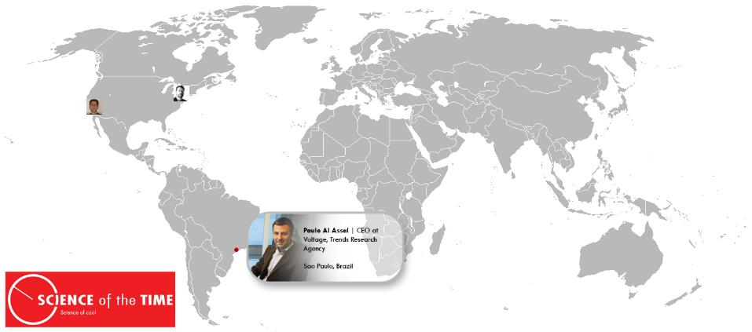

Slide 51
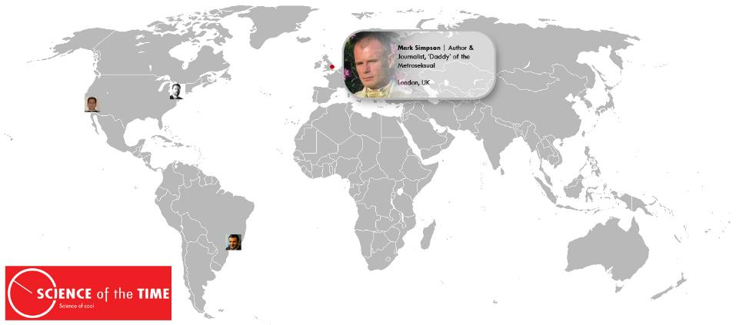

Slide 52
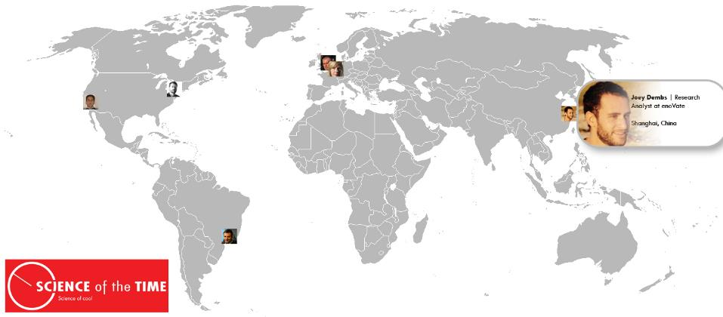

Slide 53
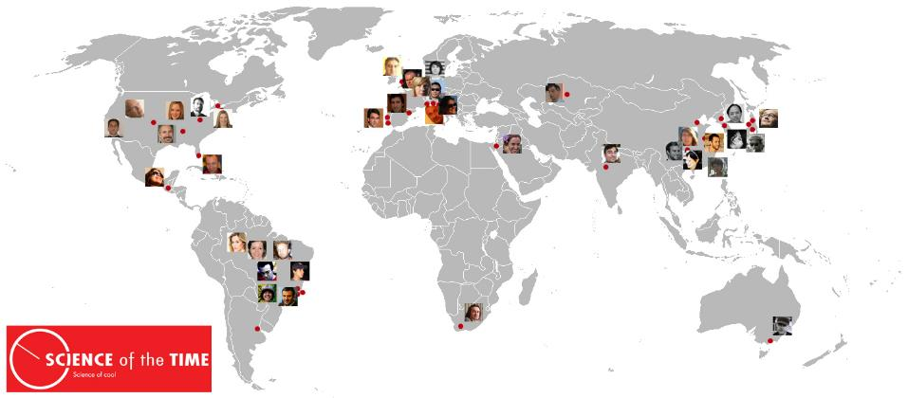

Slide 54
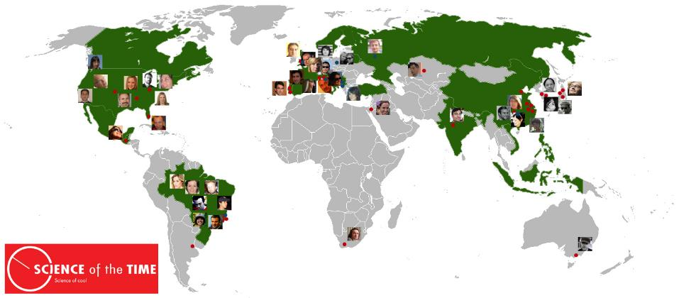

Slide 55
DEFINITION OF “COOL”:
ATTRACTIVE
INSPIRING
WITH FUTURE GROWTH POTENTIAL

Slide 56
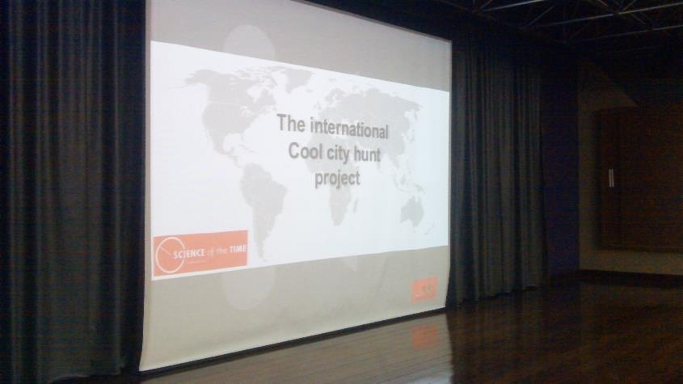

Slide 57
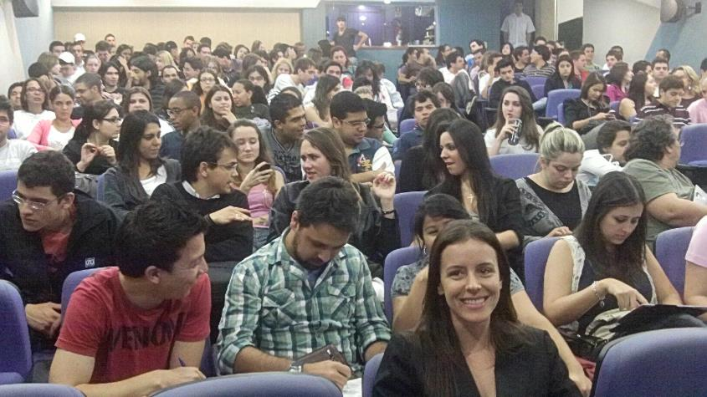

Slide 58
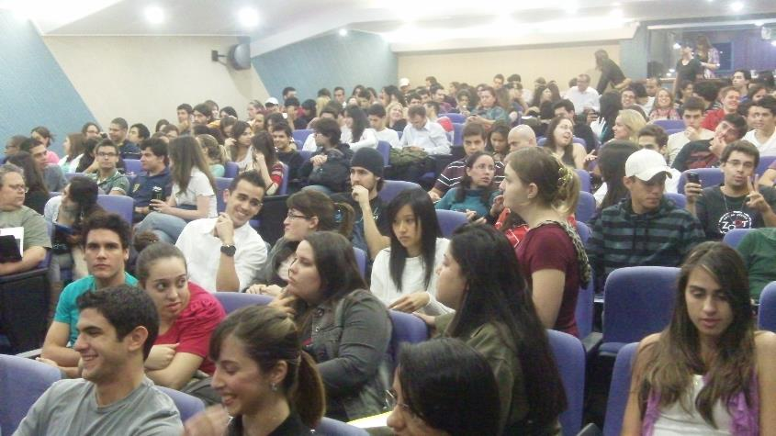

Slide 59
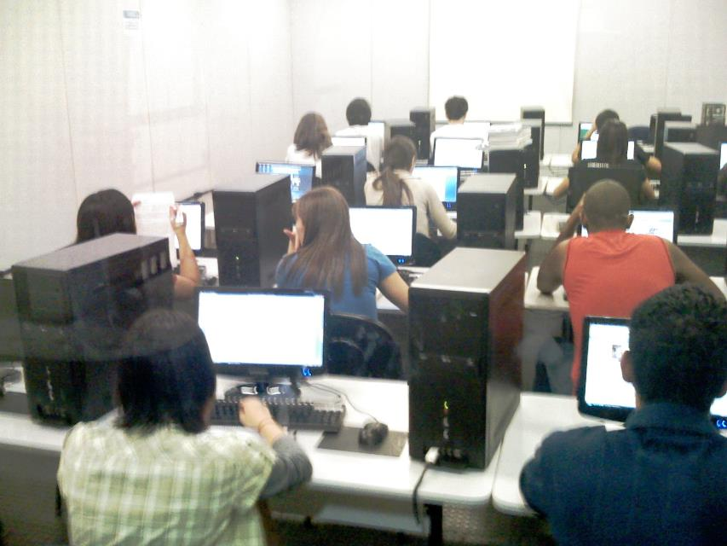

Slide 60
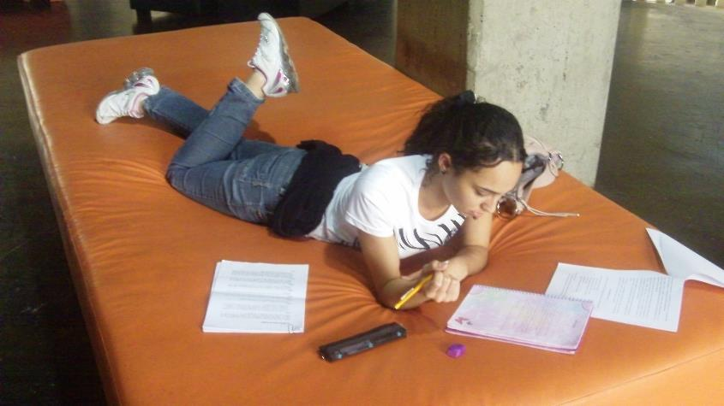

Slide 61
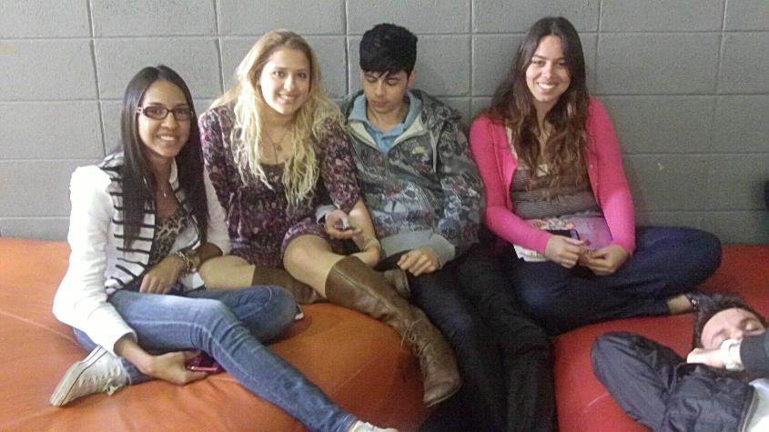

Slide 62
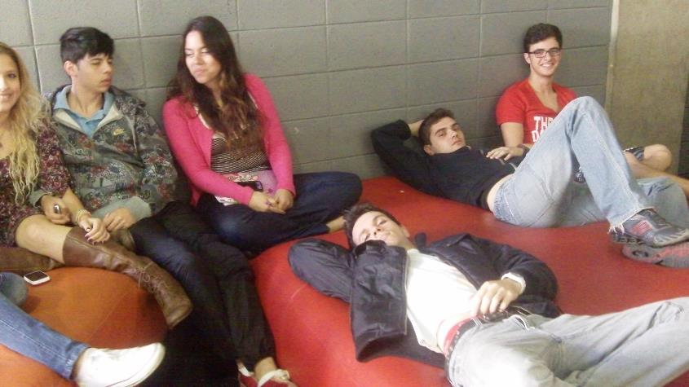

Slide 63
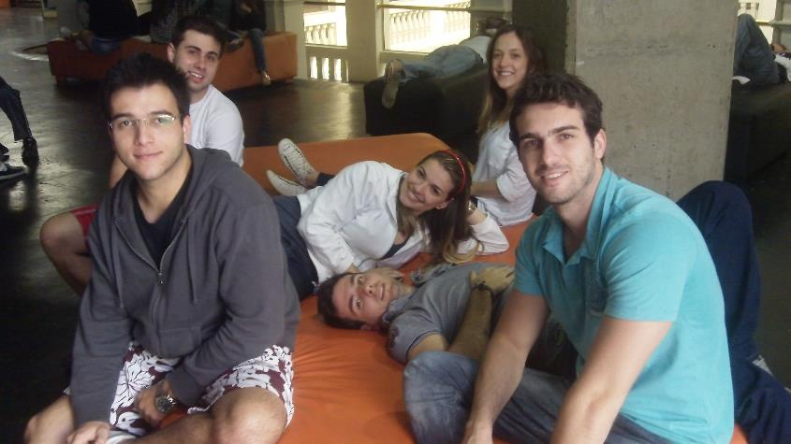

Slide 64


Slide 65


Slide 66


Slide 67


Slide 68


Slide 69


Slide 70


Slide 71


Slide 72


Slide 73


Slide 74


Slide 75


Slide 76


Slide 77


Slide 78


Slide 79


Slide 80


Slide 81


Slide 82


Slide 83


Slide 84


Slide 85


Slide 86


Slide 87


Slide 88


Slide 89


Slide 90


Slide 91


Slide 92


Slide 93


Slide 94





Notes:
Wat hebben die voorbeelden met elkaar te maken?

Slide 95

COOLHUNT 50+

Slide 96


Slide 97
Idea Generation
Mentality
Insights
Clustering
Examples

Slide 98











Slide 99


Slide 100


Slide 101


Slide 102


Slide 103


Slide 104


Slide 105


Slide 106


Slide 107


Slide 108


Slide 109


Slide 110


Slide 111


Slide 112


Slide 113
THE COOL
HOSPITALITY TREND HUNT

Slide 114

Notes:
Plus size fashion Weekend

Slide 115

Notes:
Plus size fashion Weekend

Slide 116

Notes:
Plus size fashion Weekend

Slide 117

Notes:
Plus size fashion Weekend

Slide 118
1. FUTURE ONLIFE

Slide 119

Notes:
Het nieuwe backpaken. Backpacken staat vaak synoniem voor budgetreizen. Met een tas en een tent liftend van kleine campings naar hostels. Ouderwets backpacken met flashpacking, met een ruimer budget en slim gebruik van technologie en coole gadgets. Altijd online, veilig en onderweg.

Slide 120

Notes:
Het nieuwe backpaken. Backpacken staat vaak synoniem voor budgetreizen. Met een tas en een tent liftend van kleine campings naar hostels. Ouderwets backpacken met flashpacking, met een ruimer budget en slim gebruik van technologie en coole gadgets. Altijd online, veilig en onderweg.

Slide 121


Slide 122


Slide 123











TREND 1: FUTURE ONLIFE
about: OFFLINE + ONLINE = ONLIFE
EMPOWERED BY: THE CLOUD

Slide 124
TREND 1: FUTURE ONLIFE
What will be you COOLEST example
of this trend in Hospitality?

Slide 125



Slide 126
2. COOL NEW BUSINESS MODELS

Slide 127





Example of innovative business models
Ryanair : why pay for what you don’t want
Notes:
Some are very well known. Ryanair. Most succesful low cost carrier, June 2013: 14 million passengers since 2003 (in 10 years)
Flight price in exluding all kinds of extra’s: luggage, VIP treatment, seat etc.
app. 20% of revenu from additional revenu streams such as in flight sales (f&b), gambling
Key partner: Advertising media company (adds on boarding passes)
Subsidairies from destinations
Dit maakt in één klap duidelijk waarom Ryanair zo’n lage prijzen kan vragen voor hun vliegtickets. Het maakt voor Ryanair niet zo bijzonder veel uit hoeveel ze vragen voor hun vliegtickets, ze kunnen het zich zelfs permitteren om verlies te maken op de verkoop van tickets. Het gaat er om dat ze hun vliegtuigen vol krijgen, zodat ze geld krijgen van de lokale overheden en kleinere vliegvelden om passagiers daar naar te vervoeren. De overheden en vliegvelden zien het betalen van Ryanair als een middel om het toerisme in hun regio te stimuleren. Een uniek verdienmodel binnen de luchtvaart.
Deze “aanvullende inkomsten” zijn vrijwel pure winst, en zijn goed voor meer dan 20% van de omzet van Ryanair. Concreet: van de 2.4 miljard Euro omzet, komt 500 miljoen Euro uit ‘aanvullende inkomsten’. De winstmarge op deze aanvullende inkomsten bepaalt voor 100% het bedrijfsresultaat. Ryanair bewijst dus dagelijks dat er geen geld te verdienen is met klanten vervoeren. Hun vervoer op zich is verliesgevend. Maar Ryanair bewijst ook dagelijks dat er met luchtvaart wel degelijk geld te verdienen is. Als je het creatief aanpakt. Met een duidelijk en simpel business model. http://zakelijk.infonu.nl/onderneming/88524-het-verdienmodel-van-ryanair.html

Slide 128





TREND 2: INNOVATIVE BUSINESS MODELS
SHIFTS IN WAYS BUSINESSES CREATE,
DELIVER & CAPUTRE VALUE
128

Slide 129
TREND 2: INNOVATIVE BUSINESS MODELS
What will be you COOLEST example
of this trend in Hospitality?
129

Slide 130



Example of innovative business models
Poolside Preneurs
Notes:
What it Is:
Poolsidepreneurs is an exclusive, members only club that offers entrepreneurs access to private pools, lounges, and meeting rooms at hotels around the US, as a place to work. They are starting in Los Angeles but is still under development. http://poolsidepreneurs.com/
Why it is Cool:
Pretty obvious, how awesome wouldn’t it be to just skip the office and head straight to the pool of a luxurious hotel instead.
Why it has Future Growth Potential:
Los Angeles is most likely a good starting point for these guys and hopefully they’ll be able to expand nationwide and maybe even further.
It’s probably possible to do something similar in Shanghai, although I haven’t seen any advertisement about it.
The hotels in Shanghai that offer pool access for non-residents are a few. They usually only do day-to-day access and
it’s quite expensive, depending on the hotel. This could work pretty well in Shanghai though

Slide 131
3. COOL, UNEXPECTED PERSONALIZED SERVICES

Slide 132


Examples of unexpected personalized service
Joshie at the Ritz!
Notes:
A family that had been staying in the Ritz-Carlton in Bali had brought specialized eggs and and milk for their son who had numerous food allergies.
Upon arrival, they saw that the eggs had broken and the milk had soured! The Ritz-Carlton manager and dining staff searched the town but could not find the appropriate items. Luckily, the executive chef at this particular resort remembered a store in Singapore that sold them. He contacted his mother-in-law, and asked that she buy the products and fly to Bali to deliver them, which she agreed to do. The goal is to develop such a strong emotional engagement between the hotels' staff and their guests that a guest will not consider staying anywhere else, even if they have an option.

Slide 133




Examples of unexpected personalized service
Joshie at the Ritz!
My son's Joshie was even issued a Ritz-Carlton ID badge, made an honorary member of the Loss Prevention Team, and was allowed to help by taking a shift in front of the security
Notes:
Hotel chain Ritz-Carlton has a storied reputation for great customer service. Many companies mimic its training programs, and one often hears executives saying they want to be known as the "Ritz-Carlton" of their respective industry, be it a law firm, car dealership or plumbing supplier.
Recently, my family and I experienced the Ritz-Carlton signature customer service in a way that will be talked about in our family and at my company for many years to come. My wife and two children spent a few days at the Ritz-Carlton on Amelia Island (Florida) while I was in California on business -- sadly unable to make the trip with them. Upon returning, we discovered that our son's beloved stuffed giraffe, named Joshie, had gone missing. As most parents know, children can become very attached to special blankets, teddy bears and the like. My son is extremely fond of his Joshie, and was absolutely distraught when faced with the idea of going to sleep without his favorite pal. While trying to put him to bed the first night home, I decided to tell a little white lie.
"Joshie is fine," I said. "He's just taking an extra long vacation at the resort." My son seemed to buy it, and was finally able to fall asleep, Joshie-less for the first time in a long while.
That very night, the Ritz-Carlton called to tell us they had Joshie. Thankfully, he had been found, no worse for wear, in the laundry and was handed over to the hotel's Loss Prevention Team. I came clean to the staff about the story I told my son and asked if they would mind taking a picture of Joshie on a lounge chair by the pool to substantiate my fabricated story. The Loss Prevention Team said they'd do it, and I hung up the phone very relieved.
A couple days went by, and we received a package from the hotel. It was my son's Joshie, along with some Ritz-Carlton-branded "goodies" (a frisbee, football, etc.). Also included in the package was a binder that meticulously documented his extended stay at the Ritz.

Slide 134






Examples of unexpected personalized service
Joshie at the Ritz!

Slide 135






TREND 3: COOL & UNEXPECTED PERSONALISED SERVICES
SERVICES THAT EXCEED YOUR EXPECTATIONS

Slide 136

TREND 3: UNEXPECTED PERSONALISED SERVICES
What will be you COOLEST example
of this trend in Hospitality?
Reference
136

Slide 137
4. COOL TOUCH POINTS
EXPERIENCES

Slide 138

Notes:
The Velopresso: a mobile and sustainable Espresso Bar
Marielle AH CHINE

Slide 139


Slide 140


Slide 141


Slide 142


Slide 143


Slide 144


Slide 145

Examples of touch point experiences
Italbrass Moody Aquarium Sink
Notes:
Fish tank Sink Margaux Suplisson
The cutting-edge modern sink isn’t content to just deliver hot and cold running water. Take the Moody Aquarium Sink from Italbrass. It’s all the rewarding work of a fully-functional fishtank, coupled with the decidely odd sensation of washing your hands in it. The soap dishes on either side of the watertight main basin conceal entrances into the tank, allowing feeding and maintenance, and the whole structure is mounted on an integrated chrome finish brass stand. What do the fish make of it all?

Slide 146



Examples of cool touch point experiences
Happy Pills Barcelona

Slide 147









TREND 5: TOUCH POINT EXPERIENCES
What will be you COOLEST example
of this trend in Hospitality?
Notes:
147

Slide 148
5. COOL CITY HOSPITALITY

Slide 149

Example of cool city experiences
Local hospitality agents
Notes:
Often starting with a taxi driver and of course all encounters with shop personel,

Slide 150

Examples of touch point experiences
Rickshaw rides Shanghai

Slide 151

Examples of touch point experiences
Amsterdam Bike Taxi rickshaw
Notes:
Amsterdam Bike Taxi offers unique and unforgettable rickshaw tours through the center of Amsterdam. They provide clean and comfortable transportation from A to B, sightseeing and group tours. The drivers know Amsterdam inside out and serve as your personal guide. They will take you on a magical journey where no one else will take you!

Slide 152

Example of cool city experiences
Parisian city bikes
Notes:
Wow’s / cool city experiences could also come from special services.
Parisian bikes, offering opportunities to explore the city from a totally different viewpoint

Slide 153








Example of cool city experiences
Hidden city spaces
,
Notes:
But there are often special / hidden places that make the difference – search voor these ones as well
As a Hague initiative does, sharing special places with the community

Slide 154








TREND 5: COOL CITY HOSPITALITY
the Cool City Experiences that ‘WOW’ you

Slide 155





CONTACT US
Carl Rohde
carl@scienceofthetime.com
@scienceoftime
/scienceofthetime

