Slide 1
EUHOFA BELGIUM 2012 11 -16 november
Motivation in the hospitality industry
from the bottom to the top.
Thursday, November 15
- Hugo Baron Vandamme -
Management & Motivation by Proverbs

Slide 2
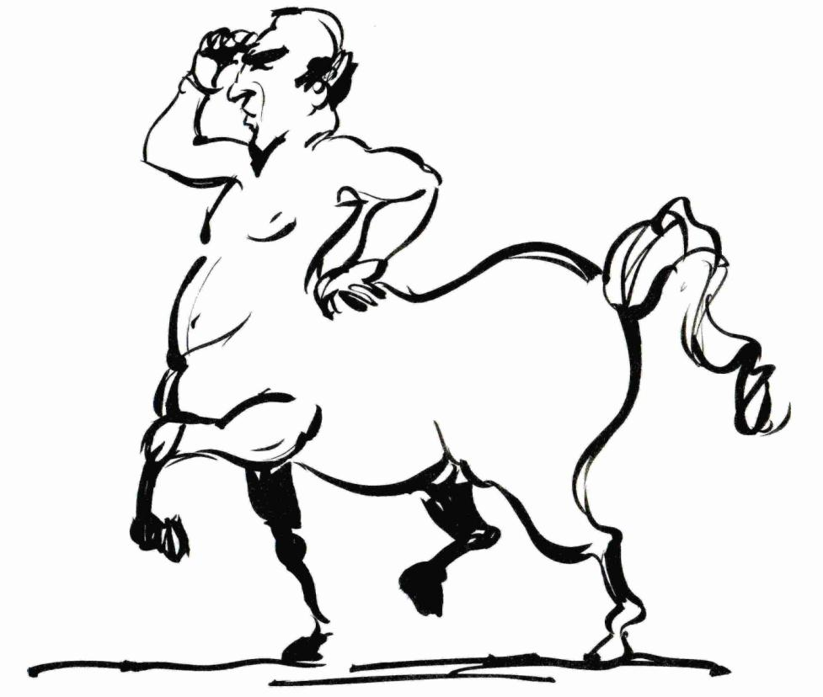
Het oog van de meester maakt het paard vet The master’s eye makes the horse fat

Slide 3
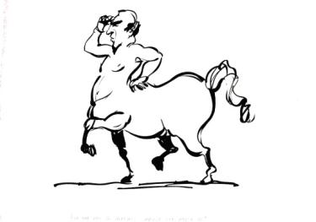
Het oog van de meester maakt het paard vet The master’s eye makes the horse fat
Know and understand your associates and students
Understand the society you are operating in
Be there and serve as an example
Be available to help and coach

Slide 4
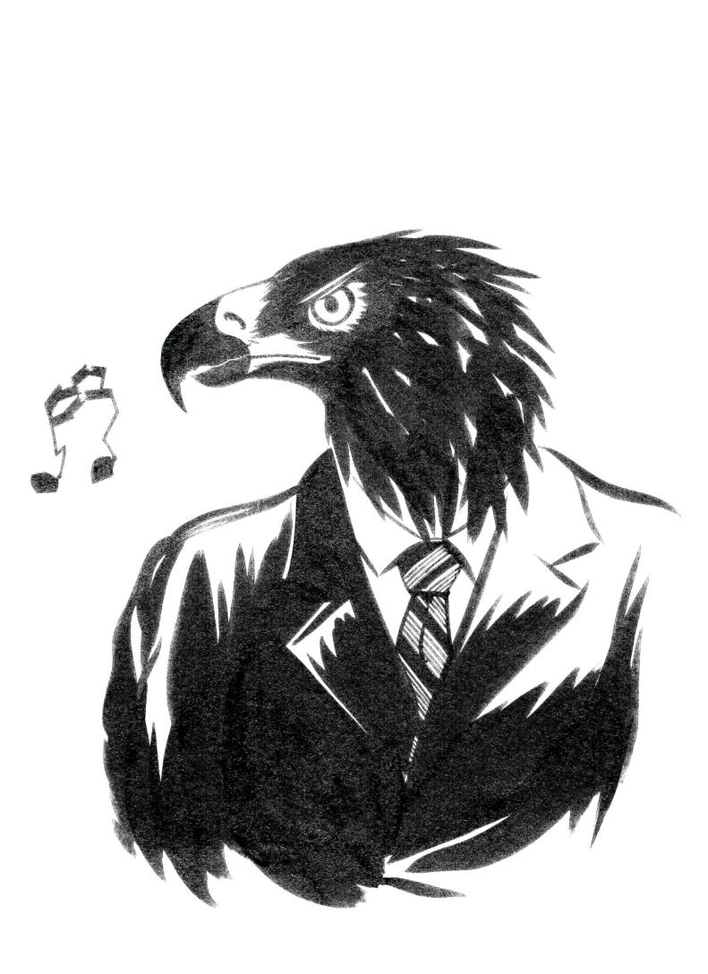
Iedere vogel zingt zoals hij gebekt is The bird is known by its note, the man by his words

Slide 5
Iedere vogel zingt zoals hij gebekt is The bird is known by its note, the man by his words
Every associate and every student is different
Search for complementarity and build teams
Sometimes, the most creative people are difficult persons
Timid, shy associates have sometimes more to say than loud callers

Slide 6
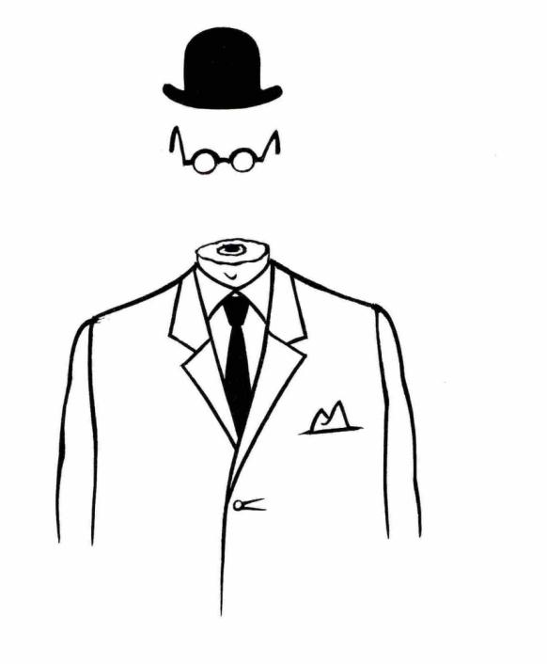
Zachte heelmeesters maken stinkende wonden The tender surgeon makes a foul wound Desperate cases call for desperate remedies

Slide 7
Zachte heelmeesters maken stinkende wonden The tender surgeon makes a foul wound Desperate cases call for desperate remedies
When necessary, take tough decisions
Problems never solve themselves
It’s an illusion that “time will solve problems”
When 2 colleagues can not work together: issues need to be solved fundamentally

Slide 8
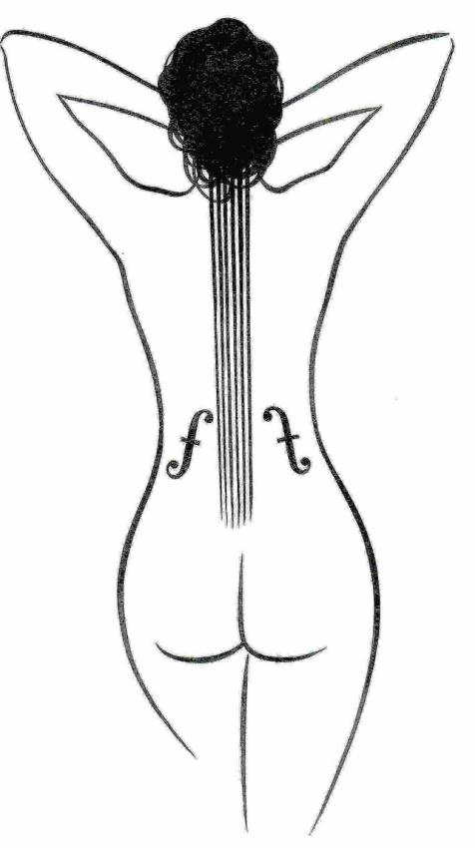
Mooie liedjes duren niet lang Good things never last forever

Slide 9
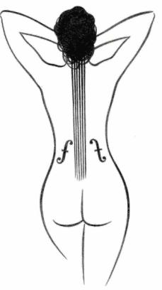
Mooie liedjes duren niet lang Good things never last forever
After sunshine comes rain
When everything looks bright, prepare for difficult times
When everything is difficult, act for a better future
When everything goes bad: smile and give your associates courage

Slide 10
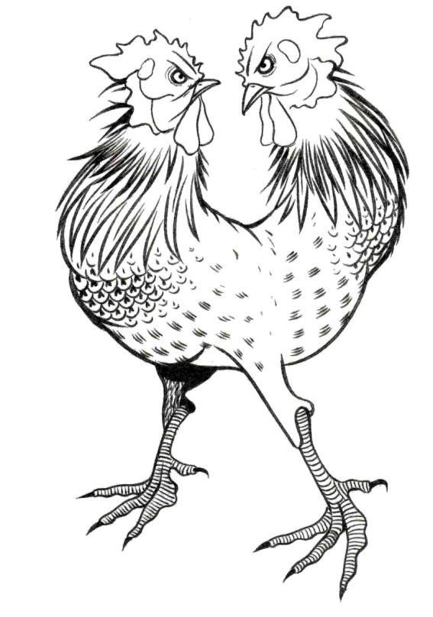
In een kippenhok is er maar plaats voor één haan Too many cooks spoil the broth

Slide 11
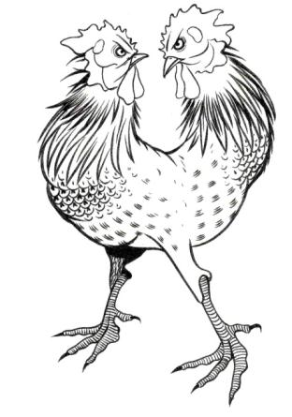
In een kippenhok is er maar plaats voor één haan Too many cooks spoil the broth
Each group needs a leader
First listen and then take your decision: no democracy
The boss must take his responsibility, but he should also be able to delegate
Never pass the buck to a colleague

Slide 12
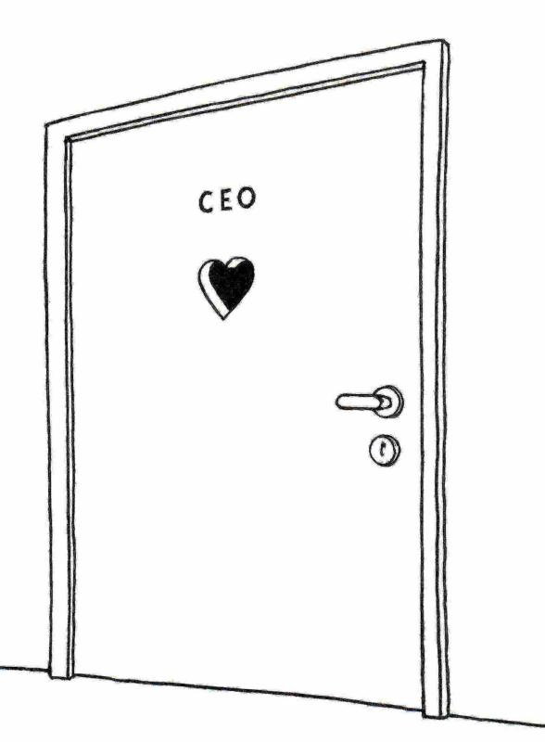
I like People I like People

Slide 13
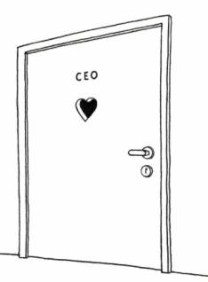
I like People I like People
You can only be a good boss when you like working with people
Be happy with the success of your associates
Love coaching
Educate and train your people

Slide 14
De boog kan niet altijd gespannen zijn A bow long bent at last waxes weak all work and no play makes jack a dull boy

Slide 15
De Boog kan niet altijd gespannen zijn A Bow long bent at last waxes Weak all work and no play makes jack a dull boy
When we feast… we feast, and when we work… we work
Happy hour = communication time
We feast in team
No routine feasts, also there one must be creative

Slide 16
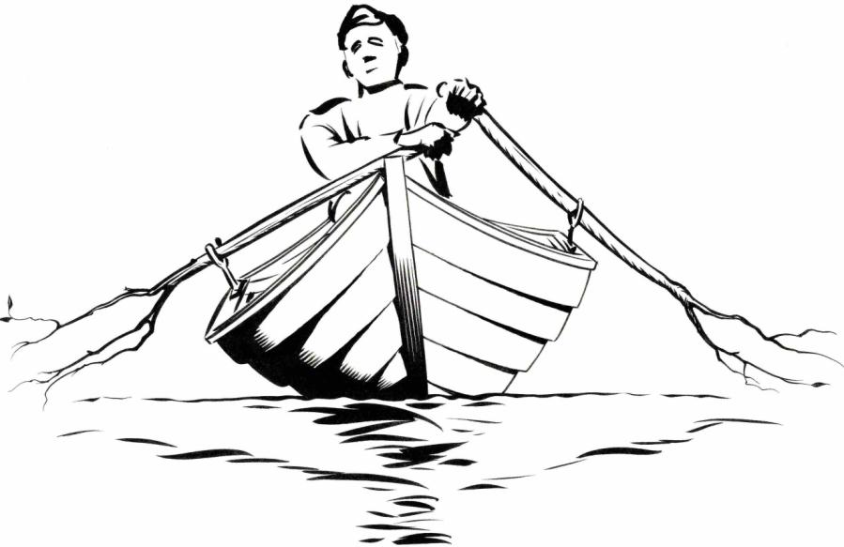
Men moet roeien met de riemen die men heeft You must plough with such oxen as you have one must make shift with what one has

Slide 17
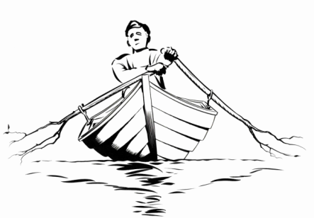
Men moet Roeien met de Riemen die men heeft You must Plough with such Oxen as you have one must make shift with what one has
You know the shortcomings of your associates
You know the talents of your new associates, at least on paper
Push your associates to use their talents at most
Push your associates to be more creative: everybody can be creative

Slide 18
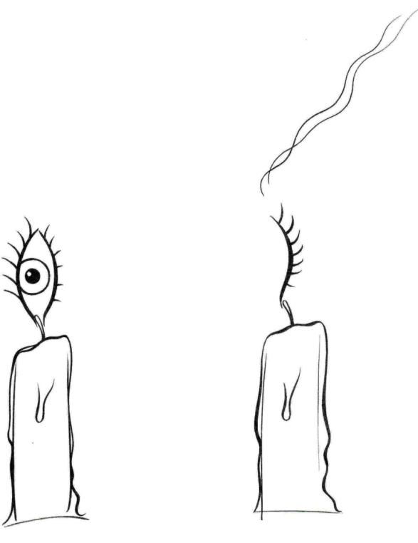
Wat baten kaars en bril als de iil niet zienen wil There are none so blind as those who will not see

Slide 19
Wat baten kaars en bril als de uil niet zienen wil There are none so blind as those who will not see
Be accessible for new things, new trends, new views
Search for innovation, for excellence
Take a 360° view
Look from the outside towards the inside

Slide 20
EUHOFA BELGIUM 2012 11 -16 november
Motivation in the hospitality industry
from the bottom to the top.
November 15 – Hugo Baron VANDAMME
Management & Motivation by Proverbs

