Slide 1
Hospitality Excellence
Hospitality Excellence Program
Notes:
Deze presentatie toont de nieuwe mogelijkheden van PowerPoint en kan het beste worden bekeken als een diavoorstelling. Deze dia's zijn ontworpen om u fantastische ideeën aan te reiken voor de presentaties die u gaat maken in PowerPoint 2010.
Voor meer voorbeeldsjablonen klikt u op het tabblad Bestand en klikt u vervolgens op het tabblad Nieuw op Voorbeeldsjablonen.

Slide 2
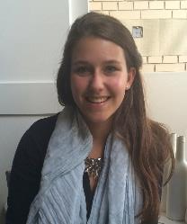
Quick introduction
Merel Vis
Participant in 2014
Concerning CSR concept
Student at Hotelschool The Hague
Mark Spoor
Participant in 2013
Internship at KHN in 2014; HEP
Responsible for Knowledge at KHN

Slide 3
The Hospitality Excellence Program

Slide 4
Hospitality Excellence Program
The hospitality excellence program is a co-creation between the Association of Hospitality Management Schools and the Royal Dutch Association for Hospitality Entrepreneurs (KHN).

Slide 5
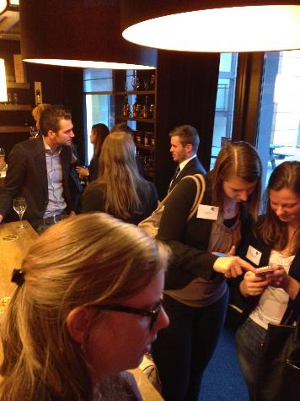
Hospitality Excellence Program (HEP)
Started in 2013
Collaborative networking teams of ambitious students from different schools
Real life ‘wicked’ problems from the hospitality industry
Professors and researchers work with teams
Design thinking methods
Notes:
Xander will do a similar talk in his part, so I’ll keep this really short and/or add on Xander’s story

Slide 6
A student’s perspective
Notes:
I am Merel Vis and I am a third year student at the Hotelschool The Hague. I participated in the HEP program in 2014 concerning CSR.
I will talk you through the methodologies we were thought and applied throughout the program. And I will tell you something about the end result of my team.
And I will give you the student perspective on what the program adds and what still can be improved.

Slide 7
Methodology
Specify what area CSR to research
Accessibilty
Brainstorm
Mental disability: Autism
Physical disabilty: Wheelchair users
Guest journey
Lunch scenario
Notes:
All students from HTH that

Slide 8
Methodology
Interviews and shadowing
Persona’s
Adele
Sander
Prototyping
Wish app
Adjustable furniture
Booklet
Business model canvas

Slide 9
Product

Slide 10
What was in it for me?
Networking with other hotelschool students and professors
Insight in real life business
Intensive coaching
In-depth research

Slide 11
What can be improved?
Setting the right expectations
About what happens with the concept?
Planning during sessions
More time with the team
More updates in between sessions

Slide 12
The Industry’s Perspective

Slide 13
Why collaborate?
To intensify relationships between education – industry
To build towards a shared center of excellence
Notes:
Hotel Schools operated individually, had their own research and their own lectorates (like islands in a sea of knowledge). Our goal was to build bridges between schools, to intensify relationsships between schools and between schools and the industry.
In this, we can build towards a shared ‘center of excellence’ .
Wherein we’re able to build a knowledge network to share and develop knowledge together.
We are able to attract and motivate students with relevant challenges that are bigger than ‘one company’
And entrepreneurs no longer need to rely on a system but can collaborate within a structure of knowledge, to grow, share questions and results
In short: to provide a network wherein education, entrepreneurs and students collaborate under a common interest: Knowledge.

Slide 14
Insert: Hospitality Excellence
Experimental
Facilitating collaboration on a wider scale
Valuable for all parties involved.
Notes:
HEP was created as a experiment to facilitate this collaborations and work towards these common goals. We brought together the five best students from the five schools, guided by some of the finest researchers and experts. We formulated challenges out of the industry and guided the students through a process of learning.
We facilitated collaboration on a wider scale: Between students from different schools, between students and experts, between the industry and schools. All while trying to be a valuable medium for all parties involved.

Slide 16
What’s in it for the industry?
Increased collaboration in education
Teaching students different ways of thinking
Informing hospitality entrepeneurs with relevant and novel developments and insights
Notes:
Explained in detail in the next 3 slides

Slide 17
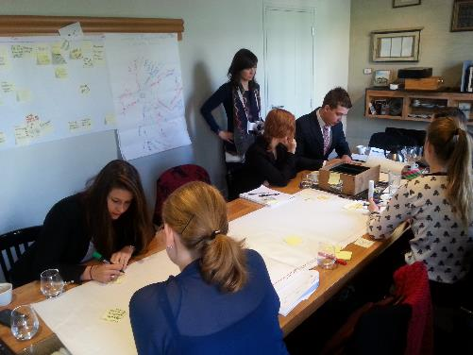
Increasing collaboration
Sharing knowledge
Collective academic agenda
Bridging the gap
Notes:
Sharing knowledge, introducing networks
Working towards a shared academic agenda, wherein schools collaborate in research efforts
Bridging the gap between schools, and between schools and the industry.

Slide 18
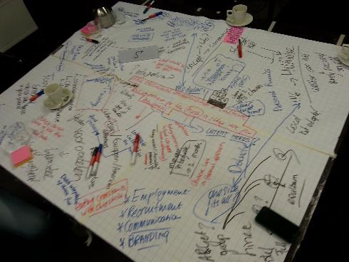
Teaching new ways of thinking
Futureproofing our students
New challenges: Wicked problems & new models
Notes:
Traditional models won’t sustain. The hospitality industry develops itself in a slower pace than other industries, but it will develop. We see new models, technology changes the way the consumers think and act. We don’t want to pay for something ordinary, they want excitement, they want experiences. Etc….
In order to prepare students for a future that cannot be predicted yet – to futureproof them – we need to teach them to think differently. For the hospitality excellence program we borrowed from design thinking methods (developed by stanford), to teach hospitality students new ways of looking at problems, to dig deeper in target groups by applying emphaty based research methods and to be creative with business models. We focus on creativity, critical thinking and collaboration.

Slide 19
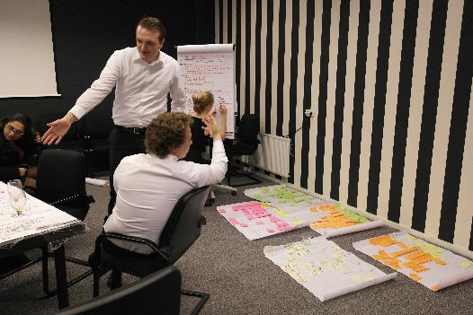
Informing the industry
Challenges formulated by the industry
Generating insights and development
Notes:
The challenges that are being used during the hospitality excellence program, were formulated by our domain advisors: They are our panel of industry experts, all entrepreneurs themselves, which are in constant contact with their specific domain (food, drinks, sleeping or leisure)
Students work on these challenges during the program and generate relevant insights during the process: A deeper understanding of an emerging problem, or a new perspective on an existing one. Insights within the hidden needs and wants of a specific target group or persona, their motivations to do something, or to abstain from something.They offer possible solutions to tackle it, create inventive new business models and offer us a creative view into a possible future.

Slide 20
Results
Extended networks
Knowledge sharing
New insights
Enthusiasm
Notes:
I’ll add some examples of positive results from the previously mentioned goals.

Slide 21
However
It’s a work in progress…
Notes:
I’ve mentioned some positive results. And quite frankly, we are very happy to organize
It’s still a work in progress.
HEP started as an experiment, with a strong structure and a strong academic base, wherein design played a mere fraction of the process and eventually dissapeared in the end.
In the second edition, we chose to go with a looser, more creative process, with a strong design base, but lacking in academic body.
One had a strong focus on results and research, one on creating a novel concept.
Both had their advantages and their disadvantages.
It remains a learning experience – for us as organization as well and and we are yet to find the sweet spot between design and academic base. All whilst managing the expectation of all parties involved and utilizing the limited amount of time you have.
However, you never progress if you never try. And the worst that could happen is that you learn something.

Slide 22
Q&A

