Slide 1
Exceeding Tourists Expectations: New Directions in Tourism Research
Mary Mutisya-(PhD)

Slide 2
The quality of tourism experiences an antecedent of customer satisfaction are a key determinant in the measurement of the attractiveness of a travel destination.

Slide 3
Tourism experience
Pre
(anticipation)
During
Post (recollection)
Getting there [and back]

Slide 4
The major indicators of quality tourism experiences are:-
The attractions and activities: core factors in travel experiences;
Travelling mediation with family and friend(s) is an important social factors affecting ‘the experience’.
The support component (amenities) i.e service providers, public sectors, relating organization, and local communities play an important factor too in the experience.

Slide 5
Zehrer, (2009), (Limassol, 2010), Frochot & Batat (2013) and Chan, To and Chu, (2016) observe:
an emergence of a tourist with new expectations of products and services hence the need to review traditional measures of satisfaction

Slide 6
Service quality measures now inadequate
Utilitarian products are based in their functionality
Tangibles
Responsiveness
Assurance
Empathy
Reliability

Slide 7
The competitive advantage shifts from quality to experiences, the ‘experiences’ have became an important factor affecting differentiation from competition.
Research shows that subjective, affective and experiential factors of tourists comprise a substantial portion of consumer satisfaction with services
The adaptation of experiences to organizational strategy therefore is critical.

Slide 8
the ‘Experience’ concept which evolved from mass customization has a significant role in the provision of culture, art, leisure and tourism.
It engages visitors in a series of memorable activities that are inherently personal, engaging the senses, emotions, physical, spiritual, or intellectual level.
It relies on the creation of experiences that are highly emotional and memorable- it is ‘hedonic consumption’!

Slide 9
the hedonic products have a sensory stimulation, emotions and fantasies.
the fundamental difference between hedonic and utilitarian products lies in their functionality.
Utilitarian products perform purely instrumental functions;
the hedonic products have a sensory stimulation, emotions and fantasies.

Slide 10
Arnould & Thompson’s (2005) Consumer Culture Theory (CCT) attempts to understand such consumption behavior through ‘Multiple Lenses’ by illuminating the contextual, symbolic, and experiential aspects of consumption.
Frochot & Batat (2013) refer to it as a shift from modernism to postmodernism.

Slide 11
Voss, Spangenberg & Grohmann (2003), as observed by Batra & Ahtola (1990) made an early attempt to measure the multiple dimensions of product/brand attitudes.
The study shows that consumers purchase goods and services and perform consumption behaviors mainly to satisfy the consummatory affective (hedonic) domain and secondly the instrumental domain for, utilitarian reasons.
The authors suggested an adoption this two-dimensional conceptualization of consumer attitudes.
However, this approach is not without its challenges, Batra and Ahtola (1990) acknowledge the difficulty in capturing both dimensions with an all-inclusive measurement tool.

Slide 12
Measurement on Destination Emotion Scale (DES) scale
Hosany and Gilbert (2010) constructed the (DES). The DES measures the diversity and intensity of tourists’ emotional experiences and consists of three dimensions:
Joy, (2) Love, and (3) Positive Surprise
Joy: (cheerful, delight, enthusiasm, joy, and pleasure)
Love: affection, caring, love, tenderness, and warm-hearted
Positive Surprise: amazement, astonishment, fascinated, inspired, and surprise

Slide 13
Measurement on HED/UT scale
Utilitarian
Necessary/unnecessary
Effective/ineffective
Functional/not functional
Practical/impractical
Helpful/unhelpful
Hedonic
Dull/exciting
Not delightful/delightful
Not fun/fun
Not thrilling/thrilling
Boring/interesting

Slide 14
Case of theme festivals(nights) in Kenya
https://www.youtube.com/watch?v=gdK26bnrclU
https://www.youtube.com/watch?v=DhF5zrPwFmc
https://www.youtube.com/watch?v=t3jJ06ErcqY

Slide 15
One of the reasons for attending a festival is “known-group socialization.”
Theme nights may offer a hedonic reason to some people while offering utilitarian justification to others
Festival visitors are likely to be seeking unique experiences, cultural enrichment, education, novelty, and socialization
Such visitors seek hedonic attributes rather than the utilitarian attributes

Slide 16
Reasons for attending theme festivals
Uniqueness, symbolic meaning, or the emotional arousal and imagery it evokes
Identity with ones roots
Have fun, to have a good time, to party, or to socialize
Novelty or curiosity

Slide 17
Both hedonic and utilitarian dimensions to festival attendance are important
both perceived utilitarian and perceived hedonic attributes of festivals significantly influence people’s festival attendance.
that perceived hedonic attributes have a significantly greater influence on festival attendance patterns than perceived utilitarian attributes.

Slide 18
Festivals provide utilitarian value (functional utility) through satisfying physical needs and hedonic value through responses evoked during the interpersonal or social, and personal experiences

Slide 19
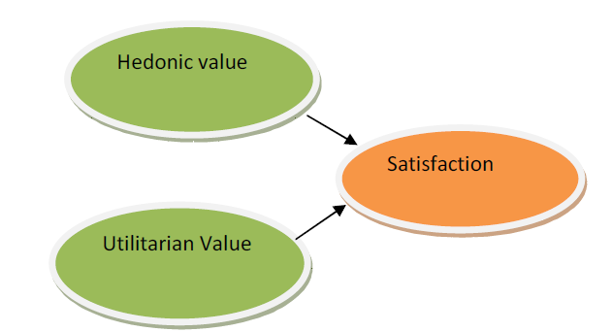
conclusion
The HED/UT scale is acceptable in H&T

