Slide 1
Euhofa International 55th Congress Nairobi, Kenya.
Green Hotel
Sustainable livelihoods initiative
BY
Dr. Isaac Kalua , Founder & Chairman of Green Africa Foundation

Slide 2
Need to utilize the environment without jeopardizing the ability of future generations to meet their own needs

Slide 3
‘GREEN’
IN 3 FOLD

Slide 4
1st ‘green’
Treating people kindly
Moral values and ethics (life skills)

Slide 5
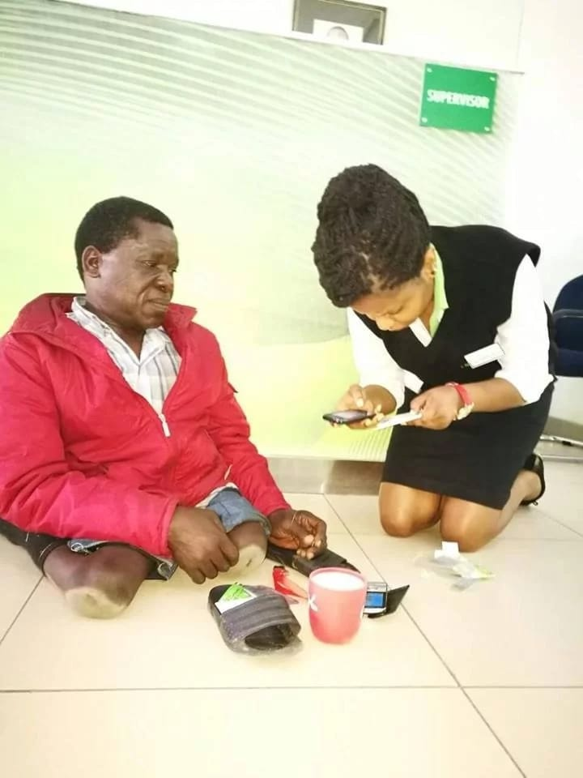
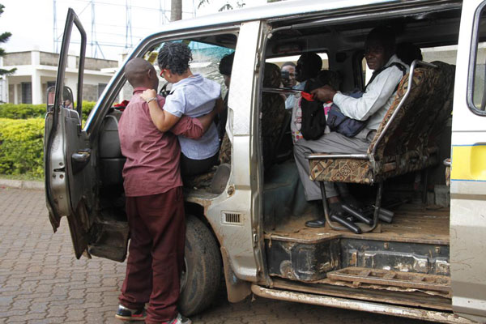

Slide 6
2nd ‘green’
Peace, Health and Creating Livelihoods

Slide 7
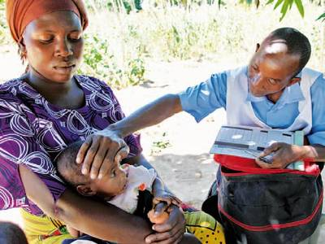
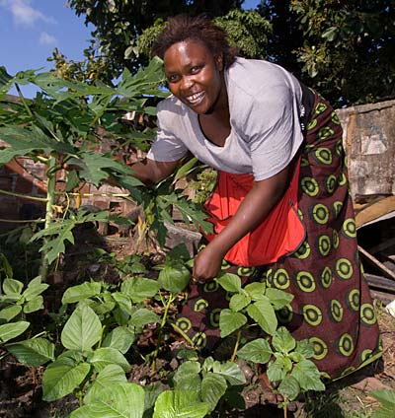

Slide 8
3rd ‘green’
Actual Environmental Conservation

Slide 9
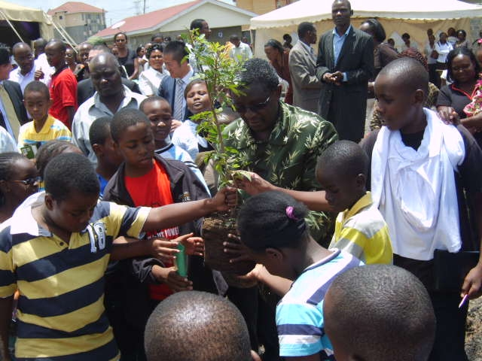

Slide 10
What is a Green Hotel?
A green hotel is a hotel that operates on the principles of the Green Economy. UNEP defines green economy as, "one that results in improved human well-being and social equity, while significantly reducing environmental risks and ecological scarcities. It is low carbon, resource efficient, and socially inclusive" (UNEP, 2011).

Slide 11
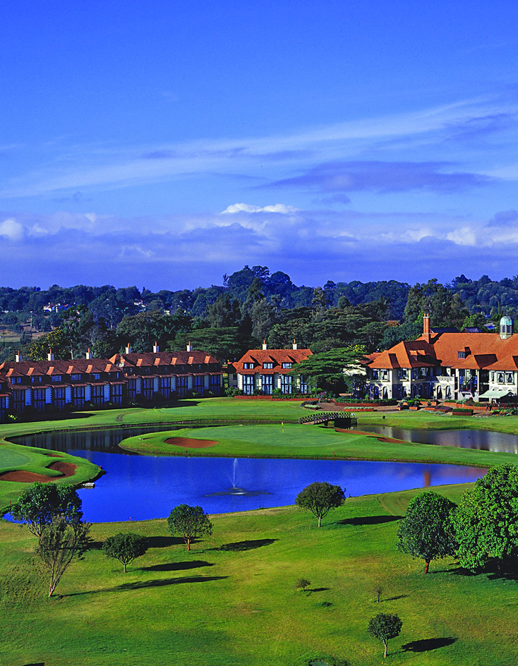
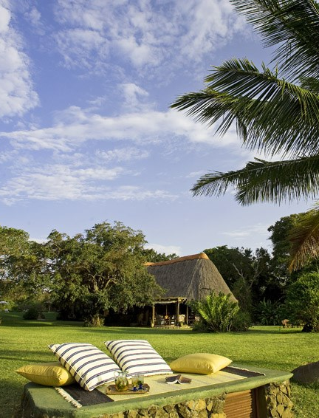

Slide 12
Green Hotels Improve Human Wellbeing
Green Hotels improve human wellbeing through the following:
Fair pay of their employees:
As of 2011, hotels employed 260, 417, 000 people which is 9% of total employment (World Travel and Tourism Council)
Economic empowerment of local communities through purchase of local goods and services
Purchase of local food
Employment of both skilled and non-skilled locals
Using hand woven products for decorative purposes
By improving human wellbeing, a green hotel also ends up improving social equity.

Slide 14
Green Hotels are Low Carbon
Use of renewable energy:
Use of hybrid cars and/or electric cars for hotel transport
Charging points to recharge electric car batteries.
Solar panels that provide guests with hot water and heating.
Following Michelle Obama’s footsteps and planting organic vegetable gardens to supplement vegetables consumed by hotel guests.
Waste recycling and optimal waste management by adoption of practices like paperless operations.

Slide 15
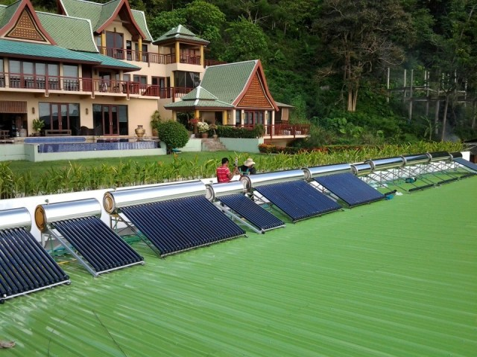
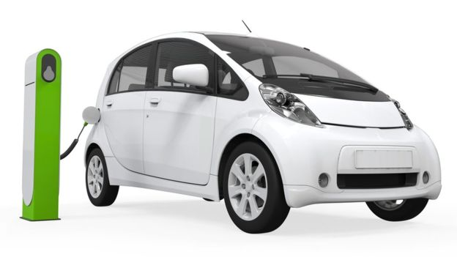
OFFICE

Slide 16
Green Hotels are Resource Efficient
Utilization of low energy consumption and LED alternatives.
Installation of reactive energy compensators. This increases the maximum active power that can be transmitted in the hotel’s energy systems and compensates voltage regulation thus decreasing voltage fluctuation.
Utilization of digital energy management systems: Energy-management systems (EMS) can reduce energy consumption by 10 to 30 percent. Through these systems, one can measure, monitor and regulate energy-using systems.
Card activated automatic light systems in rooms.
Provision of energy efficiency information to guests
Energy efficient buildings that have features like:
Double glazing used in exterior doors and windows, which facilitates saving energy used on heating.
Advanced house framing. This saves energy by using less wood and more insulation.
Cool roofs that are designed to reflect sunlight and lower roofing temperatures. This saves on air conditioning costs.
Automatic disconnection of the air conditioning system when exterior doors and windows are opened in rooms.
Partial flush systems used in toilets.

Slide 17
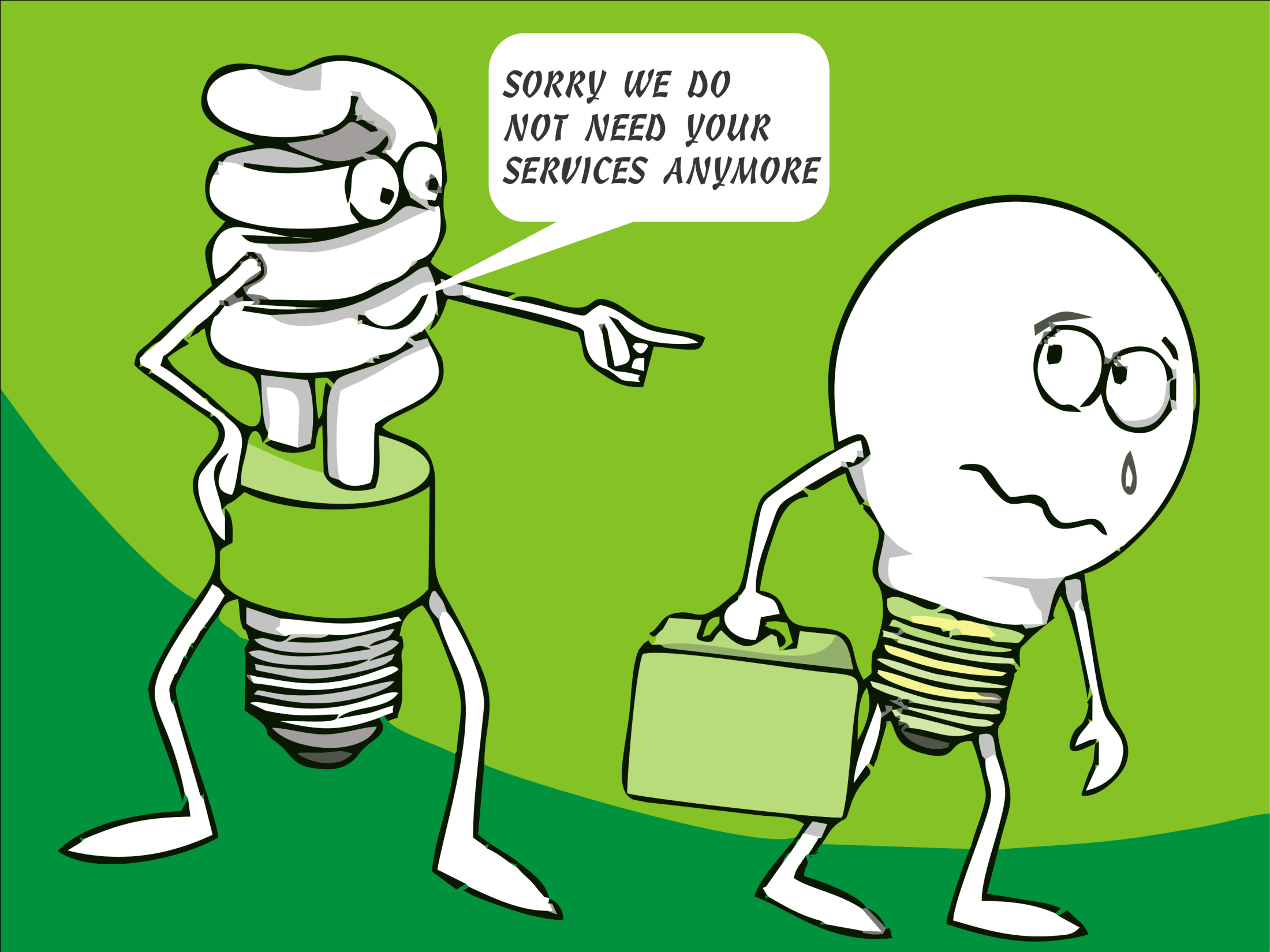

Slide 18
Green Hotels are Profitable
On TripAdvisor the World’s largest travel site, travelers can tailor their search for hotels participating in the TripAdvisor Green Leaders program and view a detailed list of environmentally-friendly practices that they can expect at each location.
A TripAdvisor survey revealed that 79 percent of travelers place importance on properties implementing eco-friendly practices. In this regard, Green becomes profitable since it becomes a distinguishing feature that traveler can use to choose a hotel.

Slide 20
Green Hotels implement the ISO 14001 Environmental Management system
This is the International Environmental Management Standard. It certifies that reducing the environmental impacts of operations and maintaining profitability are given equal treatment in hotels. This standard has features that include:
Environmental Policy
Has the organization defined and documented its environmental policy?
Environmental Aspects
Has a procedure been established, implemented and maintained to identify the environmental aspects of its current and relevant past activities?
Are these environmental aspects considered in sufficient detail? Air emission; wastewater effluent; waste management; soil pollution; raw materials and natural resource usage; hazardous and toxic material; impact on wellbeing; utility, energy and resource;
Legal and other requirement
Has a procedure been developed and implemented to identify applicable regulatory, legal and other requirements?
Are licenses like wastewater discharge permit available to demonstrate full legal compliance?
Objectives, targets and programmes
Have environmental objectives and targets been established at each relevant function and level in the organization?

Slide 21
Resources, roles, responsibility and authority
Have responsibilities and authorities for environmental management been defined and documented?
Competence, training, and awareness
Are all personnel, whose work can cause significant environmental impacts, competent on the basis of education, training and or experience?
Communication
Are procedures maintained for communication of environmental issues between various levels of the organization?
Operational control
Are activities associated with significant environmental aspects planned and carried out under specified conditions?
Monitoring and measurement
Has any environmental performance indicator that relates to objectives and targets been established?
Are documented procedures established, implemented and maintained to periodically evaluate compliance with relevant environmental legislation and other requirements?
Management review
Do periodic management reviews take place to ensure the continuing suitability and effectiveness of the Environmental Management System?

Slide 23
Conclusion
“Tourism can significantly reduce its ecological footprint and that it can become an engine of innovation for green, inclusive, and low carbon economies, and safeguard cultural creativity, diversity and human and ecosystem wellbeing.” World Summit on Sustainable Tourism+20
Green Hotels are key drivers and beneficiaries of domestic tourism and international tourism whether it is for leisure or business.

Slide 24
