Slide 1
EUHOFA BELGIUM 2012 11 -16 november
Motivation in the hospitality industry
from the bottom to the top.
Tuesday, November 14
– Dr. Luc De Grez -
Useful motivational concepts to improve learning

Slide 2
Motivation = internal state that arouses, directs and maintains behaviour

Slide 3
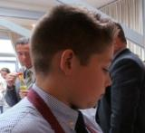
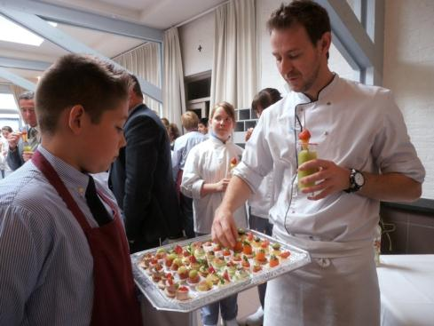
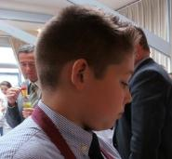
Self-Regulation
I can do this! It was a stupid idea that everything would fall to the ground!
O help! There’s my teacher!
I will tremble! Everything will fall to the ground
So far so good!

Slide 4
Social cognitive theoretical framework (Bandura)
-Self-efficacy
-Goal (orientation)
-Attribution

Slide 5
Self-efficacy
Mastery experience
Modeling
Verbal persuasion

Slide 6
Mastery experience
He’s doing well!
Yes, I can do it!!!

Slide 7
Modeling: expert model
Ah, he does it that way!!!

Slide 8
Modeling – coping model
Thank you for the advice!
If that girl can make this, I can make this too!
I like to help him! He’s so cute!

Slide 9
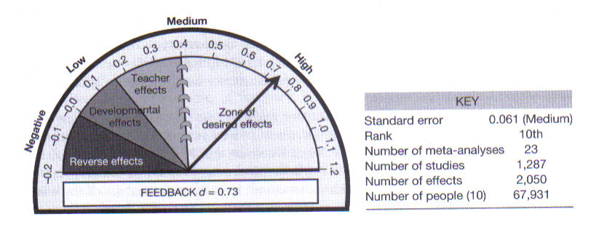
Verbal persuasion Effect of feedback summary of meta-analyses (Hattie, 2009)

Slide 10
Verbal persuasion
You’re fantastic! You’re wonderful!
Good feedback
Stimulates and dialogue
More “Process” and less “Product”
Feed up: Where am I going? (goals)
Feed back: How am I going?
Feed forward: Where to next?

Slide 11
Conclusions till now – 3 sentences
Individual
With one neighbour

Slide 12
Goal orientation
I’m worried that I will not remember it
I hope I don’t fail!
I want to learn this because it’s important!
I hope I get good grades!

Slide 13
Goal orientation = reason for engaging in achievement behaviour
I want to learn this because it’s important!
Mastery learning Skills increase through effort
Performance learning Fixed ability – show ability
I hope I get good grades!
Role of the teacher

Slide 14
Goals
Specific
Moderately challenging
Self-set
Multiple goals - Goal hierarchies

Slide 15
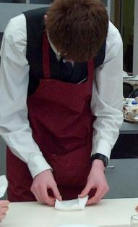
Attribution
Perceived causes!!!
This is not good!! That’s because I did not practice it like the teachers said!!
Locus : internal or external
Stability = duration of cause
Controllability

Slide 16
I hope you enjoyed the presentation and that you have learned something !

Slide 17
References
Bandura, A (1986). Social foundations of thought and action. A social cognitive theory. Englewood Cliffs, NJ.: Prentice-Hall.
Dai, D., & Sternberg, R. (Eds.) (2004). Motivation, emotion, and cognition. Integrative perspectives on intellectual functioning and development. London: Lawrence Erlbaum.
Elliot, A., & Dweck, C. (Ed) (2005). Handbook of competence and motivation. The Guilford Press.
Hattie, J. (2009). Visible learning. A synthesis of over 800 meta-analyses relating to achievement. London/New York: Routledge.
Nicol, D., & Milligan, C. (2006). Rethinking technology-supported assessment practices in relation to the seven principles of good feedback practice. In C. Bryan & K. Clegg (Eds.), Innovative assessment in higher education (pp. 64-77). London: Routledge.

