Slide 1
Hospitality Industry & Hospitality Education: An Epitome of Ambivalence?
Dr. Kenneth S. Ombongi, OGW
Notes:
1. Protocol: EUHOFA President, Maria; Chairman KUC Council; EUHOFA delegates, the Kenyan Industry stakeholders; ladies & gentlemen. 2. Discussions & recommendation at ROC Mondarian : Hotel school at the Hague on the 9th May, 2014: has come to pass: It is with a lot of humility that I salute the fellow Board members who supported my appeal and we are here today. All the EUHOFA be sure that you have a full page for yourselves in my memoirs when I write them some day in the future!

Slide 2
Sources
Anecdotes
Notes:
Context: This work in progress in which I want to use the historical methods to analyze relations between the industry and education. Anecdotes: My 2344 days in KUC and the attendant experience.

Slide 3
Sources
Secondary data

Slide 4
Sources
Interviews

Slide 5
Hospitality Industry
Hospitality Education
Notes:
Juxtapose the Hospitality Industry & Hospitality Education sectors. This is to enable me to argue that, beneath the veneer of a flourishing industry & growing training opportunities, there are interesting disjunctures, disconnections, in the relations between the 2 sectors – the industry and education. These disconnections, essentially, result in ambivalent/mixed relations trajectory which hinder mutual dependency and benefits between the 2 sectors. I propose to bring out these disconnections through a simple series of paradoxes, literal dialects, in the dynamics of the relations between 2 sectors. I will use examples from Africa and even more particularly from here in Kenya. And Finally, I will suggest that the future of the service quality in the hospitality industry lies in the salutary/helpful lessons from this trajectory of ambivalence.

Slide 6
Paradox 1
Paradox of a necessary evil:-
Hospitality education - recent phenomenon
Notes:
Kenya for example: 1960s – KUC – Frontline; Supervisory; Managerial staff
Government Ownership: ‘Governmentalism’
Cadre of professionals who made careers out of hospitality

Slide 7
Paradox 1
Paradox of a necessary evil:-
Hotel & Tourism Education – outdated
No capacity for training natural & cultural resource tour guides
Notes:
1980s and 90s
Isues of the sustainability of government-run hotel schools emerged

Slide 8
Paradox 1
Paradox of a necessary evil:-
Some level of ambivalence towards hospitality education from the industry
Some times good; some times bad
Some times positive; some times negative
Some times collaborative; some times adversarial

Slide 9
Paradox 1
Paradox of a necessary evil:-
Some training is better than no training at all
Semi-trained graduate is good for in-house training
Notes:
Industry feel: Obsolete training; limited capacity of the products of hospitality education but it is still necessary; we cannot make much without hospitality education.

Slide 10
Paradox 2
Paradox of scarcity among plenty:-
Massive expansion of training opportunities:-
Middle level colleges
Universities
Notes:
High rates of unemployment have made hospitality education very attractive because of the apparent guarantee of a job after completion.
These institutions are both private and public; some are recognized but there are others nobody knows they exist in officials circles;
It is difficult to get the number of personnel produced from all these institutions:- More than half of the 30 public universities offer courses in hospitality and tourism.

Slide 11
Paradox 2
Paradox of scarcity among plenty:-
Never mind about cost-cutting/balance sheet
Notes:
There are too many graduates out of institutions but very few can fit in actual work places. Too many and yet too few: scarcity among plenty.

Slide 12
Paradox 2
Paradox of scarcity among plenty:-
Cannot ‘Plug and play’

Slide 13
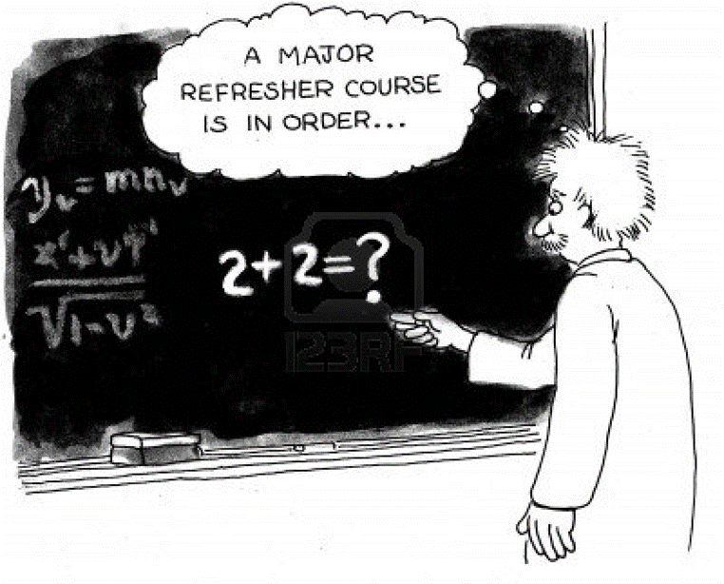
Paradox 2
Paradox of scarcity among plenty:-
Too theoretical

Slide 14
Paradox 3
Paradox of rich beggars:-
Employment creation
Average basic salary – US $100
Notes:
World Bank Report on Kenya tourism 2010: 483,000 jobs directly and indirectly; Many graduates are not sure whether they want to stay in the industry or not: banks; supermarkets & hospitals. Anecdote from my student: “Smiling at a patient in a hospital ward pays better than smiling at guests in a hotel lobby. I refused to be a rich beggar.

Slide 15
Lesson 1
Demand-driven Skills Training
Competitive Training
Notes:
Duality lessons: we can learn to avoid the trajectory of ambivalence which the industry has towards hospitality education.

Slide 16
Lesson 2
Technical skills
Conceptual skills

Slide 17
Lesson 3
International linkages
Local networking
Notes:
Technology transfer & sharing; on-the-job training; exchange of ideas.

Slide 18
We need each other!

