Slide 1
Designing hospitality experiences
November 4, 2014
Frans Melissen, Bert Smit, Geoff Marée

Slide 2
Meet: Frans
43 years, from Etten-Leur
Wife, no kids(!)
Professor Sustainable Business Models
Travels for business and leisure, loves zoos, enjoys dining out and movies
Plays golf
Doesn’t like crowds, does like to see new things, new cities, small villages, nature
“a hotel room needs to have a really comfortable bed and a practical bathroom (separate!)”

Slide 3
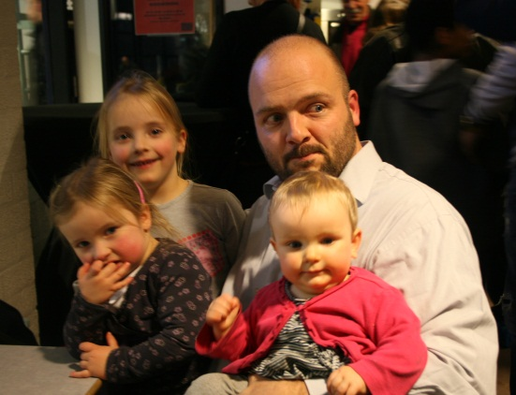
Meet: Bert
37 years, from the tiny village of Galder
Wife and four daughters(!)
Researching and Lecturing Service Design
Stays in hotels on business trips, goes to campsites with his family during holidays, loves the creativity of city entrepreneurs and design of zoos and themeparks
Fanatic bread and pastry baker
“a hotel should breathe the atmosphere of its surroundings, so that I know where I am when I wake up in the morning”

Slide 4
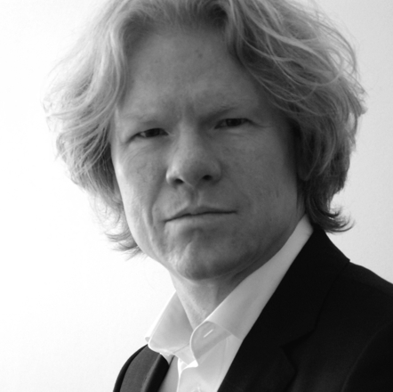
Meet: Geoff
52 years, from Breda
Wife, no kids
Lecturing and training Innovation, Imagineering, Design and Creativity in Hospitality
Travels for business and leisure, loves the fun of city-dynamics and the serenity of nature
Plays the drums in a band
Goes for new experiences, looks for inspiration and new trends
“a hotel is magic; it’s very intimate, but only for a short while”

Slide 5
Warmer upper
Take three minutes to share with your neighbour:
Your best and your worst hospitality experience
Summarize in two key-words: + and - !

Slide 6
Telepathy…..

Slide 7
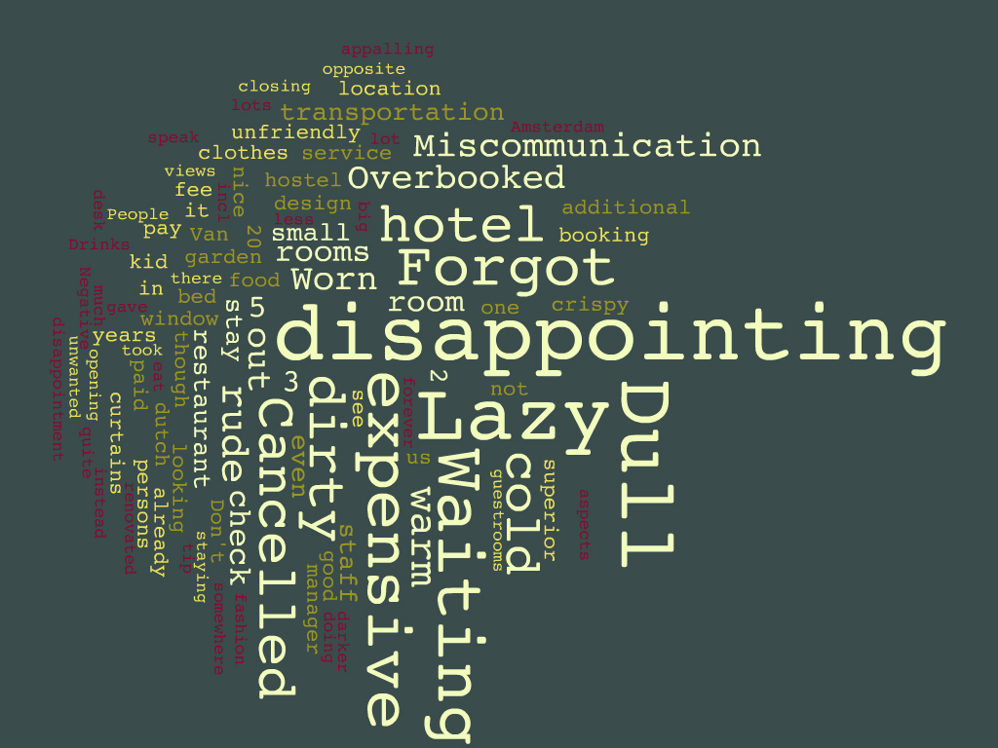
Negative:

Slide 8
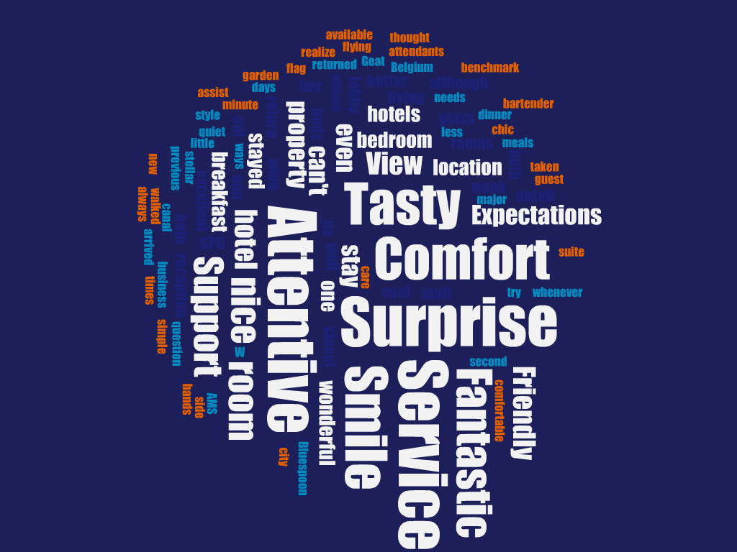
Positive:

Slide 9
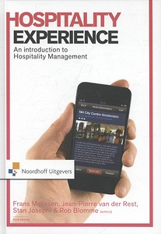
What to expect
We are going to address the following:
The structure of the design process
The tools and instruments of the design process
The creative approach of the design process
You are invited to experience:
1, 2 and 3

Slide 10
The structure
of the design process

Slide 11
Structure of the Design Process
Designing Hospitality Experiences starts with...
... the guest(s) you want to attract!
... their needs and wishes!
The Design Process cannot start without clarity about who you want to experience the hospitality experience(s) you are designing!

Slide 12
Structure of the Design Process
Understand your target group(s) and how they will experience your offer...
Personal context
experiences are context dependent
Personal context
Why are they there?
What goals do they have?
What is the purpose of your service for them?

Slide 13
Structure of the Design Process
Understand your target group(s) and how they will experience your offer...
Social
context
experiences are context dependent
Social context
Who is with them?
Who is serving them?
Who else is there?

Slide 14
Structure of the Design Process
Understand your target group(s) and how they will experience your offer...
Physical context
experiences are context dependent
Physical context
Objects, layout, appearance, house/brand style

Slide 15
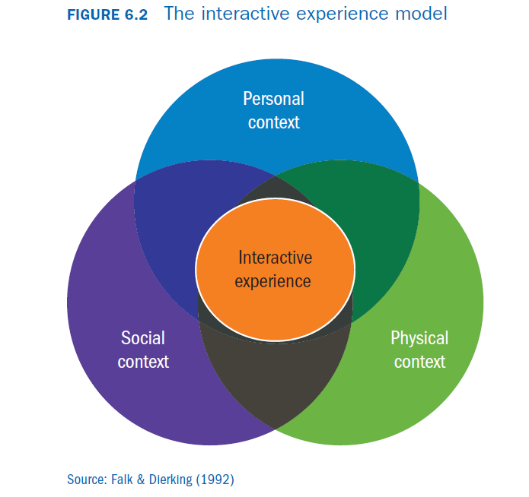
Structure of the Design Process
The combination of the personal, social and physical context create a specific experience

Slide 16
Structure of the Design Process
As a hospitality company you decide which type(s) of experiences you want to offer to which type(s) of guests!
This choice is the first step in the design process: deciding on your value proposition!
This value proposition describes the overall hospitality experience that you are offering to guests based on your values/brand.

Slide 17
Structure of the Design Process
This hospitality experience consists of multiple interactive experiences to create a specific customer journey:
time
Interactive experience = Touchpoint

Slide 18
Structure of the Design Process
Mapping all the interactive experiences or touch points that need to be created is the second step in the design process
time
Check-in
Relaxing in hotel room
Guest having breakfast

Slide 19
Structure of the Design Process
The third step in the design process zooms in on the individual touchpoints: what are the possibilities for shaping them!
Creating specific social contexts through interaction with our staff (and other guests)
Creating specific
physical contexts
(lobby, hotel room, restaurant, etc.)

Slide 20
Structure of the Design Process
The fourth step in the design process provides an overview of all possibilities for all touchpoints!
1
2
3
1
2
3
Fully staffed
Fully
automated
Elegant
Modern
Check-in process

Slide 21
1
2
3
1
2
3
Check-in
Hotel room
Restaurant
Gym
1
2
3
1
2
3
1
2
3
1
2
3
1
2
3
1
2
3

Slide 22
Structure of the Design Process
The fifth step in the design process generates design alternatives by selecting options per touchpoint!
1
2
3
1
2
3
Fully staffed
Fully
automated
Elegant
Modern
Check-in process

Slide 23
1
2
3
1
2
3
Check-in
Hotel room
Restaurant
Gym
1
2
3
1
2
3
1
2
3
1
2
3
1
2
3
1
2
3

Slide 24
1
2
3
1
2
3
Check-in
Hotel room
Restaurant
Gym
1
2
3
1
2
3
1
2
3
1
2
3
1
2
3
1
2
3

Slide 25
Structure of the Design Process
The sixth step in the design process a choice is made for the best design alternative!
1
2
3
1
2
3
1
2
3
1
2
3
1
2
3
1
2
3
1
2
3
1
2
3
1
2
3
1
2
3
1
2
3
1
2
3
1
2
3
1
2
3
1
2
3
1
2
3

Slide 26
Structure of the Design Process
The seventh and final step in the design process is to work out all details of the ultimate design!
Using a theatre analogy: you finalize the full script, including all scenes, instructions for all ‘actors’, decor and props, that together shape the customer journey that creates the hospitality experience you are offering.

Slide 27
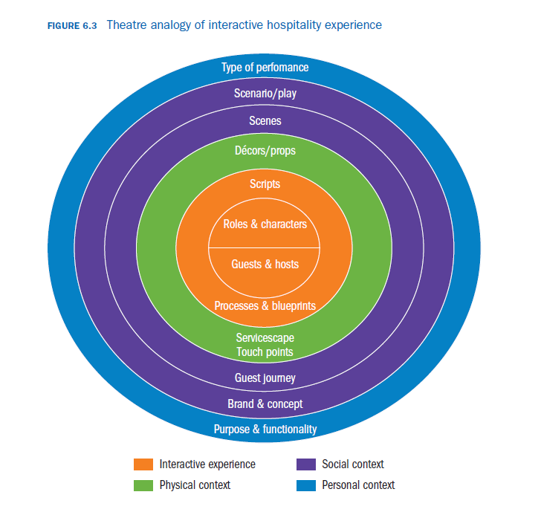
the design process:
seven steps

Slide 28
The tools and instruments
of the design process

Slide 29
personas
Morphological chart
Brand prism
Guest journey mapping

Slide 30
Using Personas as a starting point
Inspiration driven persona : prototype
Personas
Trigger empathy
Improves R&D
Improves internal communication

Slide 31
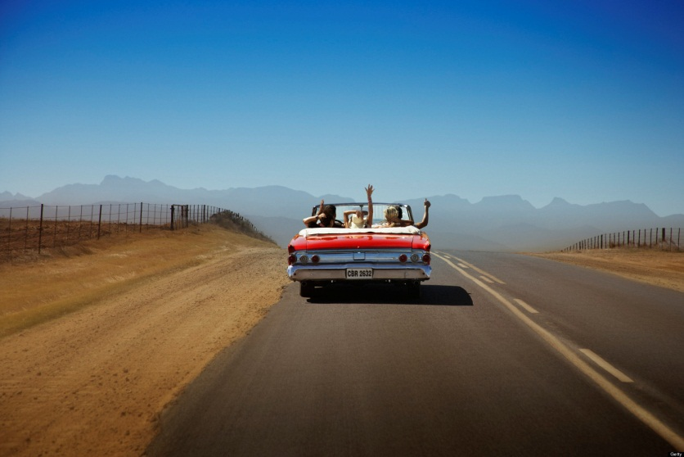
Persona
Data-driven persona : archetype
The Carefree Spirit
You don't like to be tied down
You like freedom to stay longer or head out
Having it all figured out before you go on vacation is not you.
You like to live in the moment and absorb your surroundings.
You travel best with one or two others that share your spirit and personality.
Group travel or trips with set itineraries may frustrate you.

Slide 32
Concept / Brand
Who are you, what is your identity?
How will you be recognized by your guests?
What are your values?
Who do you want to be for your guest?
Who is your ideal guest?
What should your brand say about your guests?

Slide 33
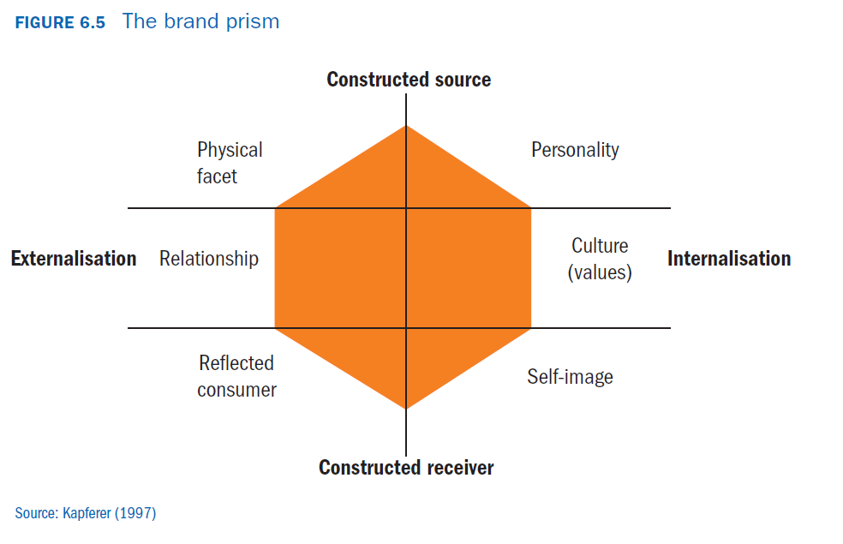
Concept / Brand

Slide 34
physique
Personality
Luxury hotels,
top locations, unique
Design, black & white
Luxury, prestige
Perfection, excellence
Relationship mode
Culture
Direct, friendly
personal
International, adapting
to local markets
Customer
reflected image
Self-image
When I travel my
expectations should
always be exceeded
successful business
travelers,
luxurious holidays

Slide 35
customer journey mapping
time
Pre
During
After
Touchpoint

Slide 36
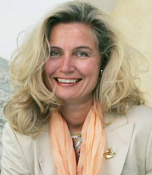
Patterns in customer journeys
Touchpoints outside the hotel

Slide 37
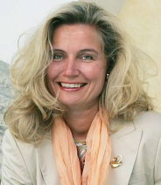
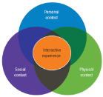
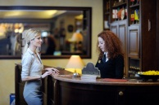
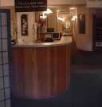
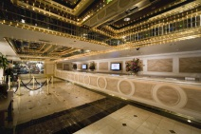
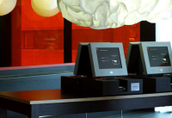
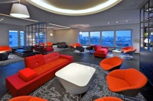
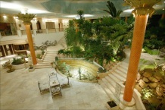
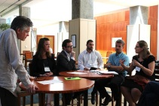
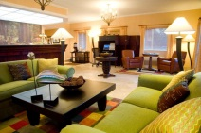
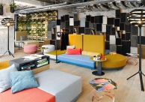
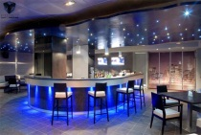
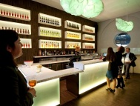
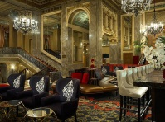
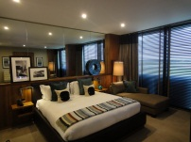
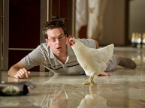
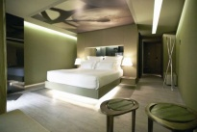
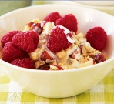
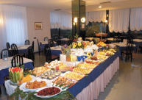
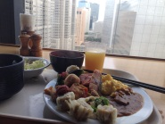
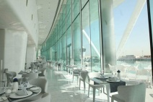
Morphological chart
Activity | alternatives
Check- in
meeting
Having a drink
Waking-up
breakfast
Activity | alternatives
Check- in
meeting
Having a drink
Waking-up
breakfast
1
2
3
1
2
3

Slide 38
The creative approach
of the design process

Slide 39
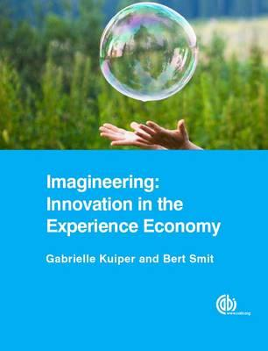
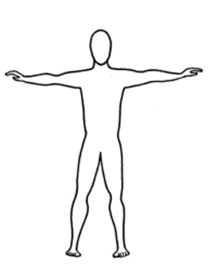
Based on: Componential model of Creativity, Amabile, 1995
information
implementation
inspiration
imagination
process
drivers
YOU
ENGINEERING
IMAGINATION
selecting
generating
T-shaped

Slide 40
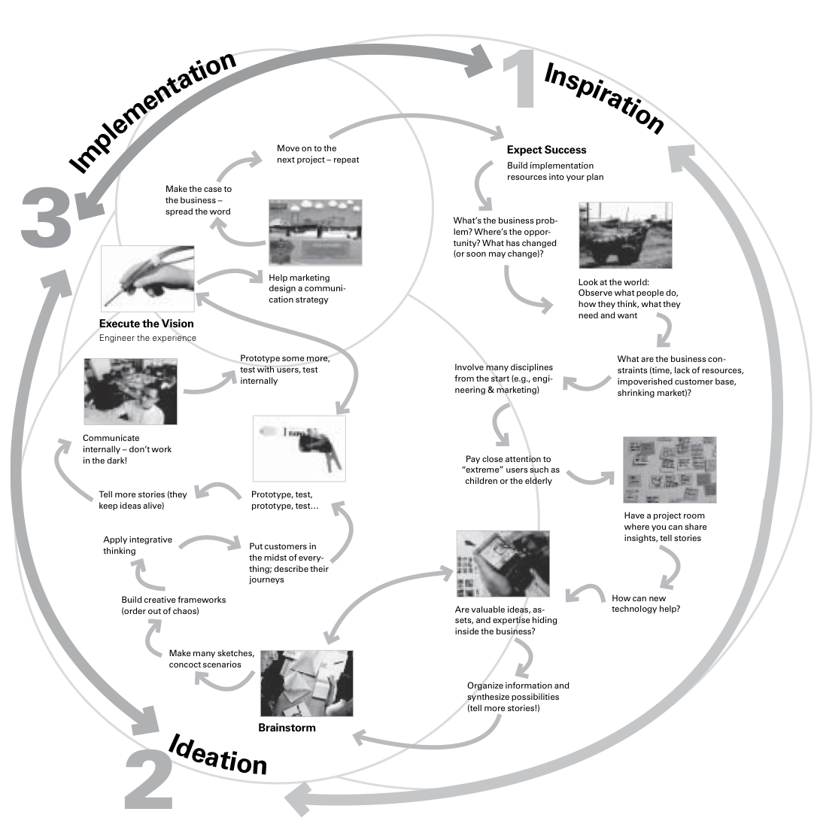
Design process, Brown, 2008

Slide 41
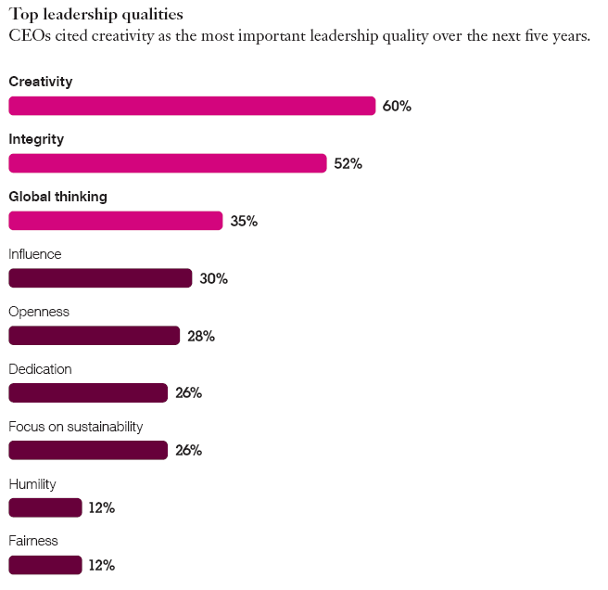
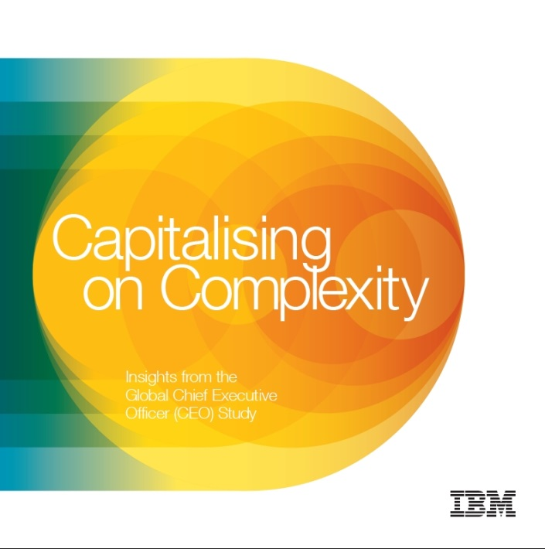

Slide 42
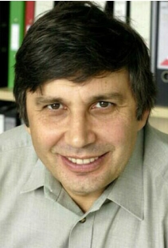
André Geim, IG-Nobel Prize 2000
the flying frog Nijmegen

Slide 43
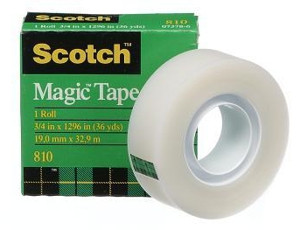
André Geim, Nobel Prize 2010
Graphene… Manchester

Slide 44
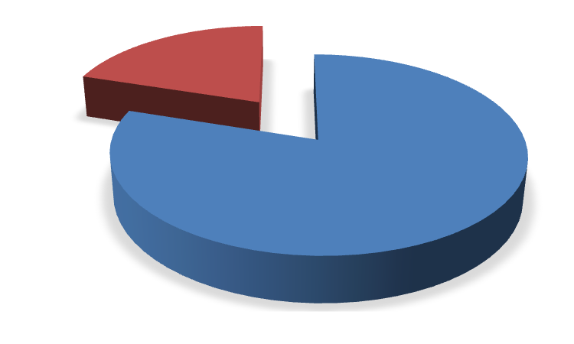
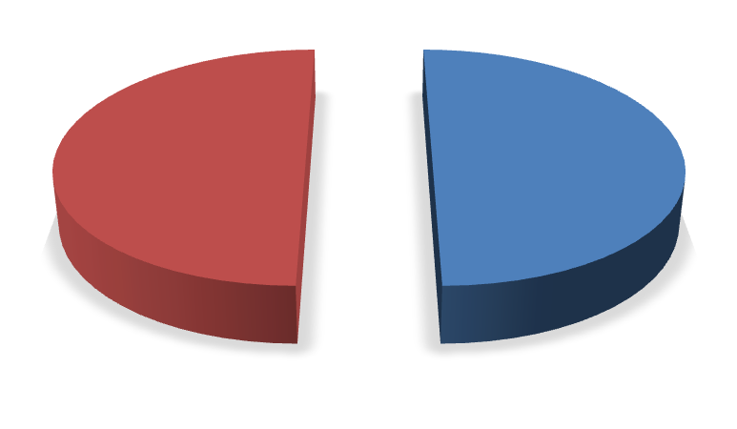
time
l
20% Play
50% Profit

Slide 45
4 straight, connected lines

Slide 46
Ways to get to the future ..successfully

Slide 47
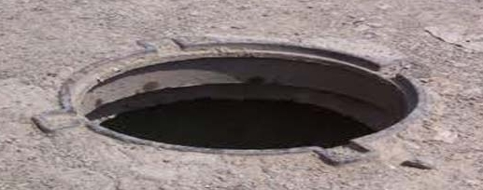
Ways to get to the future ..successfully

Slide 48
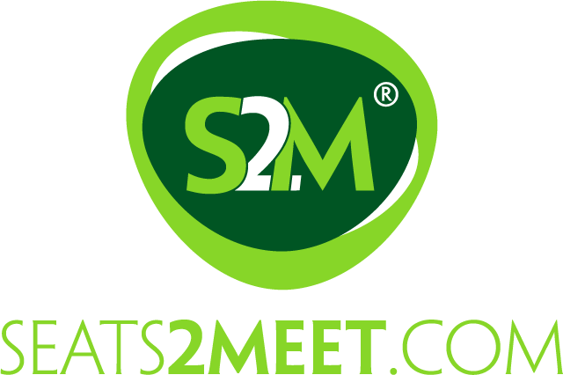
New rules, new game

Slide 49
3 straight, connected lines

Slide 50
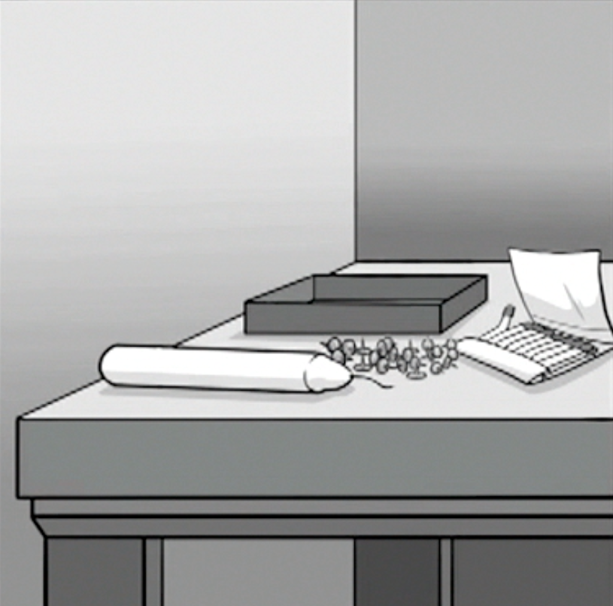
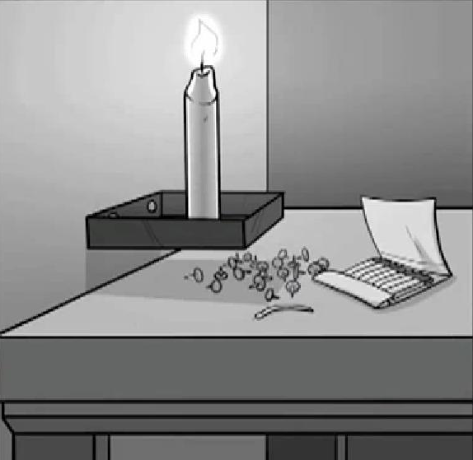
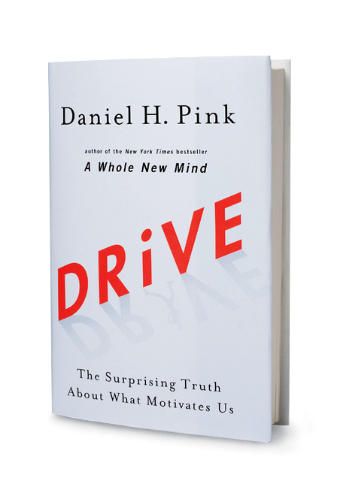
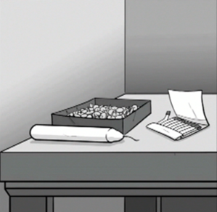
The candle problem (Duncker, 1945)

Slide 51
Essential for creativity:
1. Open challenges
2. Explorative behavior
3. Reward is in the process

Slide 52
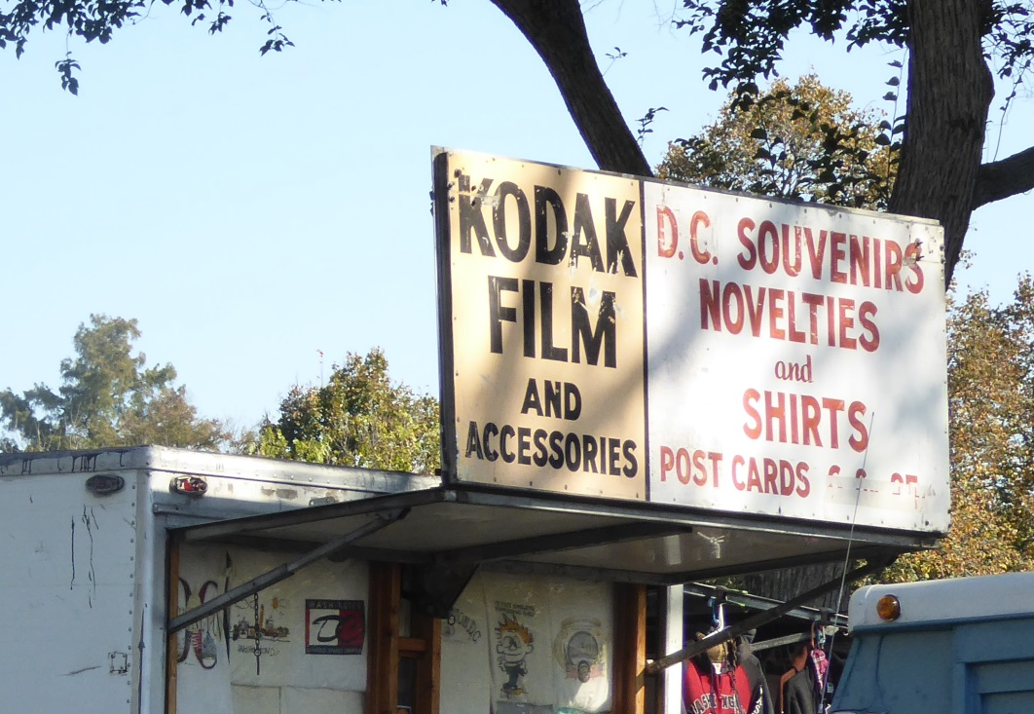
1976: Market leader in films and cameras (90%) 1989: first digital camera 2004: only 17% of camera market
2012: close to bankruptcy
2013: selling
$ 500,000,000.- of patents
2014: focus on disruptive technology

Slide 53
Continuous β-status

Slide 54
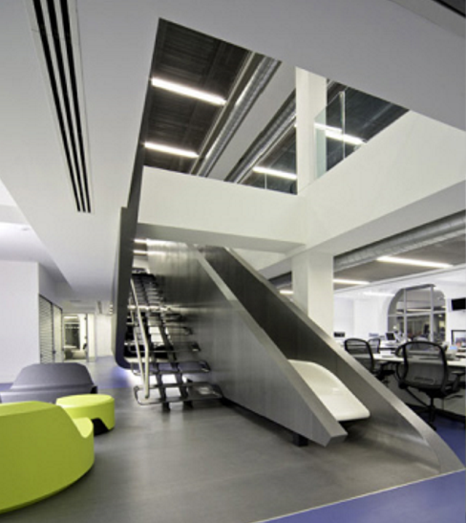
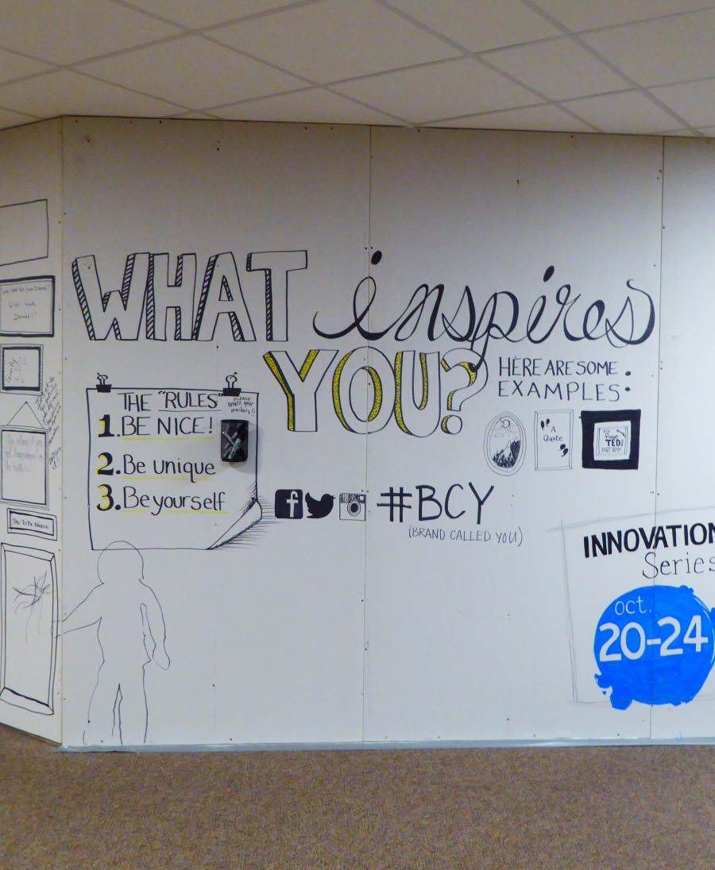
Headquarters?

Slide 55
Experience the design process:
Be open to surprise, play
Don’t be afraid to fail
Focus on the process
Embrace change
Empathize
Get others involved and..
Co-create

Slide 56
break

Slide 58
Storytelling
le Lion des Flandres

Slide 59
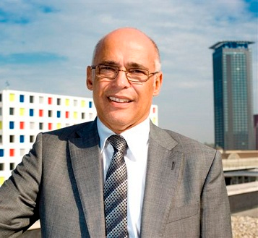
Meet Hans Vertonghen
Planning to open a new hotel in Antwerp
Has worked as (pre-opening) GM for Starwood and Dolce.
Now ready to own and operate a hotel based on his own vision and ideas

Slide 60
Hotel le Lion des Flandres
4+ Star property, aiming to be the hub for Antwerp visitors, both business and tourism.
Close to big musea and business centers
21st century hospitality with a Flemish twist

Slide 61
Meet: Jimmy
48 years from Liverpool
Wife and two kids
Self employed marketing consultant specialized in food retail. Customers throughout cities in western Europe
Stays in hotels 3-5 nights a month for business
Plays tennis, donates to art charities
Visits highlights during city stays, loves architecture
“a hotel is a place to meet, work and sleep”

Slide 62
Meet: Melanie
34 years from Amsterdam
single
Senior project manager hospitality at Royal BAM construction company. Stays in hotels 1-2 nights a month for business
Goes to the gym regularly, loves dining out and shopping with friends
“a hotel has to give the feeling of being pampered in a homely and safe environment”

Slide 63
Meet: Jörn
63 years from Berlin
Tim and his wife are retired
Former insurance agent.
Regular city trips and short breaks with his wife
Loves theatre/ opera, fine dining, studies art history
“a hotel should help me enjoy the city”

Slide 64
Your assignment
Team up!
Get to know the personas
Create the guest journey for hotel Le Lion des Flandres for each persona
Conclusions 12.00 o’clock

Slide 65
Your assignment

Slide 67
outcome
le Lion des Flandres

Slide 68
Our observations……

Slide 73
Our conclusions…….

Slide 74
Your conclusions?

Slide 75
Designing hospitality experiences
thank you
guestjourney@nhtv.nl

