Slide 1
EUHOFA BELGIUM 2012 11 -16 november
Motivation in the hospitality industry
from the bottom to the top.
The Flemish education system
Gaby Hostens
Honorary director general

Slide 2
1. Constitutional context for policymaking
Freedom of education : 2 components
Freedom to provide education, to start a school
A great diversity of providers: private and public.
Schools have networked! Under different umbrellas! Catholic, municipality, ‘state’, etc.
Free choice for parents : freedom to choose a school of one’s choice. Parents, students vote with their feet!! Importance
of choosing a ‘good’ school!

Slide 3
How to achieve freedom of education
For providers : public funding; pedagogical
autonomy and obligation to register students.
State funding has grown steadily :for private
providers ( Catholic, Jewish, non-denominational(
Steiner, Freinet, etc. )
education for the few, education for many,
education for all!
For parents and students : no fees; entitlement
to register; entitlement to a challenging curriculum = to high quality education; accessibility.

Slide 4
Constitutional context
Entitlement to moral and religious education :
- Catholic schools : Catholic religion
- Public schools : large choice of religions
and moral, non-confessional education
Access is free : no enrolment fees but not free of charge!
Equal treatment of students, parents, schools, teachers!
But objective differences justify different treatment : SEN students, official schools
that provide courses of different denominations!

Slide 5
A mix of policy tools to achieve freedom of education: Checks and balances!
Regulatory and financial framework laid down by the Flemish parliament and government;
State funding;
Equal treatment of schools, students and teachers : staffing ratios, salaries and operating expenses . Staffing ratios biased towards technical and vocational education, special
educational needs students and small schools;
Pedagogical autonomy for providers;
A diverse network of accessible schools;
Quality control by the Flemish government through core curriculum and inspection.
Create a level playing field for competition!!

Slide 6
2. Flemish hotel and culinary institutions, education in the Flemish education system
Different terms, definitions : (Initial, continuing) Vocational and technical education and training (VOTEC), Vocational education and training (VET), Career and technical education(CTE);
Different institutions : hotelschool; hospitality college; Culinary art school; Hotelfachschule; Johnson and Wales University; Ecole hôtelière; Ecole de Paris des métiers de table, du tourisme et de l’hôtellerie; VTI; etc.
Flemish secondary education : general, artistic, technical and vocational education ( 14 – 18,19);
Technical secondary education : more general subjects and less workplace experience; prepares for transition to higher education or labour market;
Vocational secondary education : more workplace experience and preparation for labour market.

Slide 7
Hotel and culinary institutions and schools in the Flemish education system
A great variety of schools : just one culinary or two (culinary, tourist) programmes or a great variety of other technical and vocational programmes along the culinary programme. Lack of visibility of the programmes???!!!!
A great variety of hotel and culinary programmes preparing for a great variety of jobs : chef, caterer, waiter, hotel receptionist, hospitality and hotel management, baker, pastry chef, butcher, etc.
Teachers need academic qualifications, workplace experience and initial teacher training;
Staffing ratios : biased towards vocational and technical education.

Slide 8
Schools and students
A large number of schools;
Student numbers : over 420,000 students in secondary education of which about 7,000 in food, hotel related programmes;
Large differences in size of schools
Largest schools have over 500 students in such programmes, small schools may have as few as 40-5.

Slide 9
3. Quality in the system? Quality and equity in the system?
Quality assurance mechanism
- Entitlement to high quality education;
- Tools to enhance quality : Flemish core
curriculum, study plans, pedagogic
counsellors, diagnostic tests;
- High quality initial teacher training : national core
curriculum!!
- No national exams, no high stakes tests or
exams!
- Flemish inspectorate to control quality :
school audit by team of inspectors every
6 years.
- CIPO-tool to analyse quality of school: Context,
Input, Process and Output. Interaction between
those 4 components of tool.

Slide 10
Quality : PISA results
OECD Programme for International Student
Assessment (PISA): international comparative
survey of student learning in reading,
mathematical and scientific literacy,
organised every 3 years for 15-year students.
PISA programme was organised in 2000, 2003,
2006 and 2009;
1 major and 2 minors: reading literacy major in
2000 and 2009; mathematical literacy and
scientific literacy minors in 2009;
Excellent average results for Flemish students!

Slide 11
PISA 2009 : Reading literacy
Shanghai-China 556
Korea 539
Finland 536
Canada 524
New Zealand 521
Japan 520
Flanders 519
Australia 515
Netherlands 508
Germany 497
OECD average 493

Slide 12
PISA 2009 : Mathematical literacy
Shanghai-China 600
Singapore 562
Korea 546
Finland 541
Flanders 537
Switzerland 534
Japan 529
Canada 527
Netherlands 526
Australia 514
OECD average 496

Slide 13
PISA 2009 : Scientific literacy
1. Shanghai-China 575
2. Finland 554
3. Japan 539
4. Korea 538
5. New Zealand 532
6. Canada 529
7. Australia 527
8. Flanders 526
9. Netherlands 522
10.Germany 520
11.OECD average 501

Slide 14
Quality and Equity in the system?
PISA index of socio-economic status (SES) is a combination of background variables :
- educational attainment of parents;
- profession of parents;
- economic, educational and cultural possessions of the family.

Slide 15
PISA 2003

Slide 16
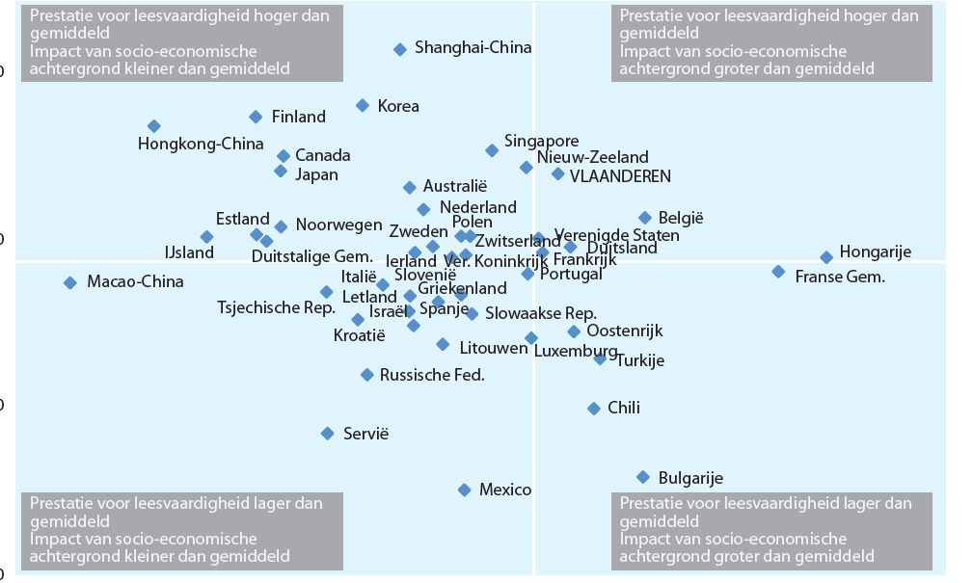

Slide 17
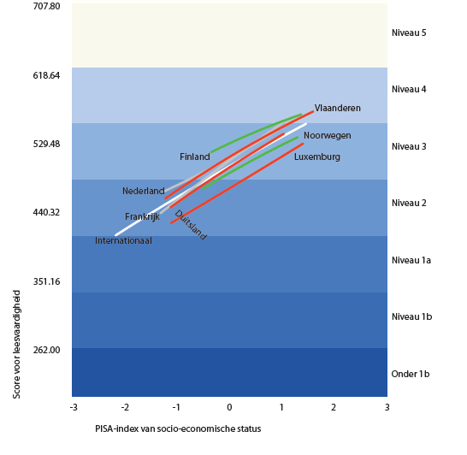

Slide 18
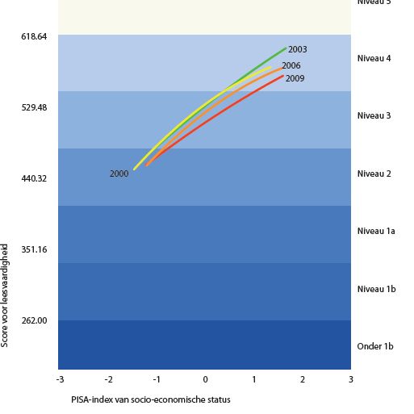

Slide 19
Flemish PISA results
Excellent average results; large group of excellent
performers;
But : steady decline of excellent results in reading literacy;
Excellent results for mathematical literacy : 2003!!
Good average results for scientific literacy;
Impact of socio-economic background;
Great impact of language spoken at home : language of instruction;
Poor results of 1st and 2nd generation immigrant students;
Importance of school choice!!

