Slide 1
Compete or Collaborate? a tale of five Dutch Hotelschools
Dr. Xander Lub
Professor of Experience & Service Design
Hospitality Business School
Saxion University of Applied Sciences

Slide 2
Introduction
Lector/Professor @ Saxion
Ass. Professor @ VU University
Coordinator of Hospitality Excellence Programme
RAAK Partner

Slide 3
Agenda
Change
Compete or collaborate
The case of five hotelschools (in a tiny country)
Collaboration – examples
Notes:
3

Slide 4
Change -Major Drivers
Global Shifts
Digital Shifts
Individualization

Slide 5
Hotel Industry drivers
Change of ownership
OTA
Peer2Peer
Industry blurring
Customer power
Notes:
5

Slide 6
Education Industry Drivers
Competition
Traditional universities –more applied courses & research
Hospitality management programmes absorbed into business schools
MOOC’s
Private education
All competing within a Bologna framework
International playing field
Accreditation and audit vs agility
Education institutes become knowledge institutes
Research
Knowledge partnerships with industry
Notes:
6

Slide 7
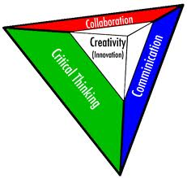
Change
In other words, lots of change!
Our curricula are outdated by the time students reach the market
How to prepare our students and our teachers:
Learn to learn, learn to innovate!
Notes:
7

Slide 8
Compete or collaborate?
Notes:
8

Slide 9
Compete or collaborate?
In a knowledge economy, collaboration is the new competition
Notes:
9

Slide 10
Five hotelschools – a tiny country
Seven years back –bitter competition
Then:
Change of directors
Grassroots collaborations btw staff exchanging relevant knowledge
Shared purpose –the “dutch hotello”
Notes:
Xander
10

Slide 11
Five schools –several forms of
early collaboration
Dublin descriptors- jointly translated to competencies for hotel management students
Inch – a joint alumni network with many events for “dutch hotellos”- initiative of alumni
Information exchange networks btw librarians, internship coordinators, economics teachers…
Increasing presence of dutch hospitality researchers at international conferences
Cross-school supervision of PhDs
Notes:
Xander
11

Slide 12
Two collaboration case studies
RAAK research project
Hospitality Excellence Platform
Notes:
Xander
12

Slide 13
Some collaboration case studies –
RAAK
RAAK research project (see previous presentation)
Project funded by government to stimulate regional innovation in SME
Eight partners: 2 research schools, 2 industry partners, 2 knowledge partners national & 2 knowledge partners international
Research grants (national/european) increasingly only awarded to collaborative initiatives, particularly with industry
Other research collaboration examples: CELTH, Hospitality Research Collaborative
Notes:
Xander
13

Slide 14
Some collaboration case studies –
RAAK 2
RAAK research project
Pros:
New knowledge and applications for industry
New insights and course materials for curriculum
Spin-off research projects
Authentic learning experiences for students (and teachers/researchers
Strengthened collaboration on other projects between stakeholders
Cons:
Project management and managing interests in a multi-stakeholder project can be very complicated
Could lead to delays
Notes:
Xander
14

Slide 15
Some collaboration case studies –
Hospitality Excellence Platform
Hospitality Excellence Platform
Initiated and seed-funded by Dutch Royal Hospitality Board (now jointly paid by schools and industry)
Set up according to inter-organizational network principles
Aims to have top students together with best researchers and entrepreneurs to find solutions for societal problems that the industry faces
Teams are mixed across schools- so are professors
Extracurricular program –more agile in content and process
Notes:
Xander
15

Slide 16
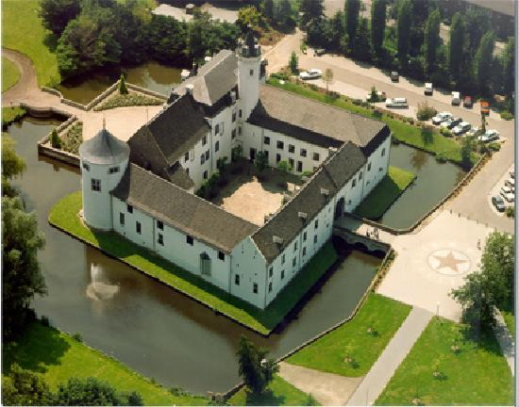
Some collaboration case studies –
Hospitality Excellence Platform 2
Hospitality Excellence Platform
Pros and cons for industry and students to be discussed by Mark and Merel in more detail
Pros:
stronger research collaborations on topics; growing into a joint research agenda
incubator for new courses
platform for new collaborations
Platform for nurturing excellence
relationship building
Cons
Extra investment
Stress factor to daily operations
Notes:
Xander
16

Slide 17
Key Take-aways
Collaboration trumps competition in a knowledge economy
More fun
Breeds innovation
Combing strengths- all parties win
Requires mutual trust
Requires long-term effort (but what doesn’t?)
Needs time and a perspective on long-term collaboration
Notes:
Xander
17

Slide 18
Final words
Join us in collaboration!
Don’t get up, the best is yet to come: Mark & Merel!
Notes:
Xander
18

