Slide 1
EUHOFA BELGIUM 2012
11 -16 november
Motivation in the hospitality industry
from the bottom to the top.
Tuesday, November 13
- Mr. Noël Selis -
Self-realization challenged: About youth and values

Slide 2
Communication = essential, but delicate factor in contemporary (hospitality)education and industry
of all time
today: seems >> ever
4 generations:
Baby Boomers - generation X - Y - Z
° misunderstandings and tensions

Slide 3
2 questions: (1) causes?
(2) solution?
(1) # communication
~ underlying values and norms
(2) solutions for constructive cooperation in the interest of the quality of our education and hospitality services

Slide 4
Problem > particular school or hotel
➔ level of the postmodern society
INDIVIDUALISTIC INTERPRETATION OF MORALITY
(utilitarian individualism) expressive individualism(*)
(1) (2)
* R. Bellah

Slide 5
(2) Postmodern expressive individualism
= culture of self disposition and self-realization (self-fulfillment ethics)(A)
It produces free, ”sovereign” individuals realizing of own identities, visions and projects based upon self-generated choices.
    hedonistic character
    paternalism ➔ ‘empowerment’
    PRIVATISATION of MORALITY(A)

Slide 6
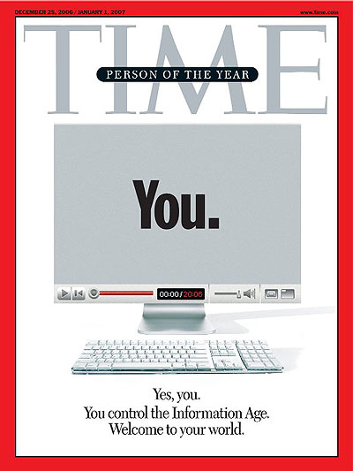

Slide 7


Slide 8
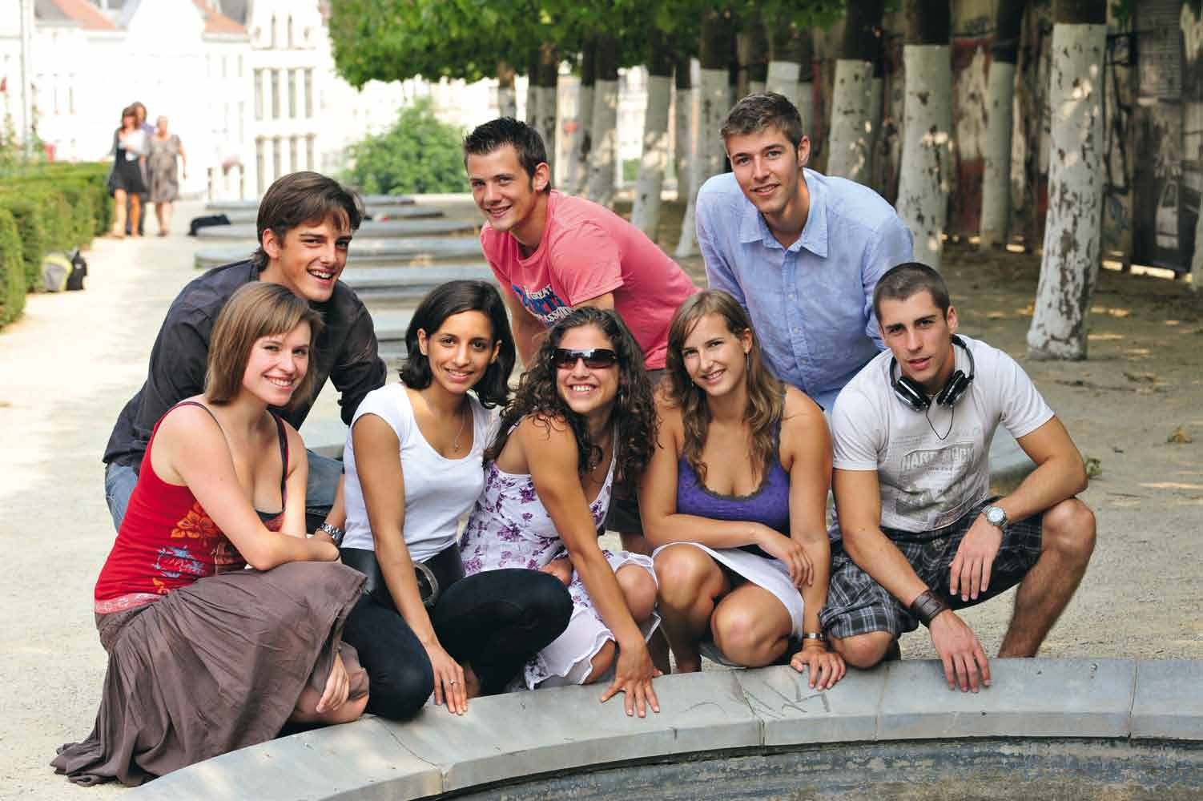

Redelijk eigenzinnig
2010-2011

Slide 9


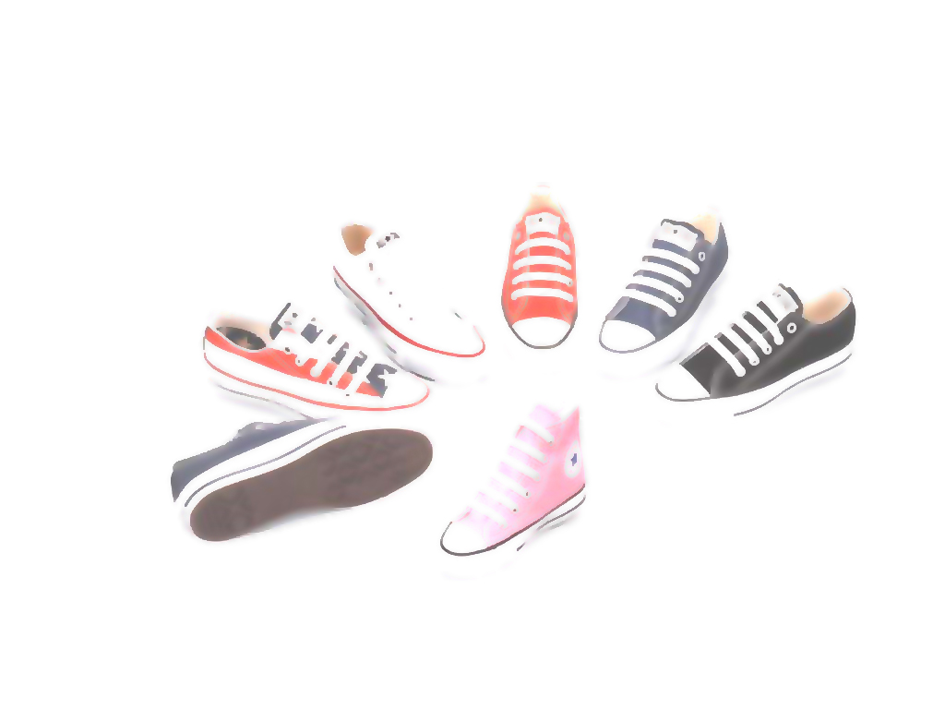
Conclusion…
Be different be urself

Slide 10
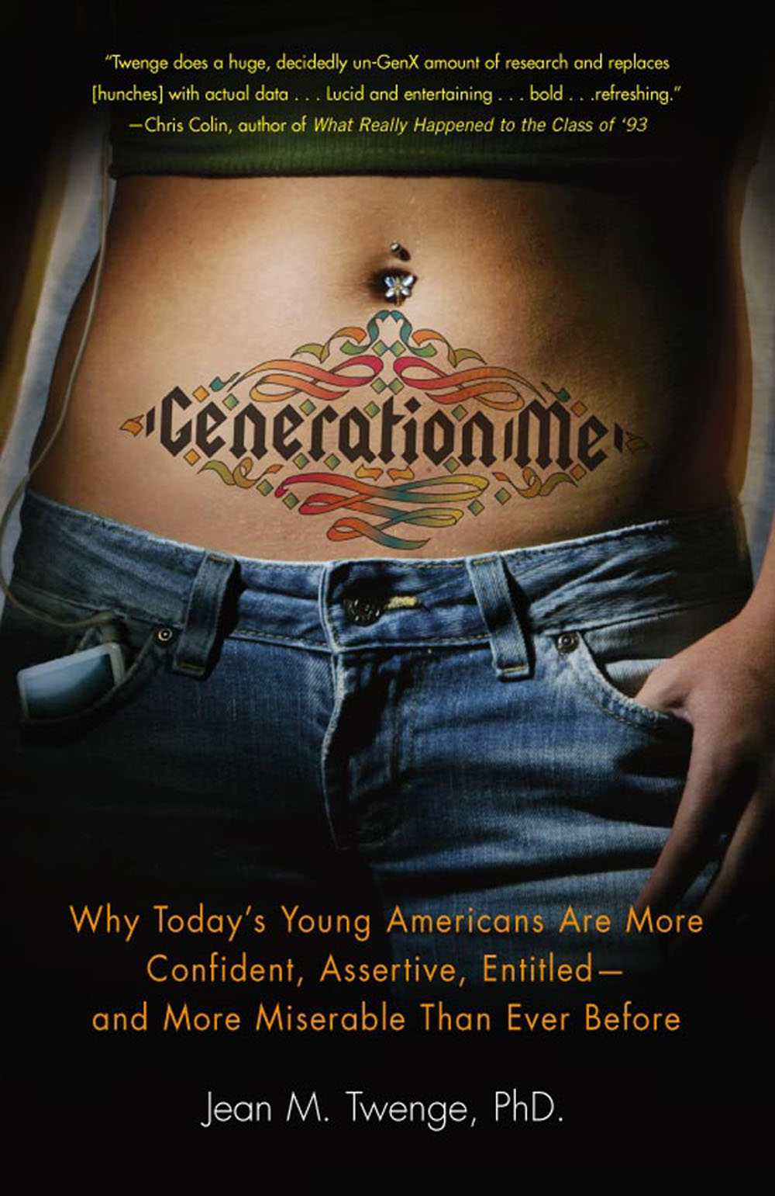
‘ME’ = Millennium Edition: ° born 80-9’s
>> self-confidence : narcissism
(net logs, blogs, Facebook …)
< NPI-test : 16.475
students
2006: 2/3 above the average; 30% more than in 1982

Slide 11
“GenMe's is a way of moving through the world beholden to few social rules and with the unshakable belief that you're important. We simply take it for granted that we should all feel good about ourselves, we are all special, and we all deserve to follow our dreams.” (J. M. Twenge)
Who is to blame?
Boomers and next generation
“One of the primary contributors to this culture of the individual is the institutionalized emphasis on self-esteem that began in the 1970s. This emphasis went overboard with GenMe, creating a narcissism, in which individuals are overly focused on themselves and lack empathy for others” (J. M. Twenge)

Slide 12
‘The secular morality of the Enlightenment has brought about in the second half of the twentieth century that everyone can choose undisturbed its own god, or that everyone can even think that he himself is god. This is - abandoned of all disadvantages - a Western performance’ (7)
7) H. Boutellier, De veiligheidsutopie. Hedendaags onbehagen en verlangen rond misdaad en straf, Den Haag, 2005

Slide 13
foundation of choice?
‘young’ generation ‘old’generation
< subjective objective
feelings principles
EMOTIVISM (B) DEONTOLOGY
° misunderstandings and frustrations

Slide 14
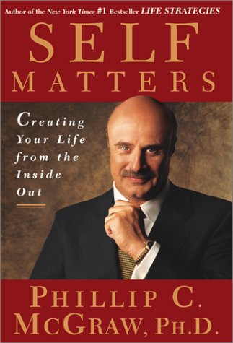

Slide 15
Personal remarks
(A) Cult of the individual self ➔risk disillusionment and depression
Egocraty = inflated ego ➔ unrealistic expectations concerning their own lives and realities
“Today's young people have been raised to aim for the stars at a time when it is more difficult than ever ➔ there's a huge clash between their expectations and reality. “ (J.M. Twenge, Generation Me: Why Today’s Young Americans Are More Confident, Assertive, Entitled—and More Miserable—Than Ever Before , Free Press, 2006)

Slide 16
Danger : frontal clash when confronted with real life : °depression, disillusionment, cynicism and suicides
“That’s what we get: unhappy and fearful thirties with the narcissism and the helplessness of a child” (Paul Verhaeghe (Ugent)
“More than any other generation in history, the children of Baby Boomers are disappointed by what they find when they arrive at adulthood. They have more freedom and independence than ever, but also far more depression, anxiety, cynicism, and loneliness.” (J.M. Twenge, Generation Me: Why Today’s Young Americans Are More Confident, Assertive, Entitled—and More Miserable—Than Ever Before , Free Press, 2006)

Slide 17
Irony: cause = ‘good’ intention to protect youth
“By protecting our kids from unhappiness as children, we’re depriving them of happiness as adults” (Gottlieb, L. (2011). How to Land Your Kid in Therapy. Atlantic Magazine(July-August)
lack of ‘psychological immunity’
(Dan Kindlon, Harvard)
“Kids who always have problems solved for them believe that they don’t know how to solve problems. And they’re right—they don’t.” (Jean Twenge, a professor of psychology at San Diego State University)

Slide 18

➔ Exposing the cult of the self in the interest of resilience
# > ME
= < ME
Implications for education:
- limits on client focus
“The obligation to motivate students by making courses funny(feel-good curriculum) weakens the academic ethos of the school, discourages the resilience of our youth and disinherited them of their legitimate intellectual heritage” (Wim Van den Broeck (VUB), Verspilling van talenten en centen. Waarom de school te weinig schoolt. Over de teloorgang van het gezag en van de kernopdracht van het onderwijs, in de ‘Onderwijskrant 158, juli-augustus-september 2011)

Slide 19
  (B) EMOTIVISM = deceptive and dangerous:
  formal tolerance ➔ lack of substantive reflection: ‘unprincipled morality’(Z. Bauman)
  ethics reduced to psychology
  ➔ ‘culture of surface’:

Slide 20
  2) Individual, emotional ethics ➔relativism: ethics unsettled:
  chaos: ‘liquid society’ : “There
  is no single right way to live” (J. M. Twenge)
‘anything goes
  Moral vacuum: fatigue, uncertainty and fear
  Danger: end rational communication ➔
  end democracy ➔ justify everything

Slide 21
Without exaggeration one can state that Western thinking at the end of the second millennium was predominantly characterized by scepticism. Whether it is about religious, about ethical or about political issues, the realization of missing certainties is unmistakably present. Sociologists speak of the ‘risk society’ in which the individual has to determine his own identity in the midst of forces and views competing with each other. The consciousness of good and evil also seems to be adrift – at least no longer anchored in ultimate values that give existence meaning and direction. In social respect furthermore, the faith in the steering capacity of political institutions seems to be crumbling away. It seems in fact that only in the area of the economy there is nothing wrong. According to some the economic success is in fact the cause of the prevailing feeling of ‘spiritual’ emptiness that characterizes the existence in the postmodern society.

Slide 22
Towards a viable society
Individualism: overestimation of individual place in the whole
‘social constitution of the individual’
“point of view of the universe”
(H. Sidgwicks)
‘DUTIES’ to ‘the whole’

Slide 23
Ethics
    # individual feelings
    = objective, universal values and principles
        Social responsibilities one believes one is fairly called upon to assume: motivational commitment to realities outside yourself
    “Tonight we proved once more that the true strength of our nation comes not from the might of our arms or the scale of our wealth, but from the enduring power of our ideals”
    Barack Obama, November 4th, 2008, Chicago

Slide 24
(b) Dutie # externally imposed
= ‘real’ autonomy:
‘auto - nomos’
self - law
imposed from social
own belief (<‘ratio’) responsibilities
FREEDOM ≈ RESPONSIBILITY

Slide 25
“The new golden rule requires that the tension between one preferences and one social commitments be reduced by increasing the realm of duties one affirms as social responsibilities - not the realm of duties that are forcibly imposed but the realm of responsibilities one believes one should discharge and that one believes one is fairly called upon to assume.” (A. Etzioni, The New Golden Rule: Community and Morality in a Democratic Society, New York, 1996)
General interest rooted in rationality and freedom
“a matter of belief rather than force” (A. Etzioni)

Slide 26
Challenge
Silence out of fear ➔ normative
commitment: guts to confront with
principles and values and appeal
to our mutual social responsibility’
“Some duties rest on the fact that there are other creatures on earth whose
circumstances we can improve”
(William Ross)

Slide 27
“So let us summon a new spirit ... of service and responsibility where each of us resolves to pitch in and work harder and look after not only ourselves, but each other. Let us remember that if this financial crisis taught us anything, it’s that we cannot have a thriving Wall Street while Main Street suffers – in this country, we rise or fall as one nation; as one people.”
Barack Obama, November 4th, 2008, Chicago

Slide 28
The Higher Education community needs to pursue opportunities to broaden our students’ vision. The culture of the self must be challenged by the culture of community. One of our highest priorities among our students should be to offer the opportunity to live and serve in community, pursue common goals, and discover the value of putting the needs of another ahead of one’s own needs.” (J.M. Twenge, Generation Me: Why Today’s Young Americans Are More Confident, Assertive, Entitled—and More Miserable—Than Ever Before , Free Press, 2006)

