Slide 1
EUHOFA BELGIUM 2012 11 -16 november
Motivation in the hospitality industry
from the bottom to the top.
Monday November 12
- Prof. Dr. Maarten Vansteenkiste -
“To Want To” or “To Have To” (Motivation or Mustivation)?
The Importance of Quality of Study and Work Motivation

Slide 2
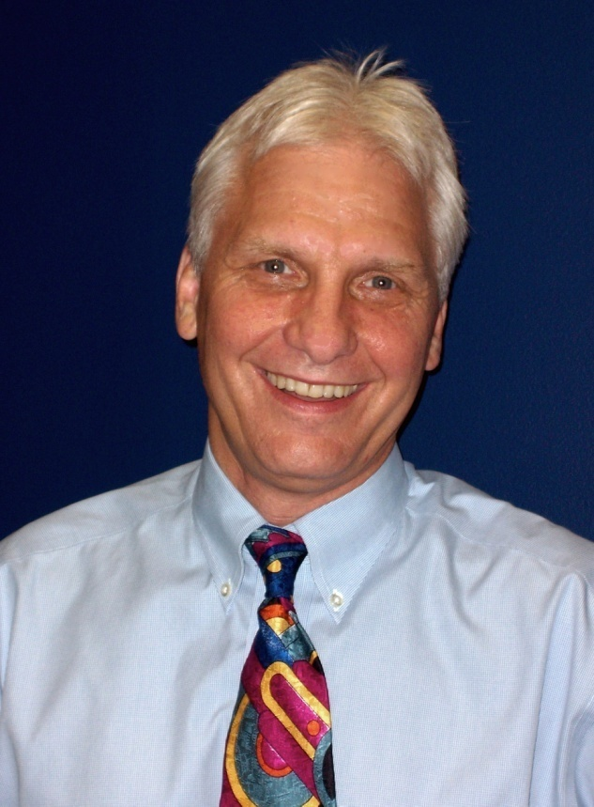
ZELF-DETERMINATIE THEORIE
Prof. Edward Deci
(University of Rochester, NY)
Prof. Richard Ryan
(University of Rochester, NY)

Slide 3
PART 1:
What are the challenges for a motivation psychologist?

Slide 4
Challenge 1
Ethymological meaning: Motivation < movere = to move
Which factors make learners move?
Which factors make employees put effort in their work?
Question concerning the reason, motive or goal behind our behavior
= clarifing STRUCTURE of motives

Slide 5
Challenge 2
Do these motives matter in terms of predicting outcomes?
(Class) participation?
Test anxiety?
Drop-out versus persistence?
Time management?
Exam performance?
Well-being & burn-out?
= question concerning PREDICTIVE VALIDITY

Slide 6
Challenge 3
How can teachers/managers nurture optimal motivation?
= identifying motivating TEACHING/MANAGERIAL STYLE
Managarial/ Teaching style
Quantity and quality of motivation to learn
Outcomes

Slide 7
TASK OF THE MANAGER / TEACHER
DOMAINEXPERTISE / KNOWHOW
(Technical) knowledge
Information
Expertise
EXPERIENCE AND INSIGHTS IN MOTIVATION
How to stimulate employees/learners?
How to convey information and communicate assignments so that employees/learners get inspired?
Necessary, but not sufficient condition
Necessary, but not sufficient condition
Transfer of correct knowledge, information and assignments in a stimulating way
Engaged employees / learners

Slide 8
Challenge 4
Which factors energize motivation?
= identifying ENERGETIC resources of motivation
= identifying UNDERLYING MECHANISM of motivation
Teaching / managarial style
Underlying mechanism
Quantity and quality of motivation to learn
Outcomes

Slide 9
Challenge 5
What leads teachers/managers to make use of a particular motivating style?
= identifying ANTECEDENTS of motivating style
Ante-cedents
Teaching / managarial style
Underlying mechanism
Quantity and quality of motivation to learn
Outcomes

Slide 10
PART 2:
What are the answers to these challenges?

Slide 11
Challenge 1: Which motivational subtypes are distinguished within SDT? “Why are students/employees putting effort in their studies/work?”

Slide 12
A little excercise:
Combine & label

Slide 13
1 | 2 | 3 | 4 | 5
Not important at all |  |  |  | Very important
I’m putting effort in this project…
1 … because I highly value this project | 1 | 2 | 3 | 4 | 5
2 … because others will esteem me more if I do so | 1 | 2 | 3 | 4 | 5
3 … because I would feel guilty if I wouldn’t do so | 1 | 2 | 3 | 4 | 5
4 … because I find this a challenging project | 1 | 2 | 3 | 4 | 5
5 … because this project has personal relevance to me | 1 | 2 | 3 | 4 | 5
6 … to gain appreciation from others (e.g., teachers, manager, clients, peers/colleagues) | 1 | 2 | 3 | 4 | 5
7 … to prove myself I’m a creative employee | 1 | 2 | 3 | 4 | 5
8 … because I find this project interesting | 1 | 2 | 3 | 4 | 5

Slide 14
Try to
Indicate which items measure the same type of motivation
Come up with a label for each type of motivation
 | Items | Name
Motivation type 1
Motivation type 2
Motivation type 3
Motivation type 4

Slide 15
Punishment rewards
expectation
Shame, guilt, self-worth
Personal relevance, meaningful
Pleasure, passion, interest
Pressure, tension, stress
Sense of choice & freedom
Controlled Motivation
“to have to”
“mustivation”
Autonomous Motivation
“to want to”

Slide 16
Punishment rewards
expectation
Shame, guilt, self-worth
Personal relevance, meaningful
Pleasure, passion, interest
Why do you follow the rules at school/work?
‘because I will be punished otherwise’
‘because I should be a good boy who gives a good example to others’
‘because I understand why the rules are necessary’
‘because I find the rules interesting’
Process of internalisation / ownership

Slide 17
Statement 1a:
Concept of motivation
The fundamental distinction within SDT concerns the differentiation between autonomous or volitional and controlled or pressured motivation.
Notes:
17

Slide 18
What about the motivation of the teachers & the managers themselves?

Slide 19
Punishment rewards
expectation
Shame, guilt, self-worth
Personal relevance, meaningful
Pleasure, passion, interest
Why do you do your best to prepare your courses?
‘simply because I’m paid for it’
‘because I have to prove my colleagues and the directory that I’m a capable and well-prepared teacher’
‘because I find this very valuable for my students’
‘because teaching is my mission/passion in life; I just like to do it’

Slide 20
Statement 1b: Motivation of the teacher / manager
SDT is not just a theory about the motivation of learners & subordinates, but also a theory about people’s personality functioning, including the teacher & manager
Implication for practice: The teacher / manager can stand in front of the mirror to question his own motivational functioning
Notes:
20

Slide 21
Challenge 2a: Does quality of motivation matter?

Slide 22
Are Autonomously Motivated Teenagers more Active and Engaged During PE classes?
N = 739 pupils (Mean age = 14.36 y), belonging to 46 classes
Two outcomes:
Videotaping entire class and rating degree of engagement
Physical activity levels as recorded by accelerometers
Aelterman, N., Vansteenkiste, M., Haerens, L., Vandenberghe, L., Demeyer, J., & Van Keer, H. (2012). Pupils’ objectively measured physical activity levels and engagement as a function of between-class and between-pupil differences in motivation towards physical education: A Self-Determination Theory approach. Journal of Sport & Exercise Psychology, 34, 457-480.

Slide 23
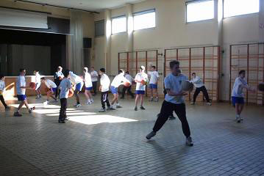
Motivation
Level 1:
Differences between pupils
Level 2:
Differences between classes
Activity level
Observed engagement
Aelterman, N., Vansteenkiste, M., Haerens, L., Vandenberghe, L., Demeyer, J., & Van Keer, H. (2012). Pupils’ objectively measured physical activity levels and engagement as a function of between-class and between-pupil differences in motivation towards physical education: A Self-Determination Theory approach. Journal of Sport & Exercise Psychology, 34, 457-480.

Slide 24
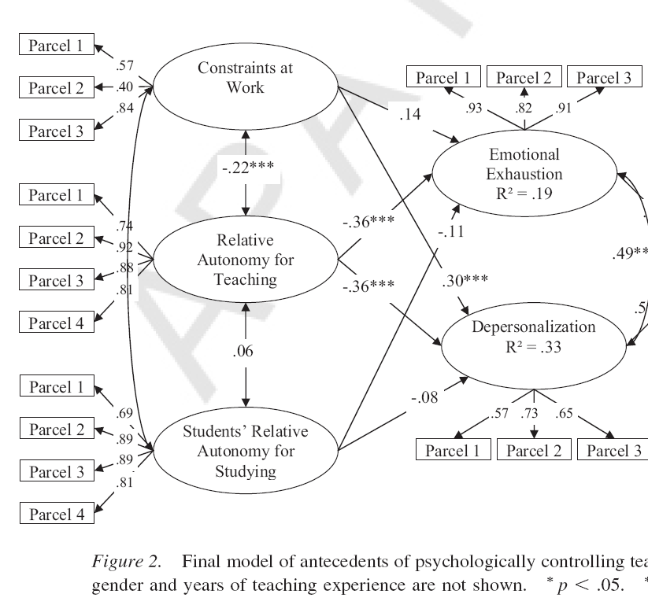
Teacher motivation & burn-out
Uitputting
-.36**
Cynisme &
depersonalisatie
-.36**
Soenens, B., Sierens, E., Vansteenkiste, M., Goossens, L., & Dochy, F. (2012). Psychologically controlling teaching: Examining self-regulated learning and achievement outcomes and antecedents. Journal of Educational Psychology, 104, 108-120.

Slide 25
Statement 2a:
Personal & collective motivations predict objectively measured outcomes
Self-reported ill-being: e.g., burn-out
Engagement as rated by external observers
Behavioral persistence indicators: e.g., physical activity levels

Slide 26
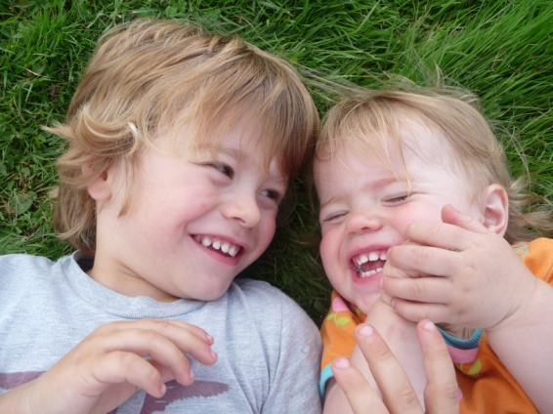
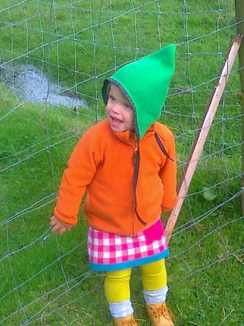
Challenge 3 Identifying the Underlying Mechanism of Growth: The Role of Psychological Need Satisfaction

Slide 27
Wich needs do meet the following criteria?
Psychological rather than fysiological
Universal
rather than culture-bounded
Innate rather than acquired
Fundamental

Slide 28
Basic needs
Need for autonomy
A
Need for relatedness
R
Need for competence
C
Being the initiator of
one’s own actions
Psychological
freedom
Getting the chance to be oneself
Being loved by
others
Having close and
intimate relations
Being able to
achieve desired
outcomes
Having control over
the result of one’s
actions
Vansteenkiste, M., Ryan, R. M., & Deci, E. L. (2008). Self-determination theory and the explanatory role of psychological needs in human well-being. In L. Bruni, F. Comim, & M. Pugno (Eds.), Capabilities and happiness (pp.187-223). Oxford, UK: Oxford University Press.

Slide 29
A
R
Optimal Motivation
Growth, Integration &
Engagement
C
Vansteenkiste, M., Ryan, R. M., & Deci, E. L. (2008). Self-determination theory and the explanatory role of psychological needs in human well-being. In L. Bruni, F. Comim, & M. Pugno (Eds.), Capabilities and happiness (pp.187-223). Oxford, UK: Oxford University Press.

Slide 30
Statement 3:
The Role of Need Satisfaction
The need for autonomy, competence and relatedness represent the ‘ABC’
of this motivation theory: they form the necessary ingredients for our daily wellness!
Implications for practice:
Teachers can try to meet the learners’ needs, every day!
Managers can create a need-supportive environment
Notes:
30

Slide 31
Challenge 4: How to create a motivating environment?

Slide 32
Autonomy-
supportive vs.
controlling environment
Autonomy
Involved vs. uninvolved
environment
Relatedness
Structured vs. chaotic
environment
Competence

Slide 33
Autonomy-supportive vs. controlling teaching

Slide 34
Suggestion 1
Try to be mindful of your language

Slide 35
Procedure
Experimental design: 2X1-design
External control
Autonomy support
Participants : 376 first year business students (19-20 years old)
Task: Reading a text on “how to learn to communicate?” (30 min.)
Outcomes:
Performance = conceptual learning
Persistence = free attendance of a role play on communication
Vansteenkiste, M., Simons, J., Lens, W., Sheldon, K. M., & Deci, E. L. (2004). Motivating learning, performance, and persistence: The synergistic role of intrinsic goals and autonomy-support. Journal of Personality and Social Psychology, 87, 246-260

Slide 36
Autonomy-supportive instructions
On your desk you can find a text that is used in the context of an experiment. The text aims to indicate how you can learn to communicate in a good way. Different communication styles are discussed within the text and the content of this text might provide you useful information that you might need on your future job. You are invited to read the text attentively, because the text can contribute to your personal development and growth on your future job. After you will have read the text, you will be asked to answer a few questions (which are not part of an exam).
Vansteenkiste, M., Simons, J., Lens, W., Sheldon, K. M., & Deci, E. L. (2004). Motivating learning, performance, and persistence: The synergistic role of intrinsic goals and autonomy-support. Journal of Personality and Social Psychology, 87, 246-260

Slide 37
Controlling instructions
On your desk you can find a text that is used in the context of an experiment. The text indicates how you should communicate in a good way. Different communication styles are discussed within the text and the content of this text should provide you useful information that you should use on your future job. You might better read the text very attentively, because the text should contribute to your personal development and growth on your future job. After you will have read the text, you must answer a few questions (which are not part of an exam).
Vansteenkiste, M., Simons, J., Lens, W., Sheldon, K. M., & Deci, E. L. (2004). Motivating learning, performance, and persistence: The synergistic role of intrinsic goals and autonomy-support. Journal of Personality and Social Psychology, 87, 246-260

Slide 38
Vansteenkiste, M., Simons, J., Lens, W., Sheldon, K. M., & Deci, E. L. (2004). Motivating learning, performance, and persistence: The synergistic role of intrinsic goals and autonomy-support. Journal of Personality and Social Psychology, 87, 246-260

Slide 39
Vansteenkiste, M., Simons, J., Lens, W., Sheldon, K. M., & Deci, E. L. (2004). Motivating learning, performance, and persistence: The synergistic role of intrinsic goals and autonomy-support. Journal of Personality and Social Psychology, 87, 246-260

Slide 40
Suggestion 1
Try to be mindful of your language
The way how tasks, instructions, and rules are communicated is of critical importance, as the communication style determines whether students are willing to be cooperative or are rather resistant against any request.

Slide 41
Suggestion 2
Try to offer the desired amount of choice

Slide 42
Option choice:
e.g., content of the project
e.g., offering different content options to choose from
Action choice
When (timing)
Participation in setting deadlines
Flexibility in work hours
Where
How
Rhythm of progress
Pace of switching between tasks
Notes:
08/31/09
42

Slide 43
Autonomy-supportive vs. controlling teachers / managers…
…make use of autonomy-supportive or inviting rather than controlling or “should” language
… allow input, provide choice, and encourage self-initiation & experimentation = empowering
… providing a meaningful & realistic rationale if choice is constrained
… work from the subordinate’s / learner’s frame of reference
… try to avoid threatening with external consequences
….try to avoid using controlling rewards & punishments to motivate others
… try to build in fun-elements

Slide 44
Does choice and participation not result in a permissive climate?

Slide 45
Structured vs. chaotic teaching

Slide 46
Suggestion 3
Try to set rules through dialogue

Slide 47
Teacher / manager autonomy-support does not imply that teachers / managers can’t set any rules or introduce any prohibitions, as if learners / subordinates need to enjoy unlimited freedom
Autonomy-supportive, relative to controlling, teachers will use a different style of introducing rules and prohibitions!

Slide 48
How can prohibitions/rules be introduced?
e.g., talking during class, using cell-phones, etc.
Structure
= guidance
e.g., prohibitions
Lack of structure
= chaos
Autonomy supportive environment
Controlling environment
Vansteenkiste, M., Sierens, E., Soenens, B., Goossens, L., Dochy, F., Aelterman, N., Haerens, L., Mouratidis, A., & Beyers, W. (2012). Identifying configurations of perceived teacher autonomy support and structure: Associations with self-regulated learning, motivation and problem behavior. Learning and Instruction, 22, 431-439.

Slide 49
How?
1) Set up a dialogue with your students to ask for their opinion = group discussion in the beginning of the academic year
eg. “What may happen such that the courses of this year would be fun?”
2) Try to provide a convincing rationale / explanation for rules
3) Try not to suppress irritation
4) Be cautious if you are setting rules that relate to the personal
territory of employees / learners!
eg. piercings, religious symbols,
5) Try to be consequent and fair in following up the agreements
Vansteenkiste, M., Sierens, E., Soenens, B., Goossens, L., Dochy, F., Aelterman, N., Haerens, L., Mouratidis, A., & Beyers, W. (2012). Identifying configurations of perceived teacher autonomy support and structure: Associations with self-regulated learning, motivation and problem behavior. Learning and Instruction, 22, 431-439.

Slide 50
Suggestion 4
Try to promote self-reflection

Slide 51
How to communicate corrective feedback?
Try to promote self-reflection: “What do you think of it yourself?” “How does the meal taste in your opinion?”
Try to pay attention to the following issues
a) Try to use the sandwich principle: positive – suggestion – positive. Try to avoid “to but”
b) Try to be detailed instead of vague and general
vb. concrete suggestions

Slide 52
Structured teachers / managers …
clearly indicate what they expect and they come to clear agreements with their students / subordinates.
… encourage self-reflection
… actively confirm confidence in the learners’/ subordinates capacities instead of provoking anxiety.
… focus on masterying the task rather than creating a competitive atmosphere
… try to offer optimal challenge
… provide positive feedback

Slide 53
Challenge 5: Which factors lead managers / teachers to adopt a controlling approach?

Slide 54
+
Self-critical perfectionisme
Controlling socialisation
Soenens, B., Elliot, A. J., Goossens, L., Vansteenkiste, M., Luyten, P., & Duriez, B. (2005). The intergenerational transmission of perfectionism: Parents’ psychological control as intervening variable. Journal of Family Psychology, 19, 358-366.

Slide 55
Conclusion
Your time is limited, so don't waste it living someone else's life. Don't be trapped by dogma -- which is living with the results of other people's thinking. Don't let the noise of others' opinions drown out your own inner voice. And most important, have the courage to follow your heart and intuition. They somehow already know what you truly want to become. Everything else is secondary."
Steve Jobs

