Slide 1
EUHOFA BELGIUM 2012
11 -16 november
Motivation in the hospitality industry
from the bottom to the top.
Thursday November 15
Delanghe Wilfried
Motivation of management
“Support the growth of your managers”

Slide 2
I would like to share with you an international survey by
Price Waterhouse concerning
“The Millennials”
PWC in the world : audit / tax / legal advisory
138 countries
770 offices
30 billion USD turnover
179000 employees
8000 partners
International inter-generation research:
18 countries
44000 web surveys
300 interviews
30 group discussions
1000 millennials and 45 leaders

Slide 3
Who are the “Milleninials” at PWC?
Gen y
born between 1980 and 1985 unmarried (75%)
Echo Boomers
Generations We
have no children (92%) right of the University (75%)
The majority of the employees at PWC (60%)

Slide 4
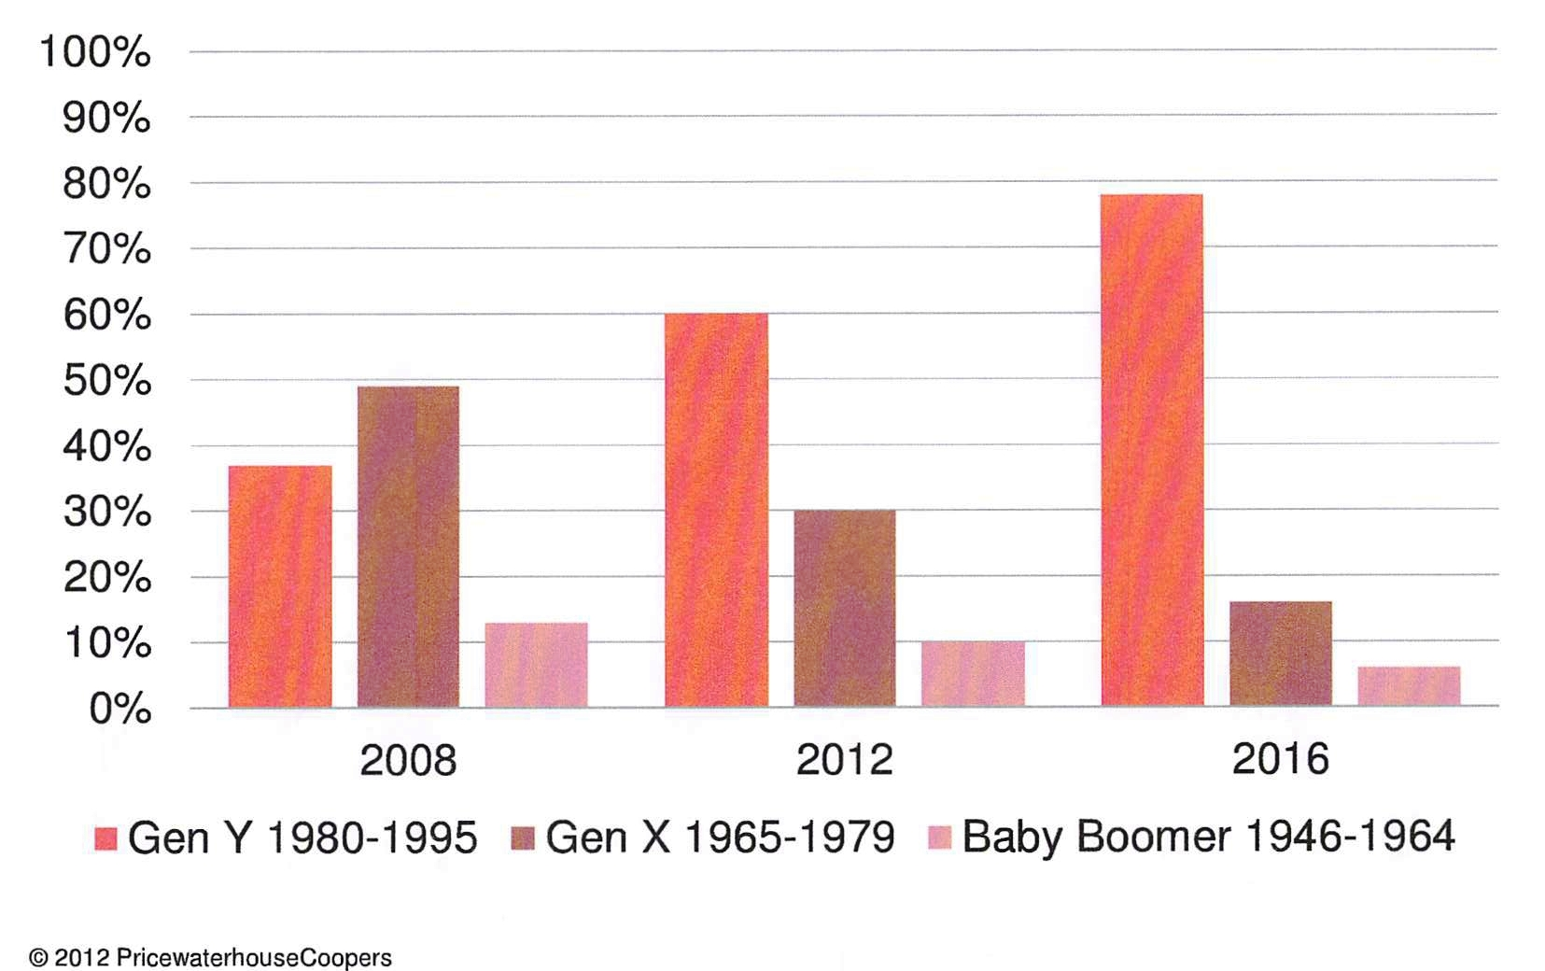
Baby boomers are “out” Millennials are “in”

Slide 5
The world has changed…
Technology direct access to people and information
Mobility borders disappear
Labour relations employers and employees have different expectations

Slide 6
Most important conclusions of the survey
“The millennial” :
are devoted to their job and word hard
want more balance between work and private life
want support and appreciation → not-millennials want more empowerment and rewards
are very demanding → it’s important to provide an environment that offers interesting work and enriching experience
team and community, friendship, support from team leaders are very important
extreme work periods have a negative impact on retention
they prefer to communicate trough emails and “instant messaging”
they with not necessary gadgets, they rely on efficient systems that save time and improve working conditions
they are less loyal to career opportunities and here fore allowing proper choices are a must

Slide 7
What is motivation?
Simply:
it’s whatever causes the person to act in a particular way
Maslow:
the human person is motivated by 5 basic needs: survival – safety– the feeling of belonging and love, esteem and self actualization
General Dwight Eisenhower:
“Motivation is the art of getting people to do what you want them to do because they want to do it”

Slide 8
Support the growth of your management
What is needed to ensure that your management would perform consistenly well???
happy managers but … happy is not the same as satisfied!!!
You need prosperous managers!!!
In “prosperous” we distinguish 2 components:
  vitality
  learning
“The combination of vitality and learning means that your managers achieve results and find ways to grow”

Slide 9
4 mechanisms to develop the prosperity of your managers
4.1 the freedom to make decisions
ex: Alaska Airlines
4.2 make information available
4.3 keep it corteous
ex: food company Zingerman
4.4 provide feedback on performance
ex: quick loans
Iglo – Ola (Birdseye)

Slide 10
How do you keep talent on board?
Avoid the “Blue Monday” syndrome!!!
Companies issued:
  psychological contracts ex. KPMG
  engagement contracts ex. SD WORX
  7 items: job content, career development, training, social atmosphere, compensation and benefits, work-life balance, job security
Develop creativity: “creativity increases with diversity and declines with sameness and routine”

Slide 11
How do you keep them on board?
Meet the demands of the new generation of recruits
Create an open
Start the retention procedure on day one by drawing psychological or engagement contracts
Evaluate the contracts on a regular base

Slide 12
Conclusion
“In general a satisfied manager does his job and feels well but brings no extra-added value for the company. That does an employee who is engaged and who is “prosperous”

